Slide 1



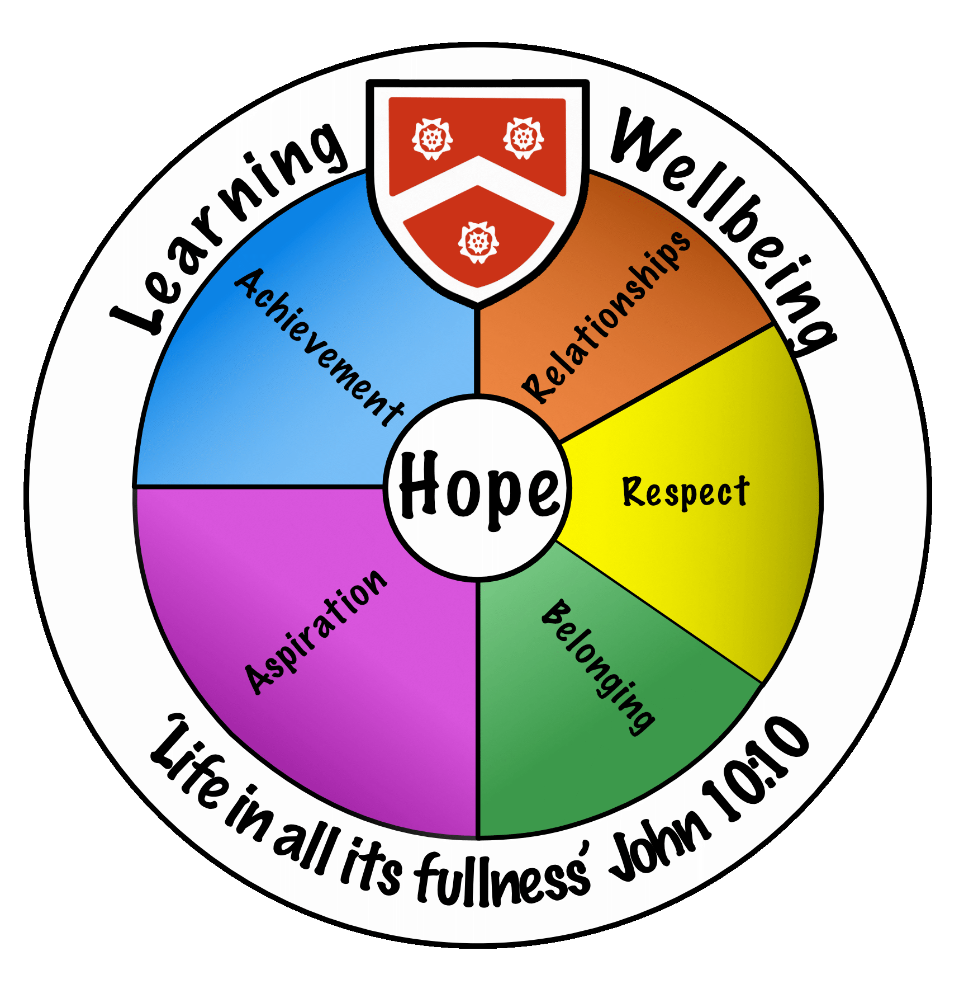
Wadham School
A Church of England Community School
Knowledge Organisers
Year 10
Term 1 & 2
2024-2025
Name.............................................................
Tutor group..............................
“Life in all its fullness” John 10:10

Slide 2


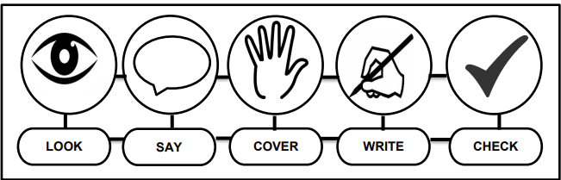



Using Your Knowledge Organiser
Look-Say-Cover-Write-Check
Retrieval practice using the look-say-cover-write-check technique, when done in regular small chunks, is one of the best ways you can learn relevant knowledge over time.
Working in Independent mode:
Look at the first bullet point or sentence
Read through it three to five times
Cover
Write it out exactly
Remove and check what you wrote and tick if correct
Repeat
When you get it 100% right, move on to the next chunk of information
Flash Cards Make flast cards with the definition on one side and key word on the other. | Self Quizing Write quizzes with answers to test yourself in the future. | Mind maps Create mindmaps linking key inforamtion you need to remember.

Slide 3

Art

Slide 4
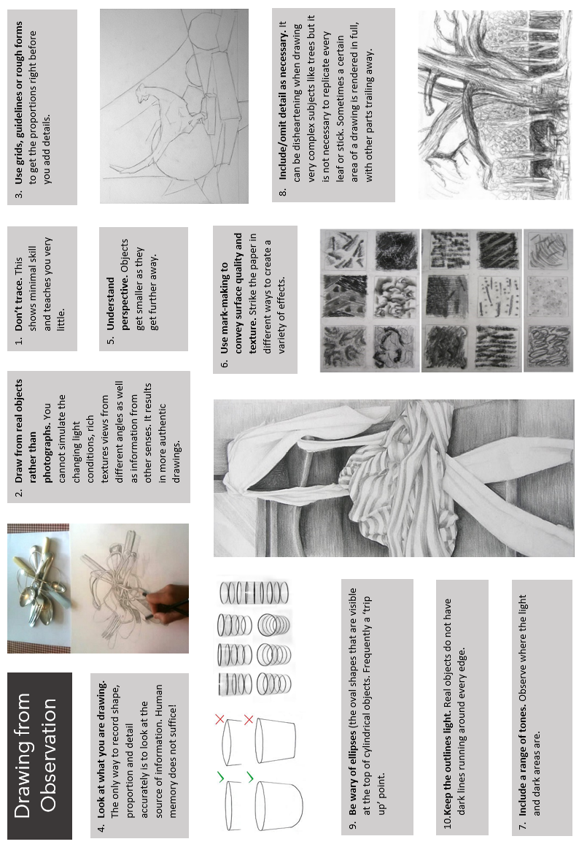
Art

Slide 5
Art, Craft and Design
Keyword | Core Knowledge
Analogous | Colours that are next to each other on the colour wheel and are related by a single hue; e.g., red, red-orange, orange, and red-violet.
Analyse | To respond to an artwork/design by examining its features as they relate to the elements of art and principles of design.
Balance | The principle of design that refers to the visual equalization of the elements in a work of art. The three major forms of balance are asymmetrical balance (where equilibrium is achieved by the balance differences in the art elements within a composition), symmetrical balance (where the art elements in a composition are balanced in a mirrorlike fashion), and radial balance (a kind of balance where the elements branch or radiate out from a central point).
Collage | Artwork made by attaching pieces of paper or other materials to a flat surface.
Colour properties | Hue (the colour name), intensity (the purity and strength of the colour), and value (lightness or darkness of the colour).
Colour scheme | The choice of colours used in a design or artwork.
Colour Wheel | A tool for organizing colour that shows the visible light spectrum organized in a circular format; a tool that helps to chart the relationships between colours (hues). On a colour wheel, the primary colours of magenta red, yellow, and cyan (turquoise) blue are the fundamental hues from which other colours can be mixed. For instance, mixing combinations of two of the primary colours results in the secondary colours of green, purple, and orange. Similarly, the mixture of a primary colour and a secondary colour can result in the creation of tertiary colours such as yellow-orange or blue-green. These relationships, as well as the concepts of warm/cool colours and analogous colours, are easily illustrated on the colour wheel chart
Complementary Colours | Pairs of colours that are opposite one another on the colour wheel. Red and green, blue and orange, and yellow and violet have the greatest degree of contrast. These pairs are also complementary colours: red-violet and yellow-green, red-orange and blue-green, and yellow-orange and blue-violet.
Composition | The arrangement of the elements of art and the principles of design within a given work of art.
Describe | To respond to an artwork by stating facts about objects and art elements present in a work; it also refers to when, where, and by whom the work was done
Elements of art | The basic components or tools of visual communication; include line, space, shape/form, value, colour, and texture.
Focal Point | the area within a composition at which the emphasis is greatest and where the eye of the viewer continually comes to rest (the centre of interest)

Slide 6
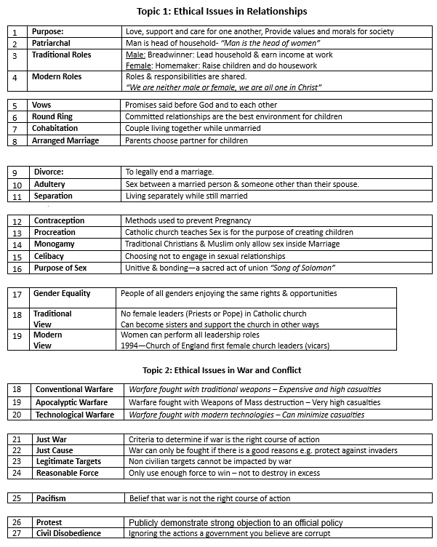
Beliefs and World Views

Slide 7
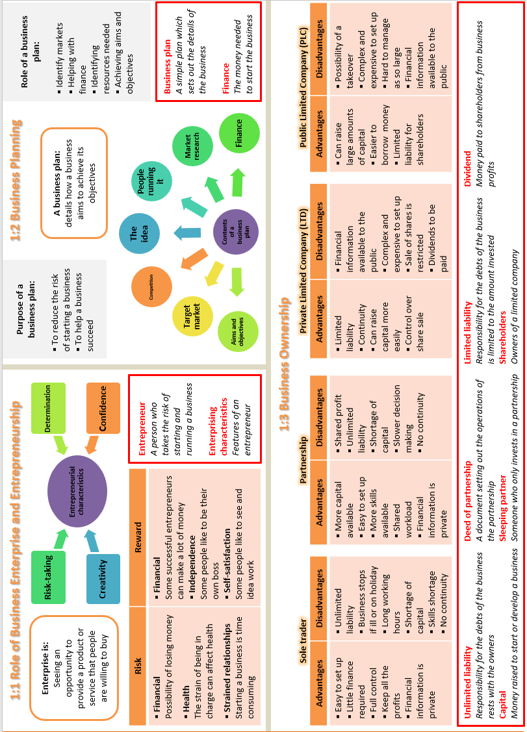
Business

Slide 8
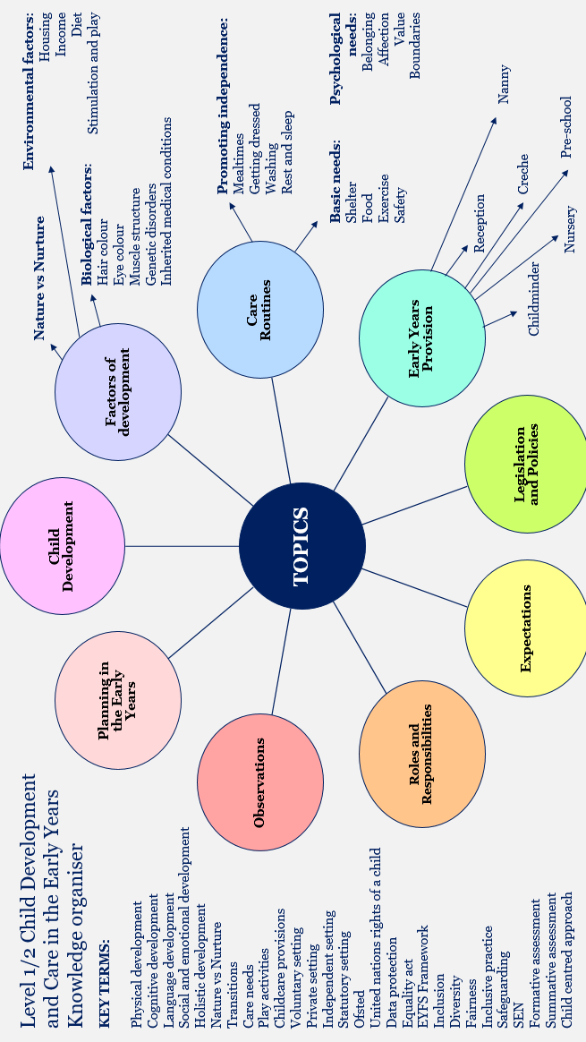
Child Development

Slide 9
Design & Technology
Keyword | Core Knowledge
Client | The person/people/audience being designed for and whose needs are being met.
Commercial process | Manufacturing method used to produce products in quantity.
Continuous improvement | The identification of improvements and subsequent evolution of products.
Functionality | How well a product carries out its purpose.
Iterative design | Design methodology based on a cyclical process of analysing, prototyping and testing to refine a product. Each iteration and result starts the process again.
Lean manufacturing | Reducing and eliminating waste in a manufacturing process.
Physical properties | Properties that refer to the actual matter that forms the material (eg insulation, conductivity, fusibility).
Primary source (research) | Research collected first-hand by a designer to develop a product or idea.
Product | Item or artefact developed for an intended audience to solve a problem or meet a need.
Prototype | An early model or sample of a product used to test a concept.
Tolerance | The minimum and maximum measurements that can be accepted when manufacturing.
User | The person/people who make use of the product that has been developed by a designer.
User centered design | Design development with the user at the centre of the focus. The designer tries to envisage how the product will actually be used, as opposed to focusing on other areas such as cost.

Slide 10
AQA English Language – Paper 1
Question Guidance (do the paper backwards):
Q5 – use the ‘Here > There > Then > Now’ frame. Here is an example with the dystopian story:
Here I am in the waiting room of this squat grey clinic with its squalid peeling walls. Years of slopping on beige discoloured paint still cannot hide the neglect and pervading sense of hopelessness. The chairs are frayed with bits of stuffing coughing out like the remnants of the past. A TV hangs loosely from the wall, it’s black mirror reflecting the decaying interior. Buzzing fizzes through the air from the shivering light overhead. The emptiness crowds around me as I wait.
There is a poster on the wall, it is a strange choice: [describe picture exam provides]
Then memories flood back of the Malthusian collapse, the riots, the catastrophes, the violence and the dreams that came before this living nightmare. How did we get to this? Scientists had achieved the utopian ambition of immortality. They had plucked out the aging gene from this symphony of life and silenced it. Death was now only for the unfortunate or the poor whilst the eternal elite were everlasting. Genetic treatments stopped people dying from old age, now you could be young, beautiful, lovely, forever. Depending on your view it was either euphoric optimism trapped in amber or humanity diving into a stagnant pool of indulgence. There was just one problem: children. Scientists had stopped death but the cost was new life. Children were still being born so they brought in a test. A test to see if you were worthy enough, good enough, optimised enough for life.
Now, I am alone. No… with you awaiting the results of this test. Waiting to see if this whispered dream of a life inside me will be permitted to join the elite. When I found out about you, I was overjoyed, love filled my heart and I had such hope for the future. Fears have begun to sneak into my heart now I run my hands over you growing within. Will you be allowed to live or will they just discard you before you even have a chance? Why am I even talking to you? You barely exist yet.
They are calling me in.
Nobody dies anymore but will they let you live?
Q4 (20 marks, 25m) – identify the key bits of the statement, agree then add and analyse (use quotations and analyse language and structure repeatedly):
Your evaluation – consider the statement and other interpretations (although, whilst, despite, etc.)
Neat evidence – use precise quotations
Additional – use more precise quotations (at least 6)
Language – analyse word choice, imagery and other methods
Structure and form – analyse perspective, pace, tone and other methods
Intentions of writer – consider WHY the writer wrote it and the impact upon readers
Q3 (8 marks, 10m) – structural methods (start-middle-end):
Start-middle-end
Neat evidence – use precise quotations
Structure and form – analyse perspective, pace, tone and other methods such as repetition, motif, cliffhanger, contrast, development, syntax, etc.
Q2 (8 marks, 10m) – language methods (imagery, word choice and other methods):
Imagery – always analyse this.
Neat evidence – as precise as possible – focus on word choices etc.
Additional – get a wide range of quotations
Language – analyse word choices, imagery and other methods such as metaphor, simile, personification, oxymoron, emotive language and syntax.
Q1 (4 marks, 5m) - identify 4 things.

Slide 11
AQA English Literature – A Christmas Carol
Prepared Introduction (learn this):
Dickens presents ________ to criticise misanthropy in Victorian London. As a philanthropist, Dickens uses his didactic allegorical novella to demonstrate the importance of kindness. Dickens crafts this through Scrooge’s redemption arc as he progresses from a ‘covetous old sinner’ to being ‘quite a baby’ symbolising his rebirth.
Make sure that you replace _________ with the focus of the question.
Key quotations to learn – prioritise the first 3 pairs.
1 | 'solitary as an oyster' |  |  | 'his own heart laughed'
2 | 'I wear the chain I forged in life' |  |  | 'light as a feather'
3 | 'decrease the surplus population' |  |  | 'are there no prisons?'
4 | 'biting weather' 'freezing fog' |  |  | 'Golden sunlight; Heavenly sky'
5 | 'gruff old bell was always peeping slily down at Scrooge' |  |  | 'merry bells'
6 | ‘Want is keenly felt, and Abundance rejoices.’ |  |  | 'Ignorance' & 'Want' 'Beware … on his brow … Doom'
7 | 'Another idol has displaced me … a golden one' |  |  | 'as good as gold’
8 | ‘tight-fisted hand at the grindstone’ |  |  | ‘apoplectic opulence’
9 | ‘If these shadows remain unaltered by the Future, the child will die.’ |  |  | ‘to Tiny Tim, who did not die, he was a second father.’
10 |  | 'a strange figure—like a child: yet not so like a child as like an old man' | 'a jolly Giant, glorious to see; who bore a glowing torch…Girded round its middle was an antique scabbard; but no sword was in it' |  | 'a solemn Phantom, draped and hooded, coming, like a mist along the ground, towards him.'

Slide 12
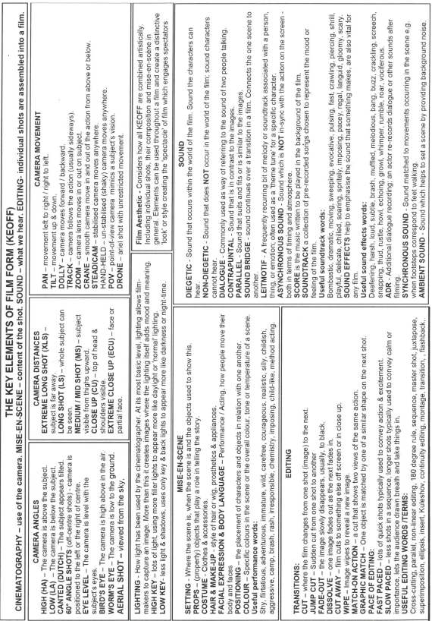
Film Studies

Slide 13
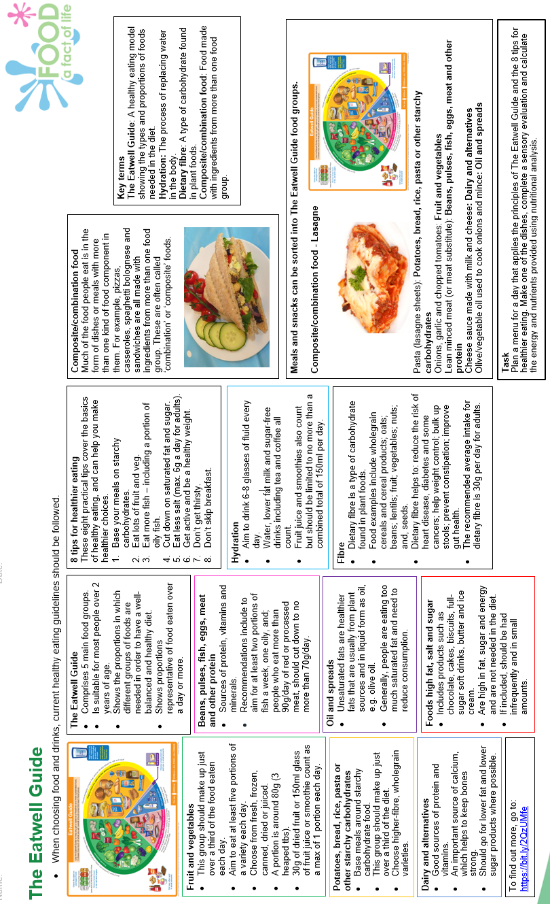
Food

Slide 14
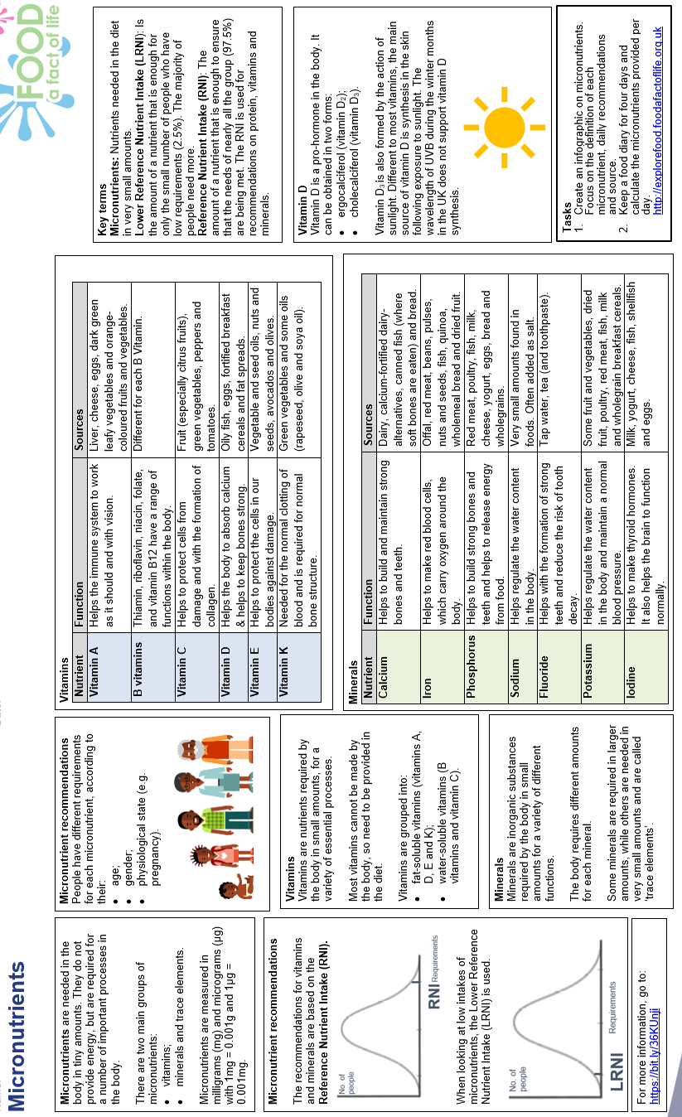
Food

Slide 15
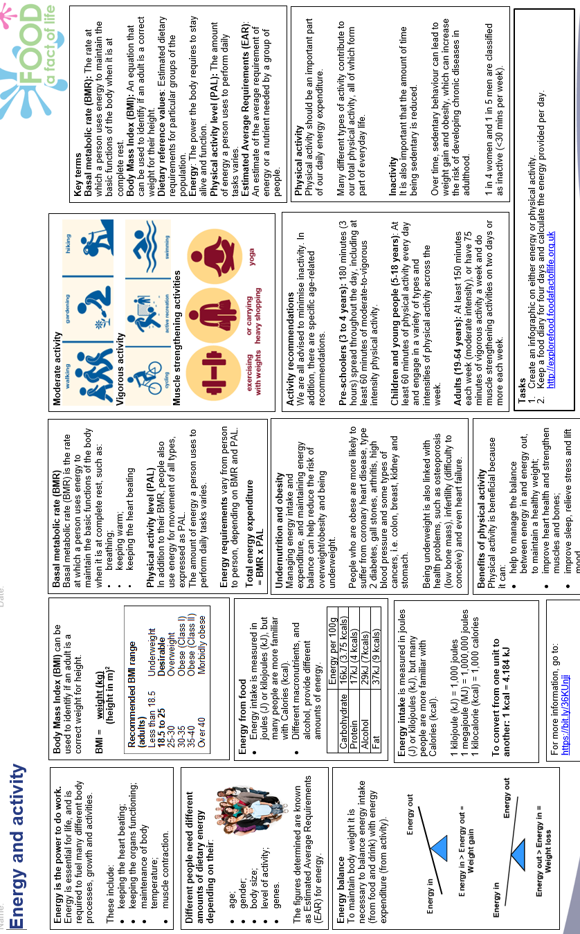
Food

Slide 16


Year 10 French Module 1: Tu as du temps à perdre (1)?
Les opinions | Opinions
À ton avis, c’est une bonne idée? | In your opinion, is it a good idea?
À mon avis, c’est … | In my opinion, it is …
amusant / ennuyeux. | fun / boring.
intéressant / nul. | interesting / rubbish.
une bonne / mauvaise idée. | a good / bad idea.
Tu es d’accord? | Do you agree?
Oui, je suis d’accord. | Yes, I agree.
Non, je ne suis pas d’accord. | No, I don’t agree.
Est-ce que tu aimes …? | Do you like …?
J’adore / J’aime … | I love / I like …
Je n’aime pas … | I don’t like …
Je déteste … | I hate …
Qu’est-ce que tu aimes regarder? | What do you like to watch?
Quel type de vidéos est-ce que tu regardes / | Which type of videos do you watch /
préfères regarder? | prefer watching?
J’aime regarder … | I like to watch …
Je regarde … | I watch …
des *clips sur une chaîne de musique. | clips on a music channel.
des émissions de sport. | sports programmes.
des émissions de télé-réalité. | reality TV programmes.
des films de science-fiction. | sci-fi films.
des vidéos amusantes d’animaux. | funny animal videos.
des vidéos de cuisine / danse sur YouTube. | cookery / dance videos on YouTube.
un peu de tout. | a bit of everything.
Avec qui est-ce que tu aimes regarder des films? | Who do you like to watch films with?
avec les membres de ma famille | with members of my family
tout(e) seul(e) dans ma chambre | alone in my bedroom
Combien de fois par mois est-ce que tu vas au cinéma? | How many times a month do you go to
 | the cinema?
Je vais au cinéma une ou deux fois par mois. | I go to the cinema once or twice a month.
Je ne vais pas souvent … | I don’t often go …
Où et comment est-ce que tu préfères regarder des films? | Where and how do you prefer watching films?
Je préfère regarder … | I prefer watching …
chez moi ou en streaming. | at home or streaming.
au cinéma, sur un grand écran. | at the cinema, on a big screen.
un peu partout, sur mon portable. | anywhere on my phone.
Quand est-ce que tu regardes des vidéos? | When do you watch videos?
Je regarde … | I watch …
le matin, avant le college. | in the morning, before school.
le soir, après les cours. | in the evening, after school.
quand j’ai du temps libre. | when I have free time.
La séance de huit heures. | The eight o’clock screening.
Trois billets, s’il vous plaît. | Three tickets, please.
Un adulte et deux enfants. | One adult and two children.
Le film finit à quelle heure? | What time does the film finish?
C’est combien? | How much is it?
Je voudrais voir / regarder … | I would like to see / watch
Le sport | Sport
l’athlétisme | athletics
le basket | basketball
la danse | dance
le foot(ball) | football
le tennis de table | table tennis
faire de l’athlétisme | doing athletics
faire de la danse | dancing
faire du sport | playing sport
jouer au basket / foot(ball) | playing basketball / football
Qu’est-ce que tu fais en ligne? | What do you do online?
J’achète (des vêtements). | I buy (clothes).
Je cherche … | I search (for) …
J’écoute (de la musique avec mes écouteurs). | I listen (to music on my headphones).
J’envoie (des messages à mes copains et copines). | I send (messages to my friends).
Je joue (à) … | I play …
Je parle (avec mon ami). | I speak (with my friend).
Je partage (des photos). | I share (photos).
Je passe (beaucoup / trop de temps) … | I spend (a lot of / too much time)…
Je télécharge (des chansons). | I download (songs).
Je fais ça … | I do that …
de temps en temps. | from time to time.
parfois. | sometimes.
souvent / tous les jours. | often / every day.
tous les soirs / week-ends. | every evening / weekend.
tout le temps. | all the time.
C’est très / vraiment / trop … | It’s very / really / too …
*affreux / amusant. | awful / fun.
dangereux / ennuyeux. | dangerous / boring.
*formidable / genial. | terrific / great.
cool / inquiétant. | cool / worrying.
mauvais pour la santé. | unhealthy.
nul / super. | rubbish / great.
une (très) bonne chose. | a (very) good thing.
cependant | however
mais | but
malgré cela | in spite of that
même si | even if
pourtant | nonetheless
toutefois | (and) yet
Il y a … | There is / are …
des applis pour tout. | apps for everything.
des risques de sécurité. | security risks.
des vols d’identité. | identity theft.

Slide 17
Year 10 French Module 1: Tu as du temps à perdre (2)?
Qu’est-ce qu’on va faire? | What are we going to do?
aujourd’hui | today
demain | tomorrow
ce matin / demain matin | this morning / tomorrow morning
cet après-midi / demain après-midi | this afternoon / tomorrow afternoon
ce soir / demain soir | this evening / tomorrow evening
à … | at …
neuf heures | nine o’clock
neuf heures et demie | half past nine
dix heures moins vingt | twenty to ten
dix heures moins le quart | quarter to ten
midi / minuit | midday / midnight
Je vais … | I am going …
aller au parc / au marché. | to go to the park / market.
visiter le château / le musée. | to visit the castle / museum.
partir … | to leave …
voir un spectacle. | to see a show.
acheter un tee-shirt. | to buy a tee-shirt.
prendre le bus. | to take the bus.
regarder un film en 3D. | to watch a film in 3D.
faire les magasins. | to go shopping.
Ça t’intéresse? | Are you interested?
Tu es libre? | Are you free?
Tu viens? | Are you coming?
D’accord, je veux bien. | OK, I would like to.
Oui, je suis libre. | Yes, I’m free.
Ça m’intéresse. | I’m interested.
Oui, merci, c’est gentil. | Yes, thanks, that’s kind of you.
Non, désolé(e), je ne peux pas. | No, sorry, I can’t.
Je ne suis pas libre. | I’m not free.
Qu’est-ce que tu as fait, le week-end dernier? | What did you do last weekend?
d’abord | first of all
ensuite | next
après | after
puis | then
plus tard | later
finalement | finally
J’ai / Nous avons … | I / We …
acheté (un *tee-shirt) | bought (a tee-shirt).
bu / mangé | drank / ate …
chanté (des chansons). | sang (songs).
dansé / lu … | danced / read …
écouté (de la musique). | listened (to music).
fait de la natation. | went swimming.
joué (au tennis). | played (tennis).
passé (un week-end) … | spent (the weekend) …
pris … | took …
regardé (le concert). | watched (the concert).
vu (mon groupe préféré). | saw (my favourite group).
Je suis / Nous sommes … | I / We …
allé(e)(s) | went
resté(e)(s) | stayed
C’était … | It was …
assez / complètement / un peu | quite / completely / a bit
amusant / cher. | fun / expensive.
génial / sympa. | great / nice.
parfait / passionnant. | perfect / exciting.
J’ai participé aux Jeux de la Francophonie! | I participated in the Francophone Games!
Tu es de quel pays? | Which country are you from?
Je suis du / de … | I am from …
Qu’est-ce que tu fais comme activité? | Which activity do you do?
Je joue … / Je fais … | I play … / I do …
Quand est-ce que tu fais ça? | When do you do that?
Je fais ça / mon entraînement le (samedi) matin. | I do that / my training on (Saturday) mornings.
Où as-tu fait ton entraînement? | Where did you train?
au centre sportif / au collège | at the sports centre / at school
À quel âge as-tu commencé à pratiquer ça? | At what age did you start practising?
J’ai commencé à l’âge de (dix) ans. | I started at (ten) years old.
Quand as-tu participé aux Jeux? | When did you participate in the Games?
J’ai participé aux Jeux l’année dernière / | I participated in the Games last year /
il y a (deux) ans. | (two) years ago.
Est-ce que tu as gagné? | Did you win?
J’ai gagné la compétition / le concours. | I won the competition.
J’ai fini en première / en troisième *position. | I finished in first / third position.
Avec qui as-tu *célébré ton succès? | With whom did you celebrate winning?
Comment avez-vous *célébré ça? | How did you celebrate that?

Slide 18
Year 10 French Module 2: Mon clan, mon tribu (1)?
Mon identité | My identity
Qu’est-ce qui fait ton identité? | What defines your identity?
Ce qui fait mon identité, c’est / ce sont … | What defines my identity is …
mes amis. | my friends.
*mon genre. | my gender.
ma langue. | my language.
ma personnalité | my personality.
ma religion. | my religion.
l’amitié | friendship
la communauté | community
le courage | courage
*la démocratie | democracy
*l’inclusivité | inclusivity
la justice | justice
le respect | respect
*la tolérance | tolerance
Tu t’entends (toujours) bien avec tes amis? | Do you (always) get on well with your friends?
Pourquoi / Pourquoi pas? | Why / Why not?
La plupart du temps, | Most of the time,
je (ne) m’entends (pas) (assez / très) bien avec | I (don’t) get on (quite / very) well with
mes amis. | my friends.
Il/Elle est … | He/She is …
Ils/Elles sont … | They are …
tout le temps | always
actif(s)/active(s). | active.
fidèle(s). | loyal.
fier(s)/fière(s) de moi. | proud of me.
*intelligent(e)(s). | intelligent.
indépendant(e)(s). | independent.
patient(e)(s). | patient.
*stupide(s). | stupid.
sympa. | nice.
travailleur(s)/travailleuse(s). | hard-working.
On s’ennuie / On s’amuse (bien) (ensemble) … | We are bored / We get on well (together) …
On *se dispute … | We argue …
On s’excuse … | We apologise …
rarement. | rarely.
de temps en temps. | from time to time.
toujours. | always.
d’habitude | usually
C’est quoi, l’amitié pour toi? | What is friendship, for you?
Pour moi, / À mon avis ... | For me, / In my opinion, ...
il est important d’avoir … | it is important to have …
un ami proche. | a close friend.
un groupe d’amis sympa. | a group of nice friends.
beaucoup d’amis amusants. | lots of fun friends.
Un bon ami est quelqu’un qui … | A good friend is someone who …
apprécie les mêmes choses que moi. | appreciates the same things as me.
partage quelques *intérêts avec moi, mais pas tous. | shares some, but not all, interests with me.
n’aime pas les mêmes activités que moi. | doesn’t like the same activities as me.
J’ai besoin … | I need …
d’amis dans le monde réel. | friends in the real world.
de groupes d’amis séparés. | separate groups of friends.
de beaucoup d’amis en ligne. | lots of friends online.
Quand je suis triste, mon/ma meilleur(e) … | When I’m sad, my best friend …
écoute mes problèmes. | listens to my problems.
offre de l’aide. | offers help.
Que fais-tu le week-end? | What do you do at the weekend?
Que fais-tu en famille? | What do you do with your family?
Dans ma famille, il y a (trois) personnes. | In my family, there are (three) people.
J’habite avec … | I live with …
Je vis avec … | I live with …
ma mère / belle-mère. | my mother / step-mother.
ma sœur / demi-sœur. | my sister / step (half)-sister.
ma tante. | my aunt.
mon père / beau-père. | my father / step-father.
mon frère. | my brother.
mes grands-parents. | my grandparents.
mon grand-père. | my grandfather.
jumeau/jumelle | twin
aîné(e) | older
petit(e) | little / younger
D’abord, le vendredi soir, … | First of all, on Friday evening …
Le samedi / dimanche … | On Saturday / Sunday …
matin | morning
après-midi | afternoon
soir | evening
à … heures | at … o’clock
(très) tard / tôt | (very) late / early
Après / Ensuite … | After / Next …
Puis … | Then …
Plus tard … | Later …
Je fais … | I do …
Je joue à des jeux. | I play games.
Je mange … | I eat …
Je m’amuse (bien). | I have fun.
Je me couche. | I go to bed.
Je m’entraîne. | I train.
Je m’habille. | I get dressed.
Je *me lave. | I wash (myself).
Je me lève. | I get up.
Je m’occupe de (mon jardin). | I look after (my garden).
Je me repose. | I relax.
Je travaille. | I work.
Je vais au lit. | I go to bed.
chez moi/nous | at my/our house
dans ma chambre | in my bedroom
dans le parc | in the park

Slide 19
Year 10 French Module 2: Mon clan, mon tribu (2)?
Décris les personnes | Describe the people
Mon frère / Ma tante est … | My brother / My aunt is …
Il/Elle est … | He/She is …
Mes parents / Ils/Elles sont … | My parents / They are …
grand(e)(s) / petit(e)(s). | tall / short.
de taille moyenne. | average height.
*chauve(s). | bald.
Il/Elle a le visage long. | He/She has a long face.
Ils/Elles ont les cheveux … | They have … hair.
blancs / blonds. | white / blond
*bruns / châtains. | brown / chestnut brown
gris / noirs / roux. | grey / black / red
longs / courts. | long / short
Il/Elle a les yeux … | He/she has … eyes.
bleus / verts / marron. | blue / green / brown
un joli sourire | a pretty smile
Ils/Elles ont *l’air (très) … | They seem (very) …
heureux/heureuses. | happy.
tristes / sympa. | sad / nice.
Il/Elle porte … | He/She wears …
Ils/Elles portent … | They wear …
des lunettes (de soleil). | (sun)glasses.
un chapeau (bleu). | a (blue) hat.
Il/Elle ressemble à son | He/She looks like his/her
grand-père / sa fille. | grandfather / his/her daughter.
Sur la photo, il y a … | In the photo, there is/are …
un homme / une femme. | a man / a woman.
un garçon / une fille. | a boy / a girl.
des enfants. | some children.
deux personnes / (des) amis. | two people / (some) friends.
C’est où? | Where is it?
Ils sont dans … | They are in …
un parc / un restaurant. | a park / a restaurant.
Au premier plan, je vois … | In the foreground, I can see …
À l’arrière-plan, il y a … | In the background, there is/are …
Que font-ils? | What are they doing?
L’homme / La femme … | The man / The woman …
regarde … | is looking …
fait de la cuisine. | is cooking.
Les personnes / Les amis … | The people / The friends …
font du vélo. | are cycling.
s’amusent bien. | are having fun.
Un bon modèle est … | A good role model is …
*créatif. | creative.
positif. | positive.
sportif. | sporty.
sa personnalité. | his/her personality
Il/Elle est né(e) … | He/She was born …
Il/Elle est devenu(e) … | He/She became …
Il/Elle a … | He/She …
écrit | wrote
eu | had
reçu | received
travaillé | worked
Il/Elle … | He/She …
encourage les gens à faire … | encourages people to do …
lutte pour / contre … | fights for / against …
partage … | shares …
Normalement, qu’est-ce que tu fais pour fêter ton anniversaire? | What do you normally do to celebrate your birthday?
L’année dernière, comment est-ce que tu as fêté | Last year, how did you celebrate
ton anniversaire? | your birthday?
L’année prochaine, qu’est-ce que tu vas faire? | Next year, what are you going to do?
On fête / a fêté / va fêter … | We celebrate / celebrated / are going to celebrate …
la naissance du fils / de la fille de … | the birth of the son / of the daughter of…
l’anniversaire de (mon frère) … | my (brother’s) birthday
avec toute la famille | with the whole family
On va / est allés / va aller … | We go / went / are going to go …
chez mon voisin/lui/nous/eux. | to my neighbour’s/his/our/their house.
au cinéma / au parc. | to the cinema / park.
On mange / a mangé / va manger … | We eat / ate / are going to eat …
un grand repas. | a big meal.
un gâteau. | a cake.
Je reçois / J’ai reçu / Je vais recevoir … | I receive / received / am going to receive …
des cartes. | cards.
beaucoup de cadeaux. | lots of presents.
J’ai … | I have …
invité mes amis. | invited my friends.
préparé des plats. | prepared the food.
loué un restaurant. | hired a restaurant.
La semaine prochaine, / Samedi prochain, je vais … | Next week / Next Saturday, I’m going to …
porter des vêtements spéciaux. | wear special clothes.
prendre des photos. | take photos.
La place des idoles | The place of idols
*J’admire … | I admire …
Je le/la suis parce qu’il/elle est … | I follow him/her because he/she is …
Il/Elle est connu(e) pour … | He/She is known for …
C’est une personne / un homme / une femme qui … | It’s a person / a man / a woman, who …
Il/Elle lutte pour / contre … | He/She fights for / against …
Un bon modèle est quelqu’un qui … | A good role model is someone who …
aide les gens. | helps people.
se comporte bien. | behaves well.
inspire les autres. | inspires others.

Slide 20
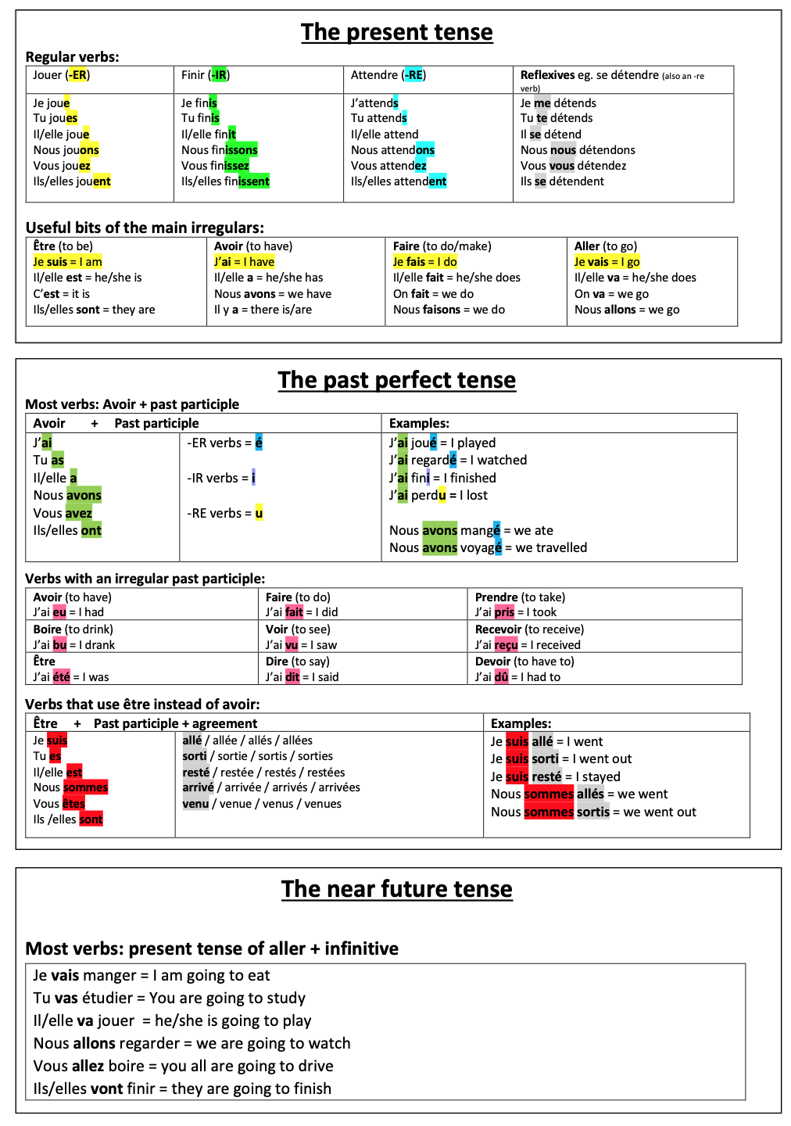
Year 10 French Module 1: Tenses

Slide 21
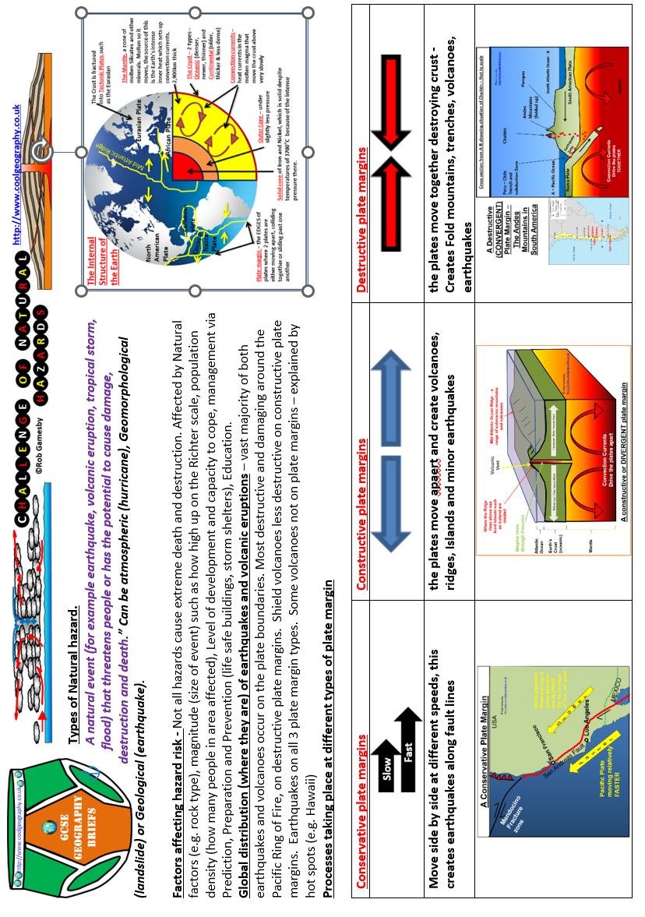
Geography

Slide 22
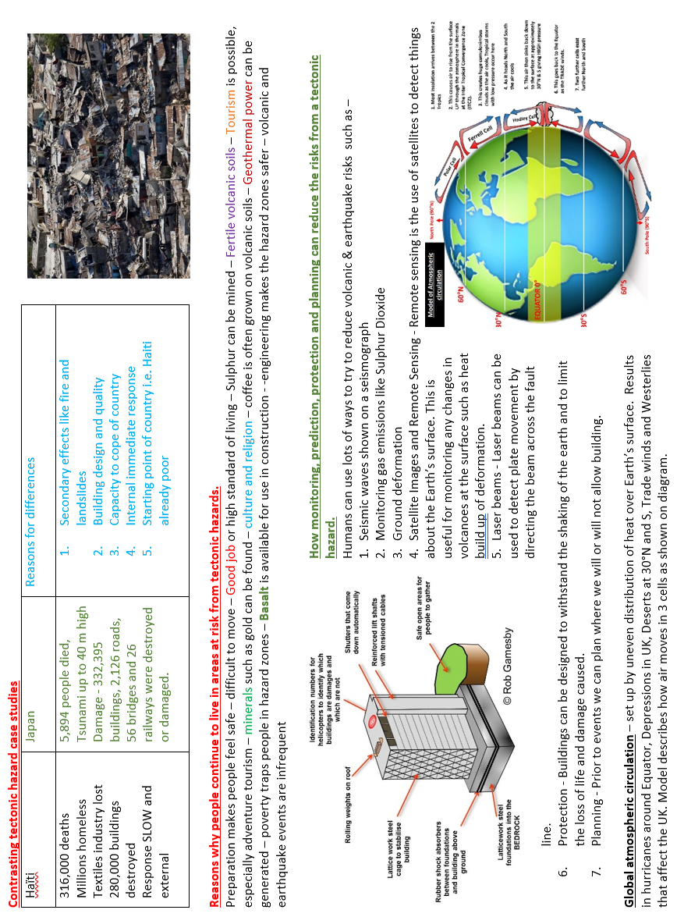
Geography

Slide 23
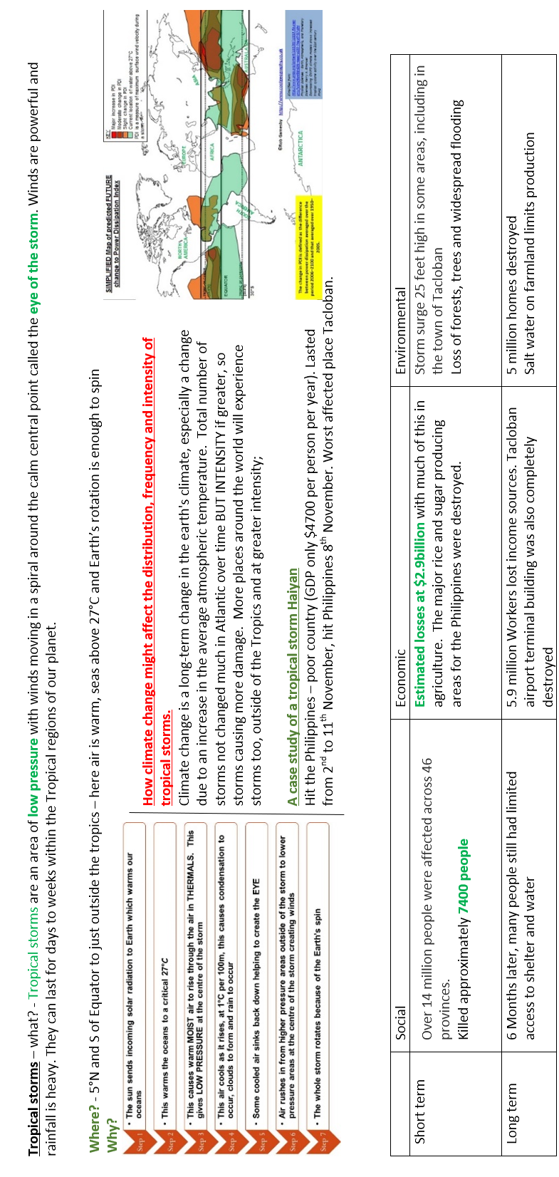
Geography

Slide 24
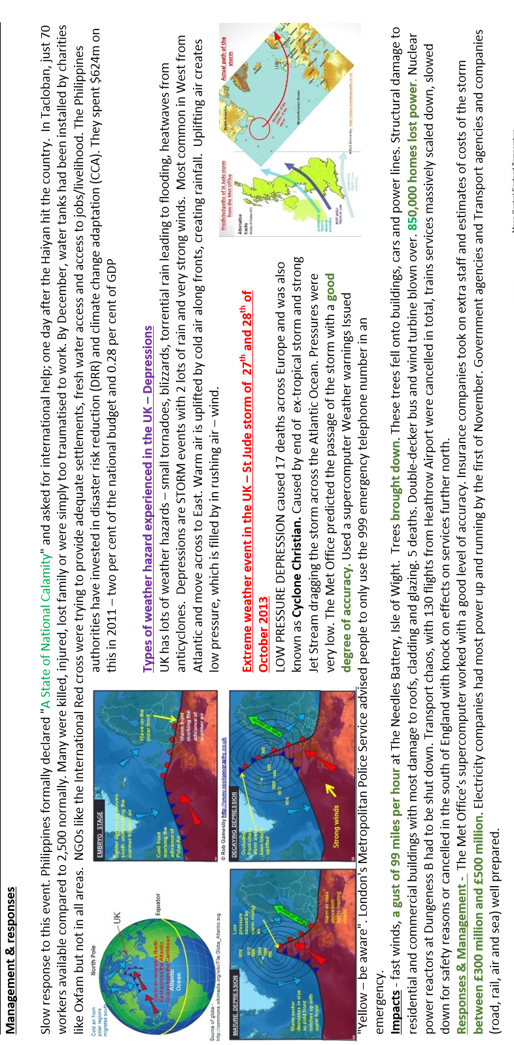
Geography

Slide 25
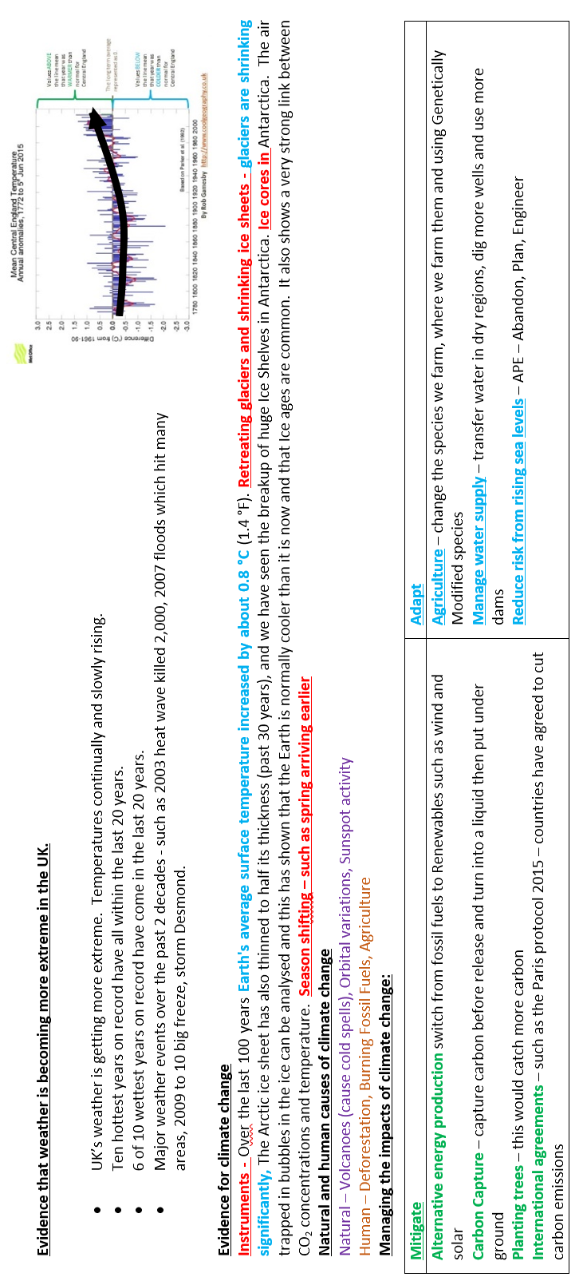
Geography

Slide 26
Year 10 German Module 2: Endlich mal Freizeit (1)!
Kennst du diese Musiker? | Do you know these musicians?
Rockmusik | Rock music
Helene Fischer | Helene Fischer
Was ist deine Lieblingsmusik? | What is your favourite music?
Ich liebe/mag... (nicht) / Ich hasse... | I love/like... (not) / I hate...
Rock | Rock
die Musik von (Mozart) | the music of (Mozart)
elektronische Musik | electronic music
klassische Musik | classical music
Popmusik | Pop music
Tanzmusik | dance music
denn er/sie/es ist... | because he/she/it is...
extrem | extremely
ganz | quite
nicht | not
sehr | very
wirklich | really
ziemlich | rather
zu | too
interessant | interesting
komisch | funny, strange
langsam | slow
langweilig | boring
laut | loud
modern | modern
modisch | fashionable
schnell | fast, quick
spannend | exciting
Ich tanze/koche/singe. | I dance/cook/sing.
Ich mache Fotos. | I take photos.
Ich lese Bücher/Romane. | I read books/novels.
Ich male/zeichne Bilder. | I paint/draw pictures.
Ich höre Musik. | I listen to music.
Ich sehe fern/Filme. | I watch TV/films.
ab und zu | now and again
jeden Tag/täglich | every day/daily
manchmal | sometimes
(fast) nie | (almost) never
oft | often
selten | rarely
am Wochenende | at the weekend
Technologie | Technology
Welche Geräte benutzt du? | Which appliances/pieces of equipment do you use?
Ich habe/Wir haben... | I/We have...
Ich benutze/Wir benutzen... | I/We use...
einen Laptop | a laptop
einen Computer | a computer
ein Handy | a mobile phone
eine Spielkonsole | a games console
ein Smartphone | a smartphone
ein Tablet | a tablet
Was machst du online? | What do you do online?
Ich sehe mir (Filme/Videos) an. | I watch (films/videos).
Ich lade (Apps) herunter. | I download (apps).
Ich sehe fern. | I watch TV.
*Ich lade (Fotos) hoch | I upload (photos).
Ich nehme (Musik) auf. | I record (music).
Ich rufe (meine Freunde) an. | I call/phone (my friends).
Ich benutze soziale Medien. | I use social media.
Ich chatte/plaudere (mit Freunden) | I chat (with friends).
Ich schreibe/lese/schicke... | I write/read/send...
Nachrichten | news, messages
Ich folge berühmten Persönlichkeiten. | I follow famous people.
Ich streame (gern) (Musik/Serien). | I stream (like) (music/series).
Und wie oft? | And how often?
häufig | frequently
immer | always
jeden Abend | every evening
jeden Nachmittag | every afternoon
jede Woche / wöchentlich | every week / weekly
normalerweise | normally
Was sind die Vorteile/Nachteile von Technologie? | What are the advantages/disadvantages of technology?
Man kann... | You can...
Computer-Viren bekommen. | get computer viruses.
falsche Informationen oder Nachrichten lesen. | read wrong/untrue information or news.
Filme und Musik herunterladen. | download films and music
Informationen schnell finden. | find information quickly.
mit Freunden in Kontakt bleiben. | keep in touch with friends.
Probleme mit Cyberkriminalität oder Mobbing erleben. | have problems with cybercrime or bullying.
Freizeitaktivitäten | Free time activities
Was machst du gern in deiner Freizeit? | What do you like to do in your free time?
Mein Lieblingshobby ist... | My favourite hobby is...
Meine Lieblingsfreizeitaktivität ist... | My favourite free time activity is...
Ich interessiere mich (sehr/nicht) für | I'm (very/not) interested in
Einkaufen | Shopping
Fernsehen | TV
Gaming | Gaming
Lesen | Reading
Radfahren | Cycling
Sport | Sport
Ich spiele am Computer. | I play on the computer.
Ich gehe... | I go...
einkaufen. | shopping.
ins Kino. | to the cinema.
in die Stadt. | to town.
schwimmen | swimming.
wandern | hiking.
Ich besuche (Austtellungen/Freunde) | I visit (exhibitions /friends).

Slide 27
Year 10 German Module 2: Endlich mal Freizeit (2)!
Möchtest/Willst du... sehen? | Would you like / Do you want to see?
einen Film | a film
eine Ausstellung | an exhibition
eine Vorstellung | a performance
Möchtest/Willst du... gehen? | Would you like.../ Do you want to go to...?
auf das (aufs) Konzert | to a concert
ins Theater | to the theatre
Möchtest du Fußball spielen? | Would you like to play football?
Ja, gerne! | Yes, gladly!
Vielleicht. | Perhaps.
Nein, danke. | No, thank you.
Ich darf nicht. | I am not allowed.
Es tut mir (wirklich) leid. | I'm (really) sorry.
Ich habe keine Lust. | I don't feel like it.
Ich möchte eine Karte / Karten kaufen, bitte. | I would like to buy a ticket / tickets, please.
Was kostet das / eine Karte? | How much is that / a ticket?
Wo ist das Café / das Restaurant? | Where is the café / restaurant?
Wie ist das Essen? | How is the food?
Können Sie empfehlen? | Can you recommend...?
eine Ausstellung | an exhibition
Wann/Um wie viel Uhr beginnt...? | When / At what time does... start?
Wann/Um wie viel Uhr endet...? | When does... finish?
die Vorstellung | the performance
Wann/Um wie viel Uhr öffnet...? | When / At what time does... open?
Wann / Um wie viel Uhr schließt...? | When / At what time does... close?
das Museum | the museum
Gibt es hier...? | Is there a / Are there any .... here?
Gibt es in der Nähe...? | Is there a / Are there any... nearby?
ein Café | a café
Toiletten | toilets
die Gewalt | violence
die Spannung | suspense, tension
die Stimmung | mood, atmosphere
Der Film war... | The film was...
Die Schauspieler(innen) waren... | The actors/actresses were...
ein bisschen | a little, a bit
total | totally
völlig | completely
kompliziert | complicated
lang | long
lustig | funny
schwach | weak
super | super
toll | great, terrific
traurig | sad
Hast du Pläne? | Do you have plans?
Was wirst du am Wochenende machen? | What will you do at the weekend?
Ich werde... | I will...
später | later
heute Nachmittag | this afternoon
heute Abend | this evening
heute Nacht | tonight
morgen (früh) | tomorrow (morning)
nächsten (Samstag) | next (Saturday)
nächstes Wochenende | next weekend
allein | alone
mit meinem Freund / meiner Freundin | with my friend / with my girlfriend
mit meinen Freunden/mit meinen Freundinnen | with my friends / with my girlfriends
mit meiner Familie | with my family
am Strand | at the beach
im Park | in the park
in der Stadt (Mitte) | in the town (centre)
in (Stuttgart) | in (Stuttgart)
zu Hause | at home
(Bücher) lesen | read (books)
(soziale Medien) benutzen | use (social media)
(Videos) hochladen | upload (videos)
Wie wird das sein? | What will it/that be like?
Ich werde das finden. | I will find it/that.
Das wird sein... | It/That will be...
ermüdend | tiring
fantastisch | fantastic
schlecht | bad
danach | afterwards
in der Stadt (Mitte) | in the town (centre)
in (Stuttgart) | in (Stuttgart)
zu Hause | at home
(Bücher) lesen | read (books)
Wie war der Film? | How was the film?
Das war… | It was…
ein Film | a film
ein Krimi | a detective story, thriller
eine Komödie | a comedy
eine Serie | a series
Im Film ging es um | The film was about
einen Schüler / eine Schülerin | a pupil, student
eine Familie | a family
eine Reise | a journey, trip
Die Sendung fand in (Berlin) statt. | The programme took place in…
Es gab... | There was / were...
(Der Film) hatte... | (The film) had...
keinen / keine / kein | no
(zu) viel | too much
wenig | little, few

Slide 28
Year 10 German Module 3: Meine Welt, deine Welt (1)
Feste | Festivals/celebrations
Ich finde | I find/think
Meiner Meinung nach ist... | In my opinion... is
(der) Markt | market
(das) Fest | festival, celebration
interessant.... | interesting
langweilig.... | boring
laut.... | loud
schlecht.... | bad
schön,... | beautiful
teuer.... | expensive
toll, | great, terrific
weil... mir das (nicht) gut gefällt. | because I (don't) like it.
mir das (keinen) Spaß macht. | it's not fun for me.
das mein Lieblingshobby ist | that is my favorite hobby
es (zu) viele Menschen gibt | there are (too) many people
mich das (nicht) interessiert | I am not interested in that
ich... (nicht) mag | I don't like...
Der Weihnachtsmarkt... | The Christmas market...
Das Radsportfest ... | The cycling festival....
Das Blumenfest | The flower festival
interessiert mich (nicht).... | (doesn't) interest me...
weil es... ist. | because it is...
laut | loud
schön | beautiful
teuer | expensive
toll | great
weil es eine Menge Leute gibt | because there are a lot of people
meine... die... heißen, sind... | My…who are called, are...
meine ... die nie geheiratet haben, sind... | My... who never married, are...
haben | He/She/It is... / They are..
ab und zu | now and again
immer | always
manchmal | sometimes
nicht | not
nie | never
oft | often
sehr | very
total | completely
ziemlich | rather
freundlich | friendly
glücklich | happy
lustig | funny
sportlich | sporty
traurig | sad
Er/Sie trägt (k)eine Brille. | He/She (doesn't) wear glasses.
Verhältnisse | Relationships
Wer bist du? | Who are you?
Beziehungen | Relationships
Hast du eine gute Beziehung zu? | Do you have a good relationship with...?
Verstehst du dich gut mit...? | Do you get on well with...?
Ja, ich habe eine gute Beziehung zu | Yes, I have a good relationship with...
meinem (Vater) | my (father)
deiner (Tante) | your (aunt)
deinen (Großeltern) | your (grandparents)
ihm | him
ihr | her
ihnen | them
weil er ist... | because he is...
weil sie ist... | because she is...
weil sie sind... | because they are...
aktiv | active
böse | angry
ehrlich | honest
ernst | serious
fleißig | hard-working
freundlich | friendly
gestresst | stressed
glücklich | happy
komisch | funny, strange
laut | loud
locker | relaxed
lustig | funny
sportlich | sporty
streng | strict
süß | sweet
unabhängig | independent
Familie | Family
Wie ist deine Familie? | How is your family?
Familie | Family
Beschreib (mir) deine Familie! | Describe your family (to me)!
In meiner Familie gibt es | In my family, there are
meinen (Bruder) / meine (Schwester) / meine (Eltern) | my (brother) / my (sister) / my (parents)
Das ist mein (Bruder) / meine (Schwester) / mein (Kaninchen). | That is my (brother) / my (sister) / my (rabbit).
Das sind meine (Eltern/Mütter/Väter/Brüder/Schwestern/Geschwister). | These are my (parents/mothers/fathers/brothers/sisters/siblings).
Mein/Meine.... der/die/das heißt.... | My..., who is called.....
hat Haare/Augen | has hair/eyes
blonde | blond(e)
braune | brown
grüne | green
kurze | short
lange | long
rote | red
schwarze | black
ist | is
groß | big/tall
klein | small

Slide 29
Year 10 German Module 3: Meine Welt, deine Welt (2)
Vorbilder | Role Models
Er/Sie ist ein gutes Vorbild, weil er/sie immer mindestens Minderheiten unterstützt hat | He/she is a good role model, because he/she has always supported minorities at least
der Mann | man
der Rassismus | racism
der Sexismus | sexism
der Unterschied | difference
die Ausbildung | training, education
die Diskriminierung | discrimination
die Frau | woman
die Jugendlichen | young people
die Menschen | people
die Minderheit | minority
die *Homophobie | homophobia
die *Transphobie | transphobia
das Mobbing | bullying
das Problem | problem
das Recht | right, law
akzeptieren | accept
erleben | experience
feiern | celebrate
kämpfen | fight, struggle
respektieren | respect
sollen | ought/supposed to, should
unterstützen | support
alt | old
ausländisch | foreign
behindert | disabled
lesbisch | lesbian
nicht binär | non-binary
schlecht | bad
schwul | gay
wichtig | important
rassistisch | racist
früher | previously, in the past
gegen | against
Zu Weihnachten... | At Christmas...
gab es eine Party / eine Feier / ein Fest | there was a party/a celebration/a festival
habe ich/haben wir | I/we
viel (mit Freunden / meiner Familie / im Restaurant) | a lot (with friends/my family/in a restaurant)
gefeiert | celebrated
gelacht | laughed
gesungen | sang
getanzt | danced
gegessen | ate
getrunken | drank
nette Leute kennengelernt | got to know nice/kind people
Spaß gehabt | had fun
bin ich/sind wir... gefahren/gegangen | I/we went...
mit dem Bus / mit dem Zug / zu Fuß | by bus/by train/on foot
ins Kino / nach Berlin | to the cinema/to Berlin
zum Fest / zur Party | to the festival/party
Partyzeit! | Party time!
der Anfang | start, beginning
der Geburtstag | birthday
der Kuchen | cake
der Silvester | New Year's Eve
der Sommer | summer
die Feier | party, festival
die Ferien | holidays
die Musik | music
das Jahr | year
das Kino | cinema
das Neujahr | New Year, New Year's Day
das *Weihnachten | Christmas
einladen | invite
essen | eat
feiern | celebrate
gehen | go
hören | hear, listen (to)
lachen | laugh
organisieren | organize
planen | plan
singen | sing
tanzen | dance
trinken | drink
stattfinden | take place
danach | afterwards
letzt | last
nächst | next
normalerweise | normally
Es gibt ... | There is/are...
Es gab ... | There was/were...
Es wird... geben | There will be....
Normalerweise feiere ich…mit meiner Familie. | Normally I celebrate…with my family.
Letztes Jahr haben wir…gefeiert. | Last year we celebrated…
Nächstes Jahr werde ich (meinen Geburtstag) feiern. | Next year I will celebrate (my birthday).
Wir haben gefeiert! | We celebrated!
gestern | yesterday
am Wochenende | at the weekend
letzte Woche | last week
neulich | recently, the other day
letztes Jahr | last year
in den Ferien | in the holidays
im Winter | in winter
Am (Musik-/*Diwali-/*Vesakh-) Fest... | At a music/Diwali/Vesakh festival...
Am Karneval... | At Carnival...
An Neujahr... | On New Year's Day...
An Silvester... | On New Year's Eve...
Auf einer Party/*Feier.... | At a party/celebration...
An *Chanukka /*Eid al-Fitr... | At Hanukkah/Eid al-Fitr...
Zu meinem Geburtstag... | On my birthday...

Slide 30
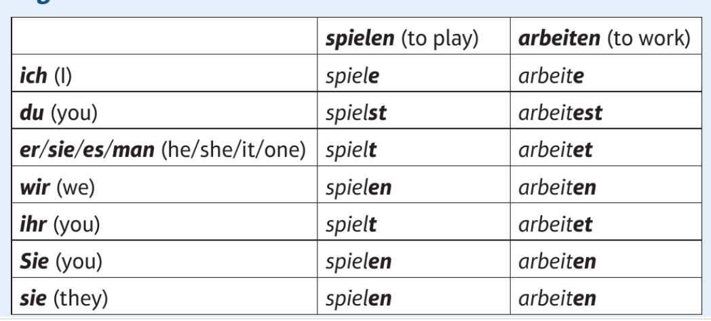
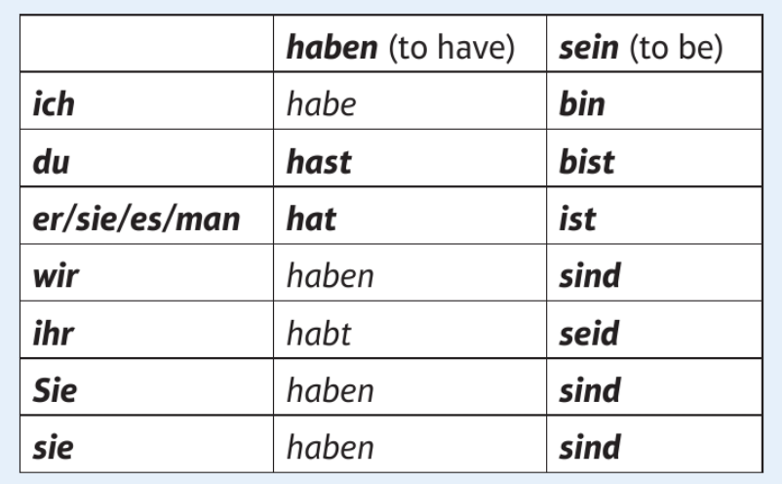
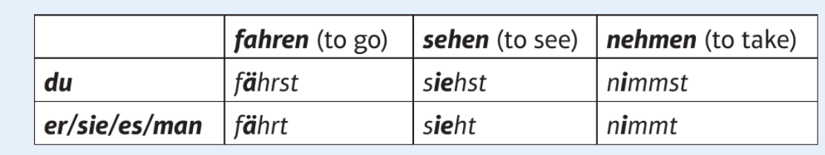
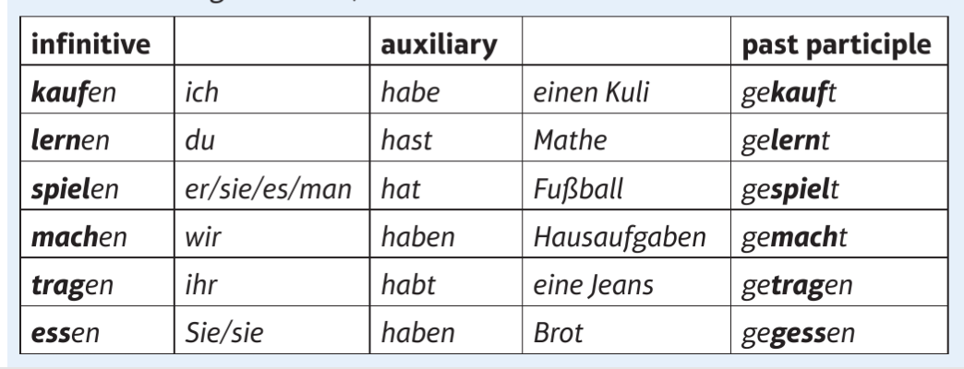
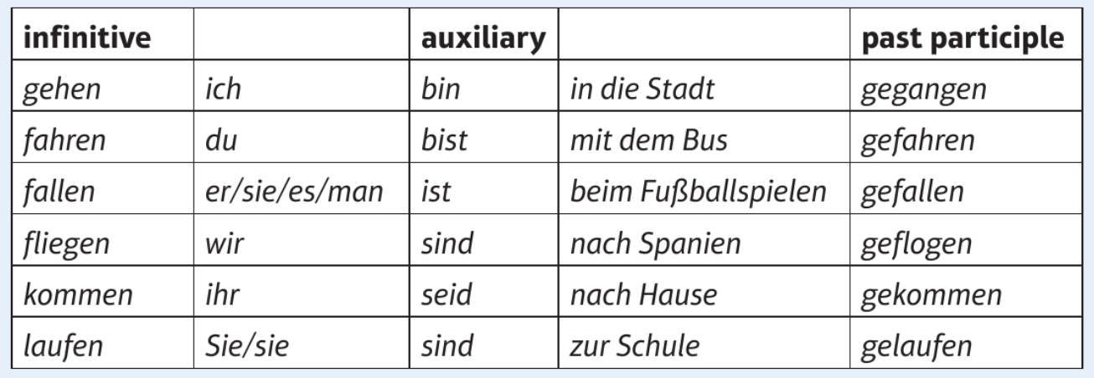
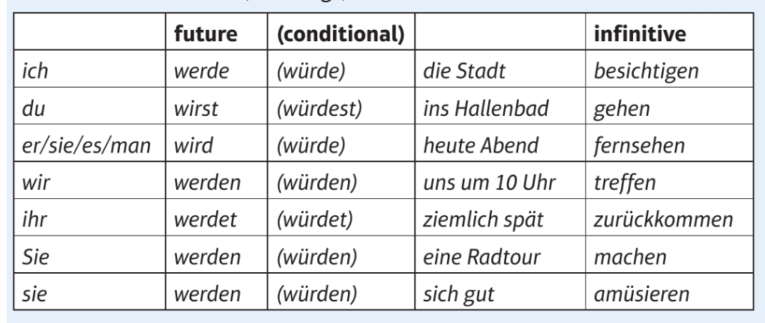
Year 10 German: Tenses
The present tense
Regular present tense verbs follow this pattern.
‘haben’, ‘sein’ and some other irregular verbs have some slight changes.
The past perfect tense
Most verbs will have ‘haben’ as their auxiliary verb.
Some verbs (usually involving movement) use ‘sein’ as their auxiliary verb.
The future and conditional tenses
Both the future and conditional tenses have infinitives at the end of sentences.
The conditional tense is used to say what you would do.

Slide 31
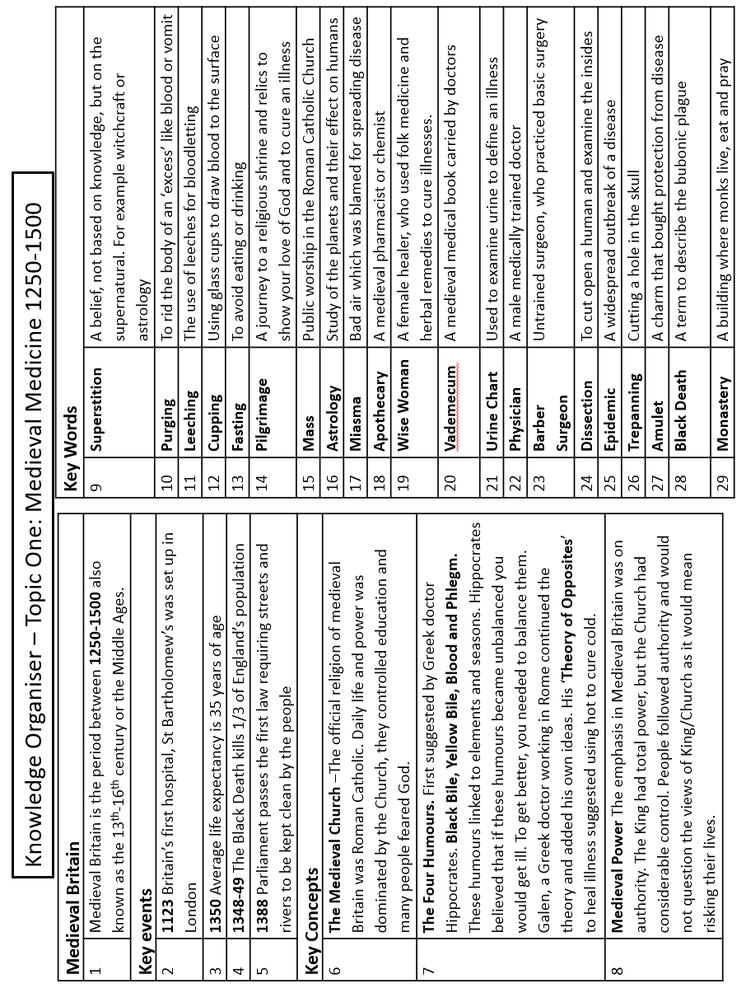
History

Slide 32
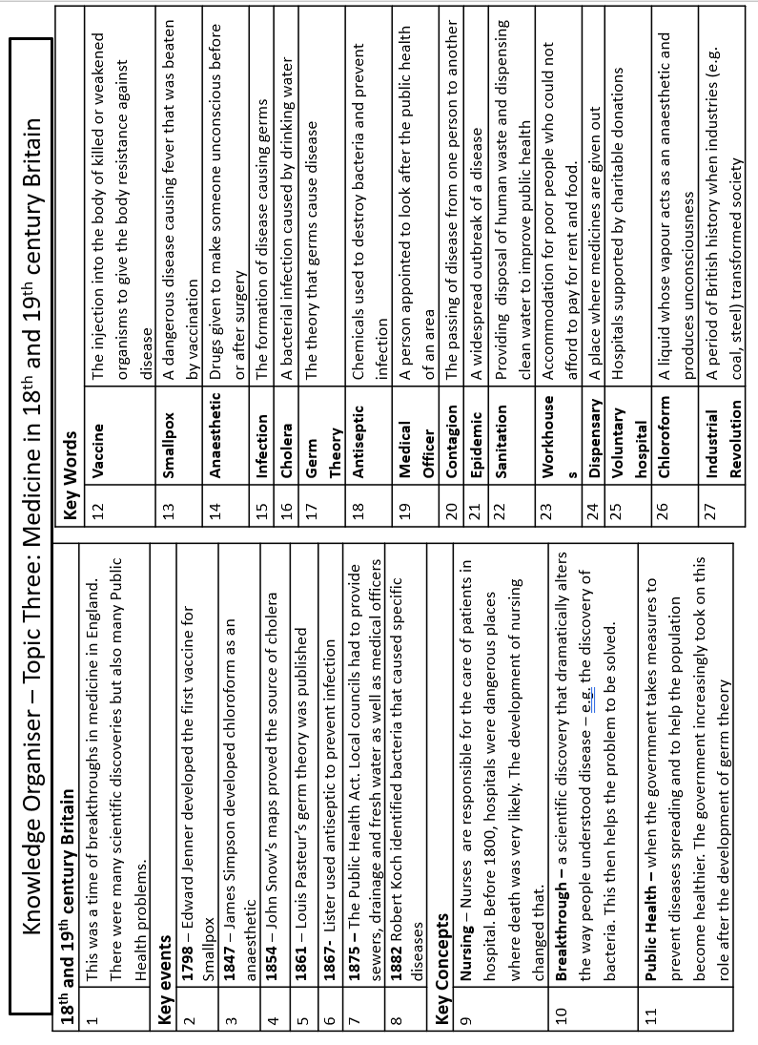
History

Slide 33
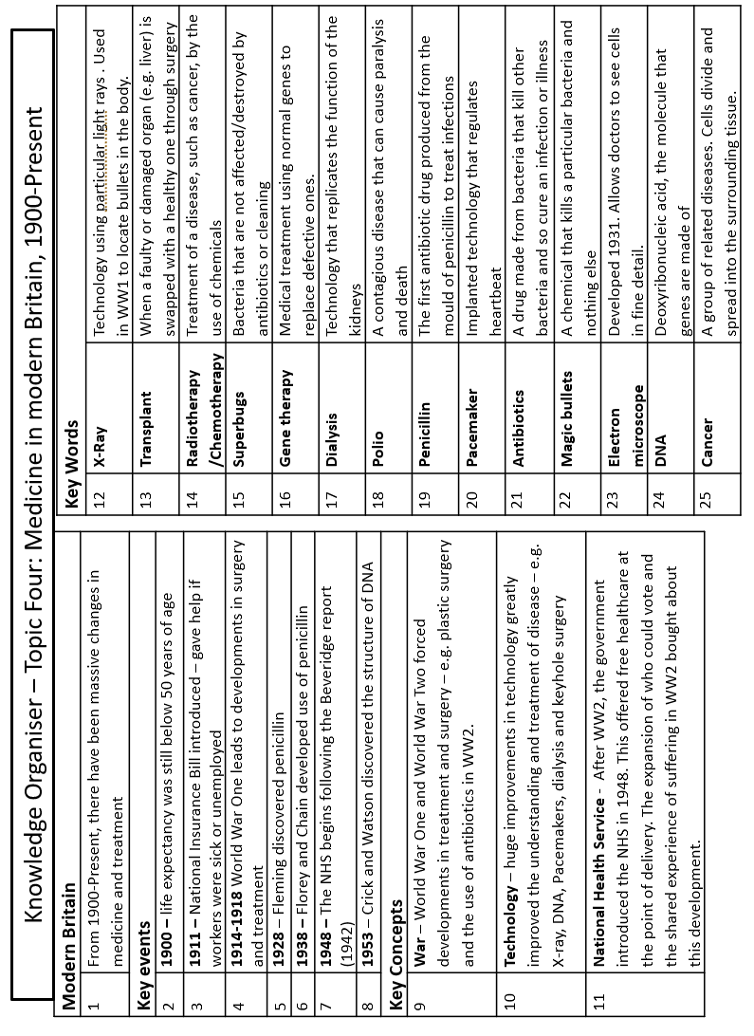
History

Slide 34
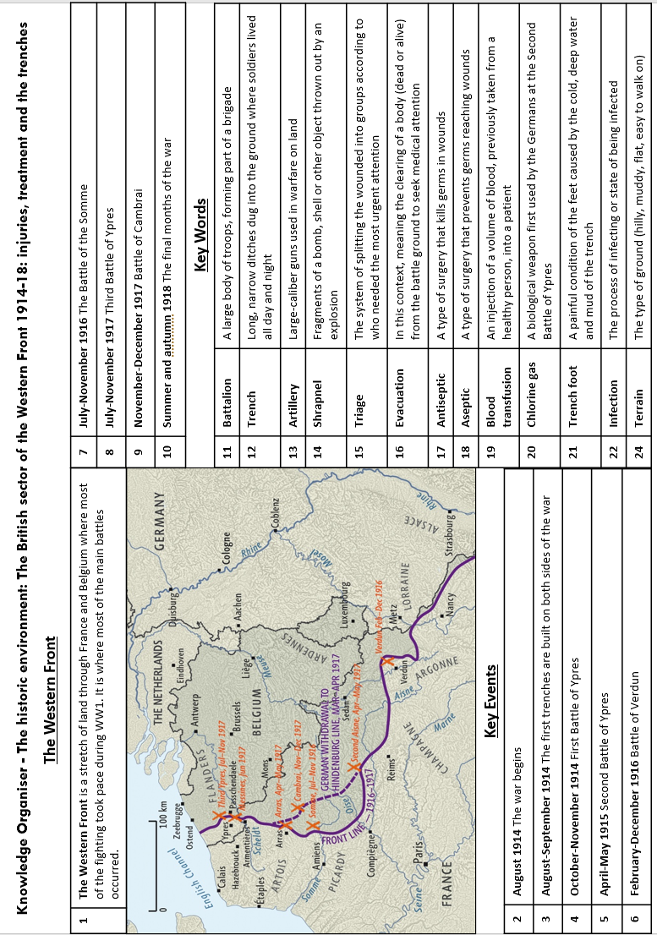
History

Slide 35
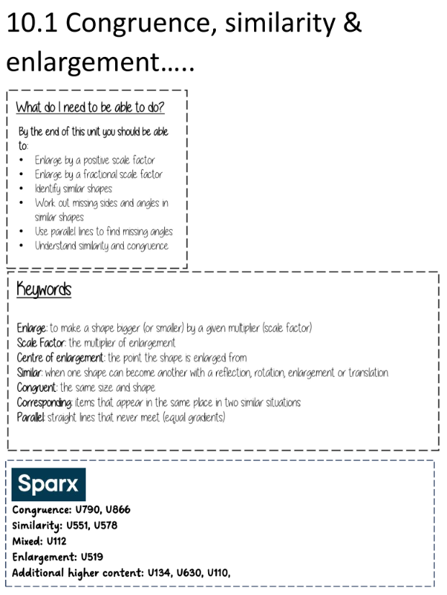
Mathematics

Slide 36
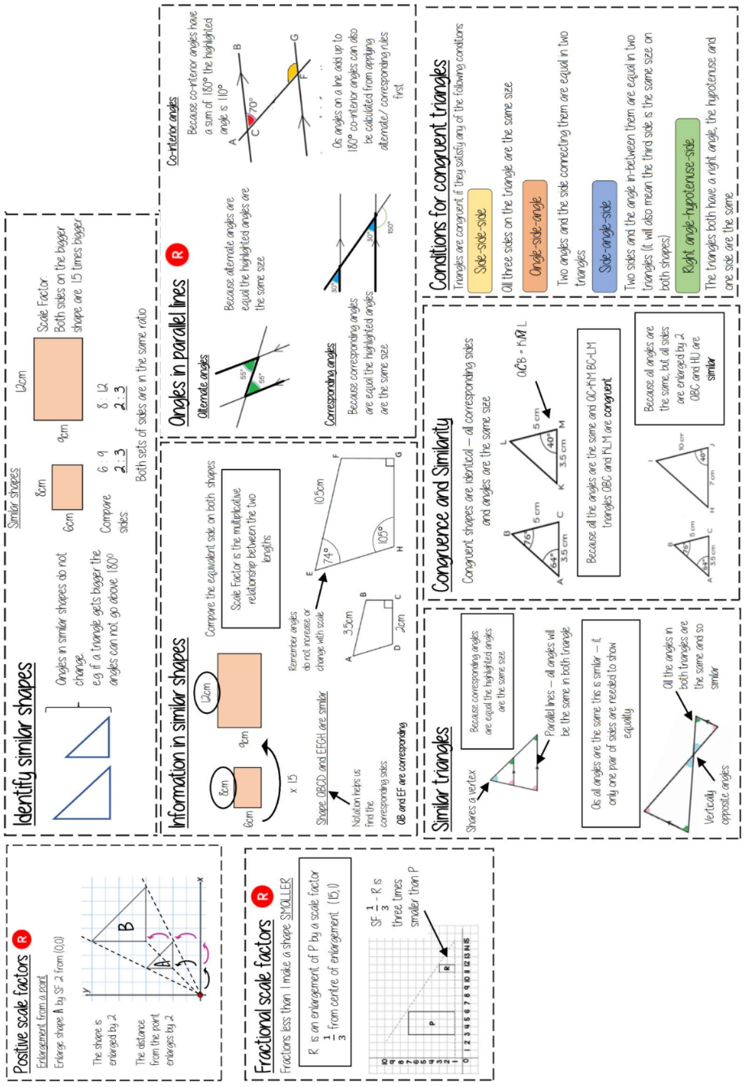
Mathematics

Slide 37
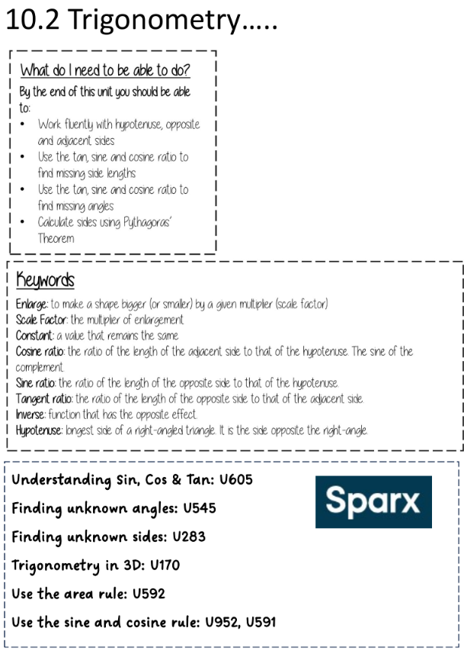
Mathematics

Slide 38
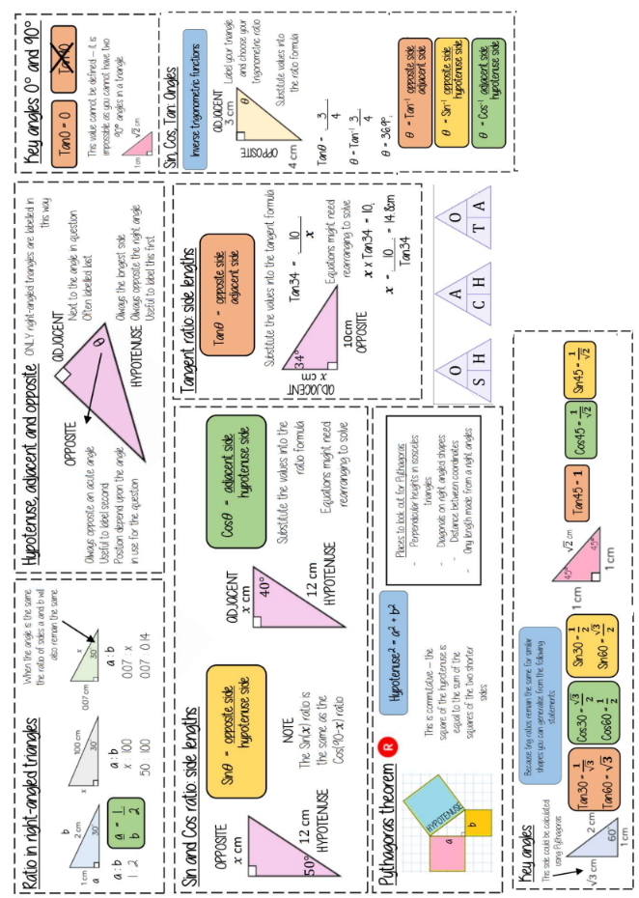
Mathematics

Slide 39
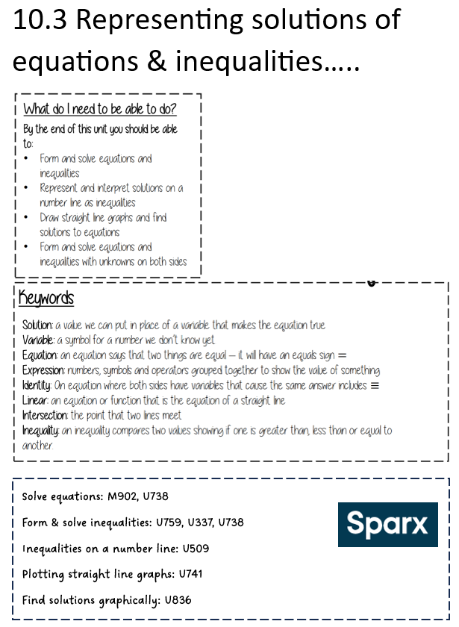
Mathematics

Slide 40
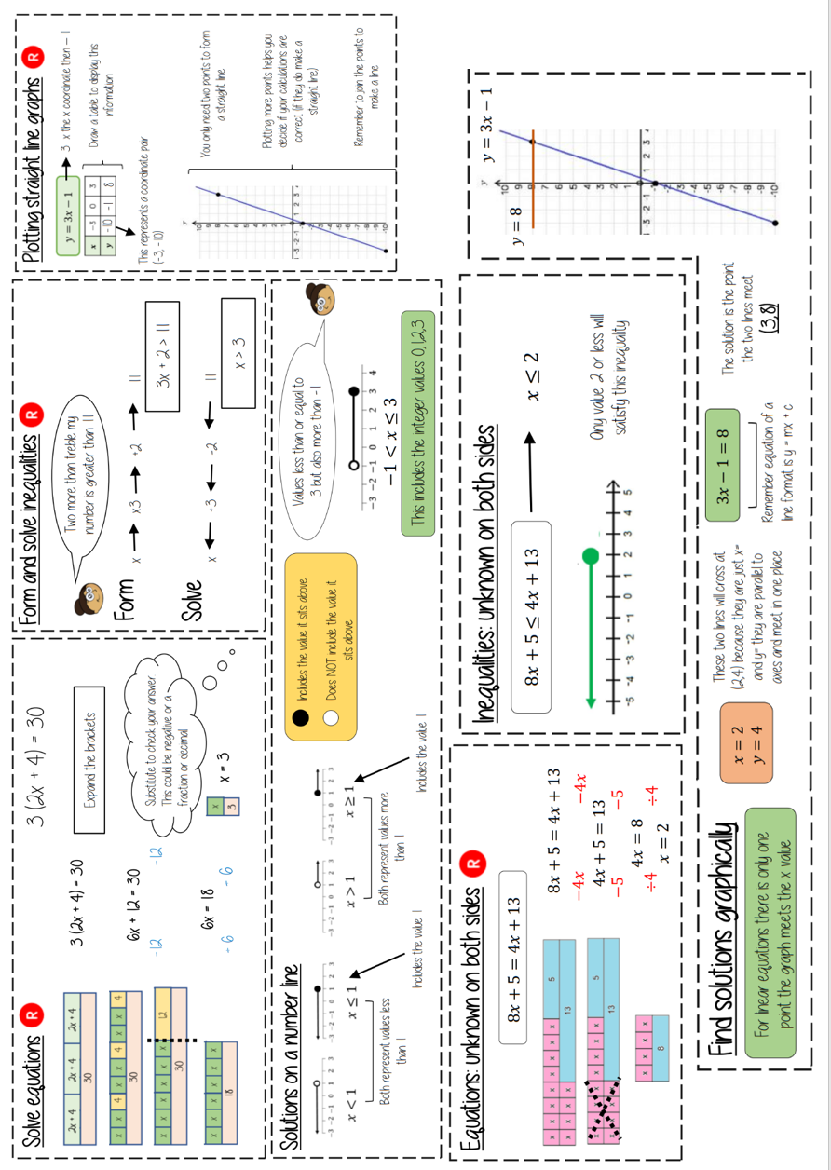
Mathematics

Slide 41
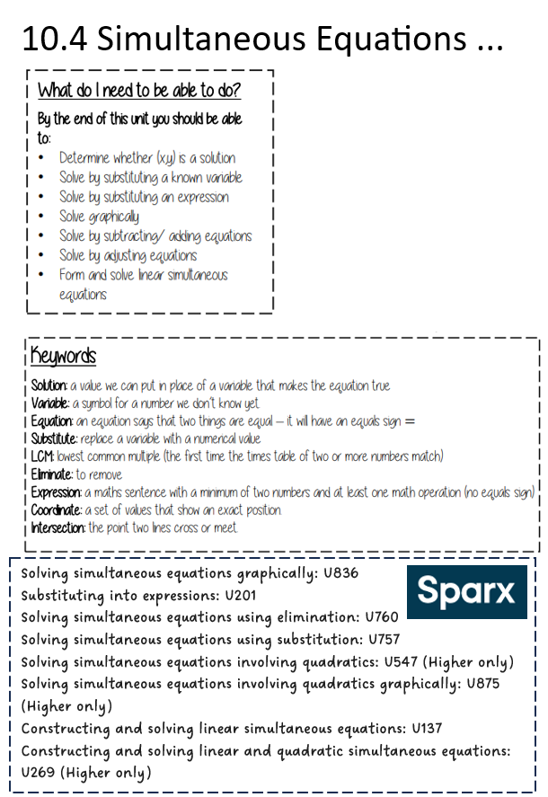
Mathematics

Slide 42
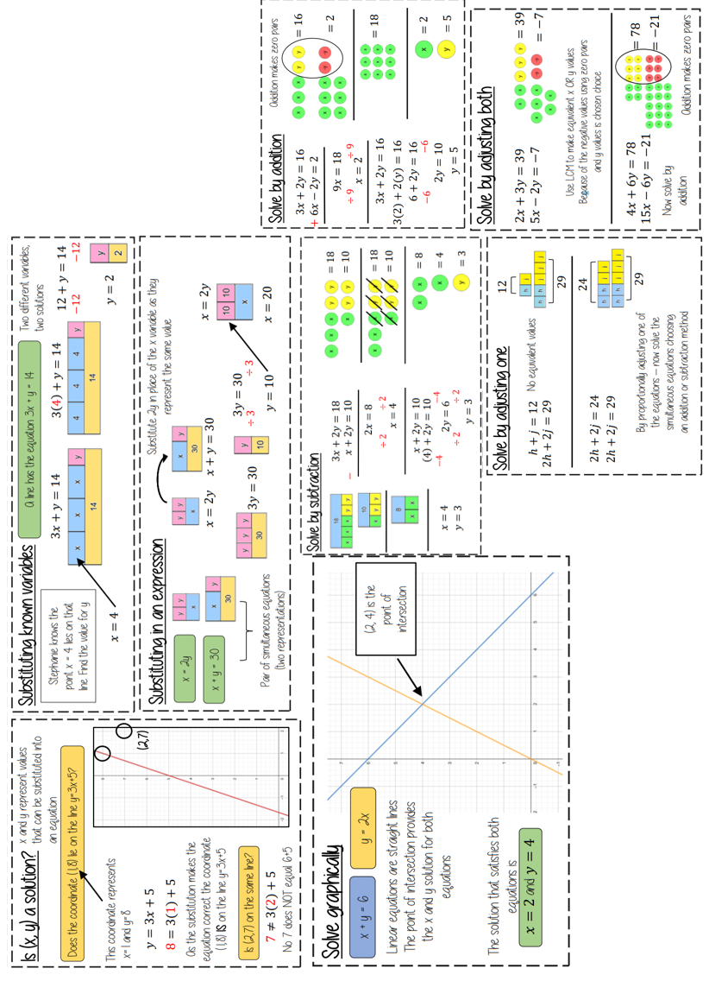
Mathematics

Slide 43
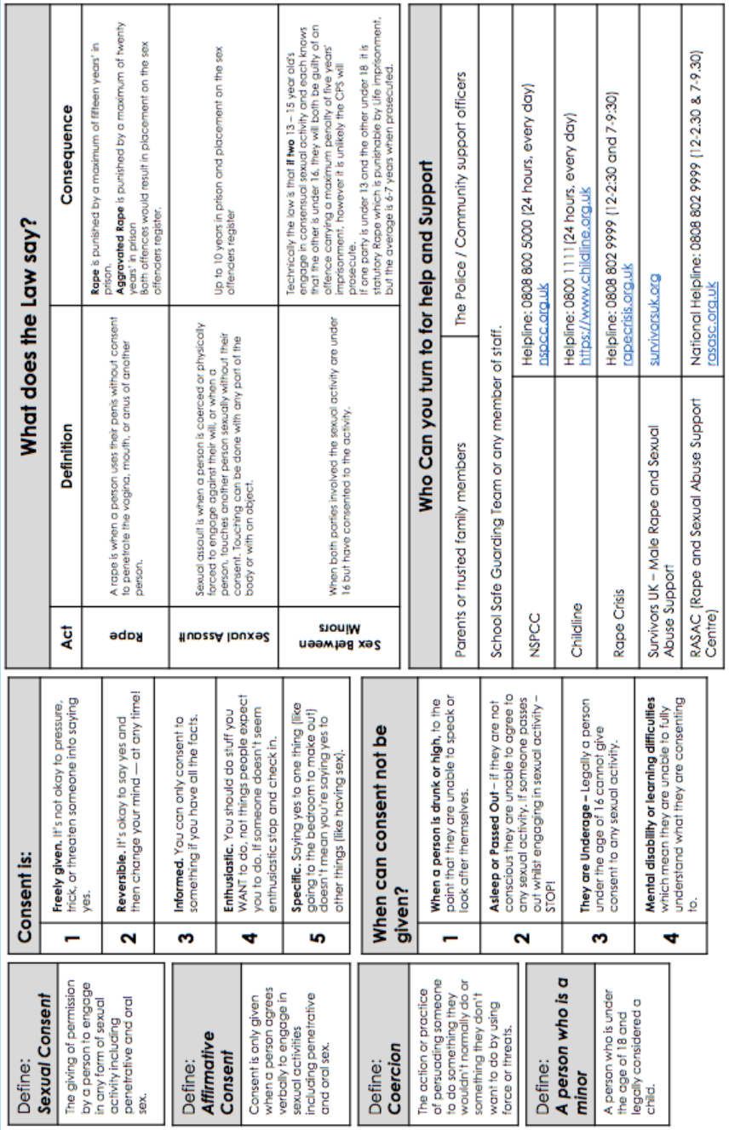
Personal Development

Slide 44
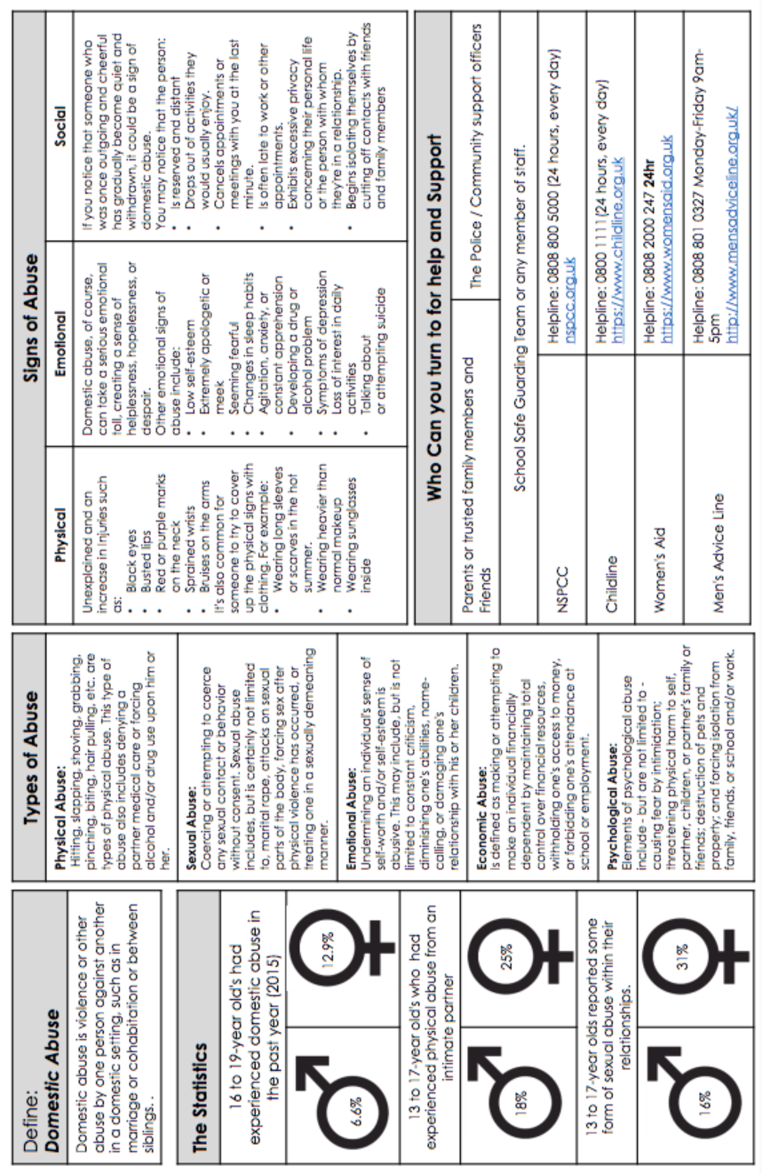
Personal Development

Slide 45
GCSE PE
Cardiac Output -The volume of blood pumped per minute by each ventricle of the heart. Cardiac output = stroke volume x heart rate. Measured in litres/min.
Cardio-respiratory system The combination of the cardiovascular and respiratory systems working together to deliver O2 and remove CO2 from the body.
Double circulatory system The body has 2 systems which circulate blood. The systemic system delivers oxygen to working muscles and the pulmonary system collects oxygen from the lungs.
Haemoglobin is found if red blood cells and binds with oxygen to carry it to wear it is needed
Heart rate The number of times the heart beats per minute (bpm)
Pulmonary Artery A blood vessel which transports deoxygenated blood from the heart to the lungs
Pulmonary Circulatory System A network of blood vessels which transport blood to and from the lungs to collect oxygen and remove carbon dioxide.
Pulmonary Vein A blood vessel which transports oxygenated blood from the lungs to the heart
Red blood cells Produced in bone marrow and contain haemoglobin. They carry and deliver oxygen around the body
Septum the wall which separates the sides of the heart
Stroke Volume The amount of blood pumped out of the left ventricle during each contraction, measured in ml
Systemic Circulatory System A network of blood vessels which transport blood to and from the body to deliver oxygen and collect carbon dioxide
Veins Blood vessels which carry blood towards the heart. Carrying blood at low pressure, they have valves, thin walls, large lumens and normally carry deoxygenated blood
Vena Cava the largest vein which carries deoxygenated blood back to the heart
Ventricles The two large, lower chambers of the heart

Slide 46
GCSE PE
1.1.b. Muscular System Key Terms
Agonist The muscle that works to create the movement
Antagonist The muscle that relaxes & lengthens to allow movement to occur
Antagonistic muscle action - A pair of muscles that work together to produce movement, with one muscle contracting whilst the other muscle relaxes
Fixator A muscle that assists movement by supporting or stabilising joints and the rest of the body
Insertion where the contracting muscle attaches to the bone it moves
Origin The end of the muscle which is attached to a bone that is stable and doesn’t during muscular contraction
Tendon Tough, flexible bands of fibrous tissue which join muscle to bone (or other muscles) allowing bones to move when muscles contract
1.1.d. Cardiovascular System Key Terms
Atrium The 2 small, upper chambers of the heart
Arteries Blood vessels which carry blood away from the heart. Carrying blood at high pressure, they have thick walls, smaller lumens and normally carry oxygenated blood.
Aorta The largest artery in the body which carries oxygenated blood away from the heart
Blood Pressure How strongly the blood pushes against the walls of the blood vessels
Blood Pressure How strongly the blood pushes against the walls of the blood vessels
Blood vessels - Tubular structures that carry blood around our bodies
Capillaries Small blood vessels with very thin walls very small lumen for diffusion to take place
Capillarisation The development of blood capillaries in the body which increases through long term effects of exercise

Slide 47
GCSE PE
1.1.c Movement Analysis Key Terms
Frontal axis of rotation An axis which runs from the front to the back of the body (gymnast performing a cartwheel)
Lever system Where the body’s muscles pull on the bones to create movement. They can be either 1st, 2nd or 3rd class levers. 1, 2, 3= F, L, E!
Longitudinal axis of rotation Passes vertically from the top to the bottom of your body. A discus throw uses this axis
Mechanical advantage 1st and 2nd class levers provide a mechanical advantage. This means a large load can me moved with a smaller amount of effort from the muscles
Planes of movement Imaginary flat surfaces which run through the body. There are 3, sagittal, transverse & frontal
Rotation Movement of body or body part in a clockwise or anti clockwise direction
Sagittal plane An imaginary flat surface which divides the body vertically into left and right sides
Second class lever A lever where the load and the effort are on the same side as the fulcrum, with the load near the fulcrum
Third class lever A level where the effort is placed between the load and the fulcrum. The effort must travel a shorter distance and be greater than the load
Transverse axis of rotation An imaginary line which runs through the body from left to right. A somersault uses this axis
Transverse plane -An imaginary flat surface which divides the body into top and bottom

Slide 48
GCSE PE
1.1.d. Respiratory System Key Terms
Aerobic capacity The maximum amount of oxygen your body can take in and use, measured with the V02 max test
Aerobic Exercise/Activity When oxygen is used for the duration of exercise to make energy, usually at moderate intensity at a continuous rate.
Alveoli Small air sacks in the lungs which are the site of gas exchange.
Anaerobic Exercise/Activity ‘Without oxygen’. High intensity exercise for short periods of time where oxygen is not predominantly used to produce energy
Breathing rate number of breaths taken per minute
Gas exchange The movement of O2 and CO2 between the alveoli and capillaries and the working muscles and capillaries.
Minute ventilation (minute volume) Then volume of gas inhaled OR exhaled from the lungs in 1 minute
Mitochondria the place in each muscle cell where energy is produced
Respiratory Muscles Muscles which help air move in and out of the lungs (diaphragm and intercostals)
Respiration system gets oxygen into the body and removes carbon dioxide. Its made up of the mouth/nose – bronchi- bronchioles and alveoli
Tidal volume The amount of air breathed in or out in one breath. Measured in ml
Trachea (windpipe) The pipe which connects the nose/mouth to the bronc

Slide 49
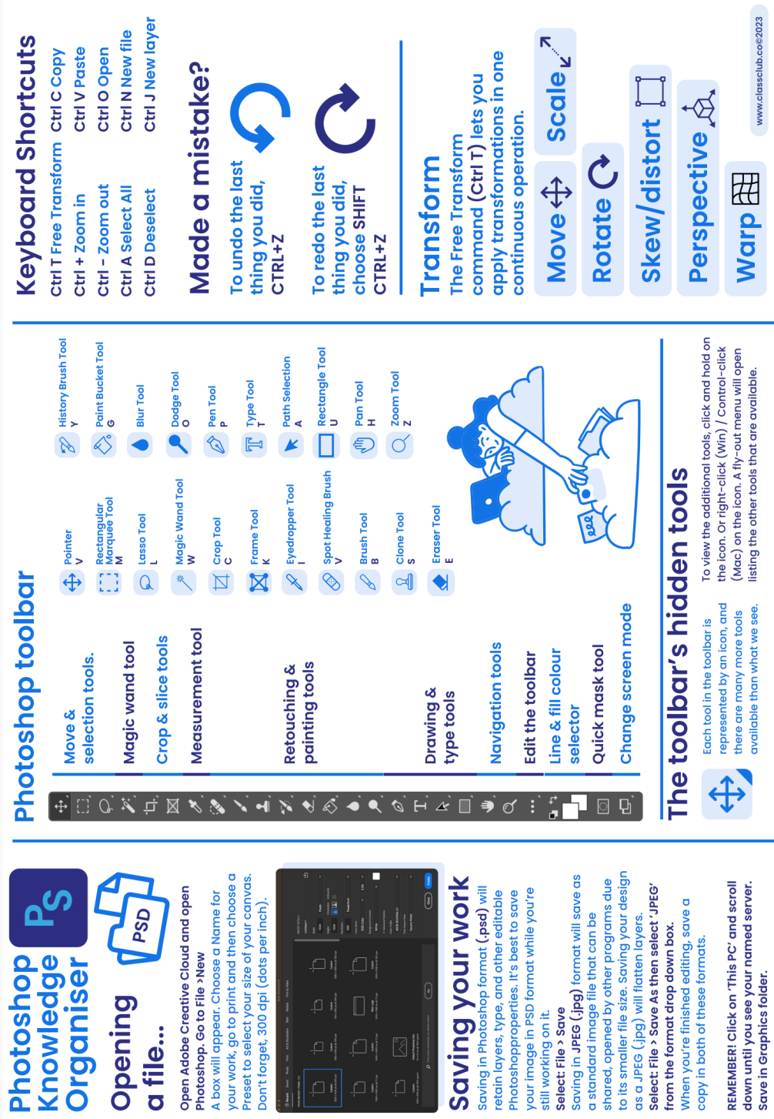
Photography

Slide 50
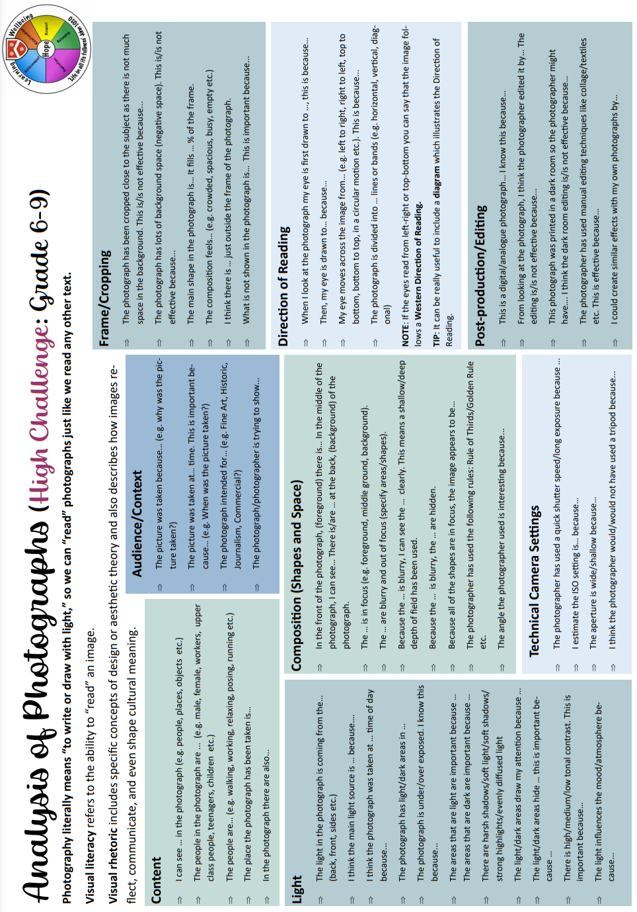
Photography

Slide 51
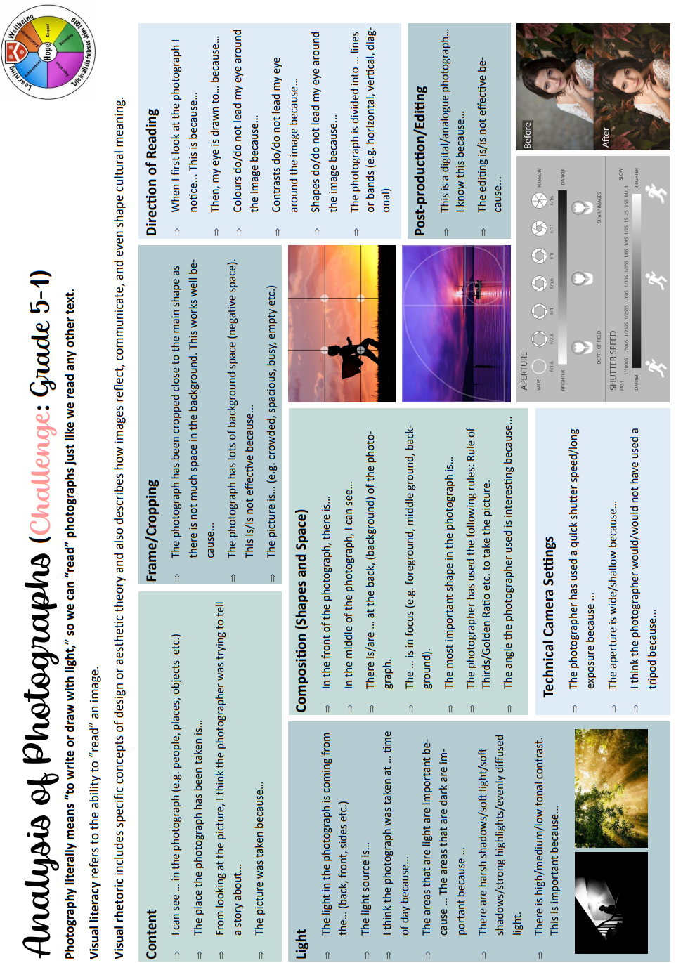
Photography

Slide 52
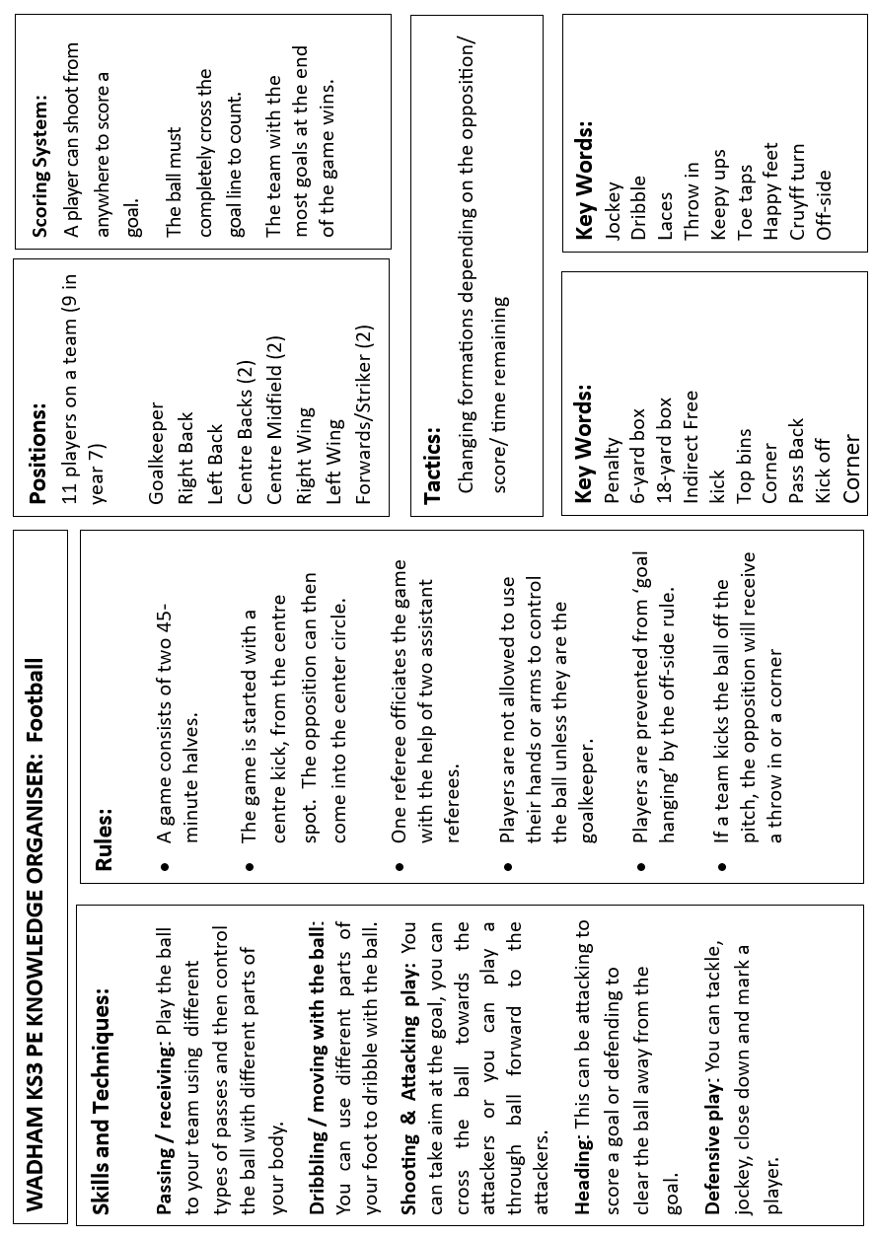
Physical Education

Slide 53
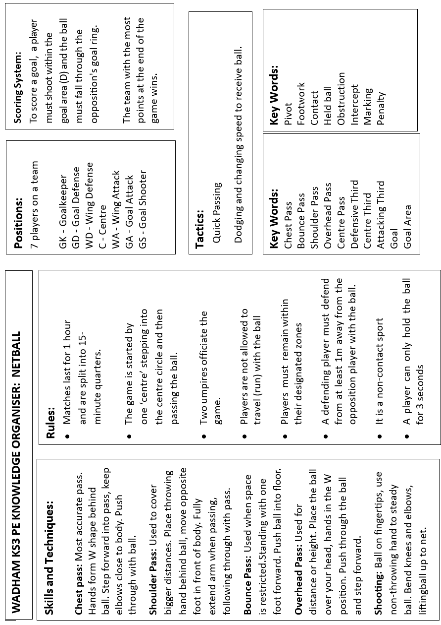
Physical Education

Slide 54
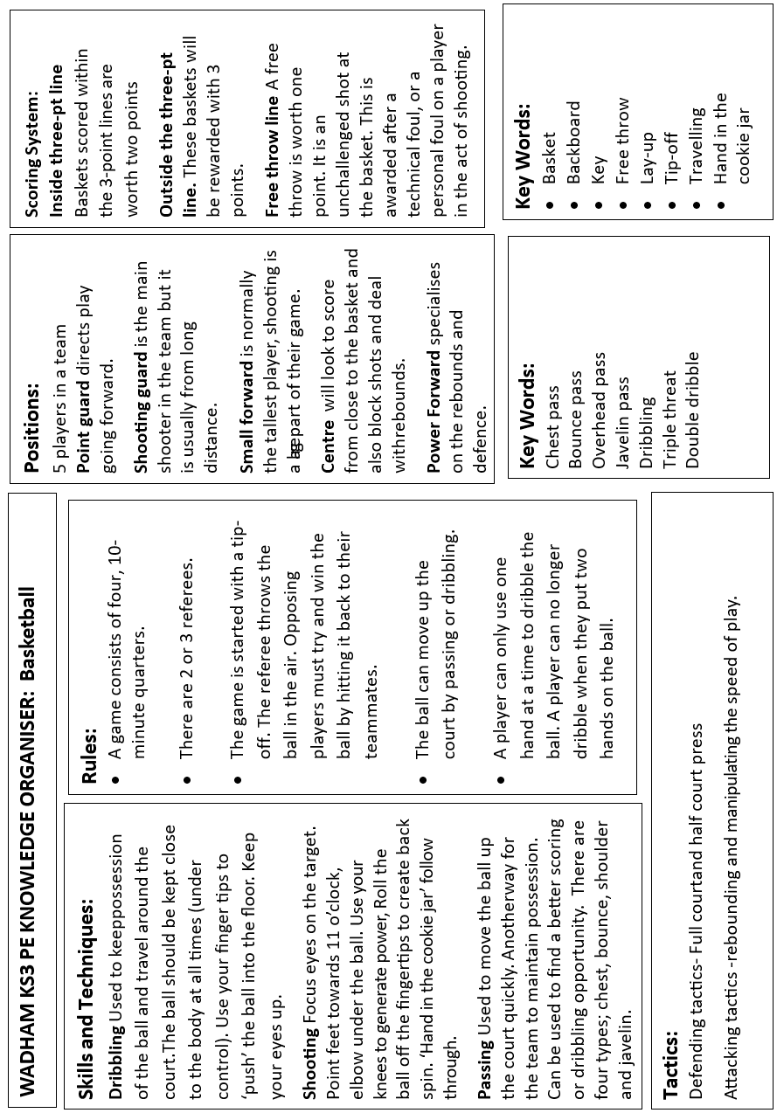
Physical Education

Slide 55
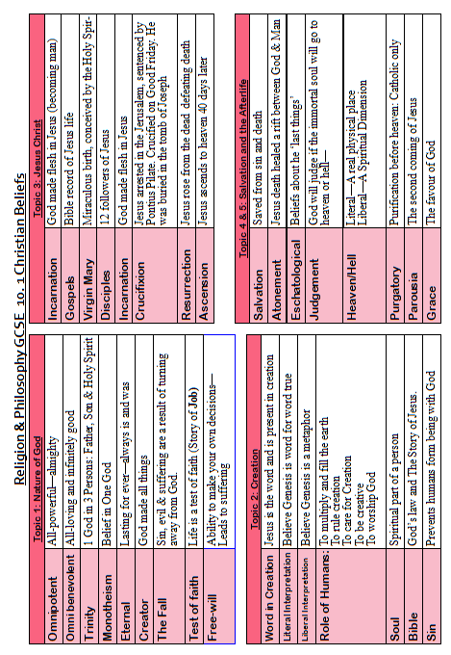
Religion and Philosophy

Slide 56
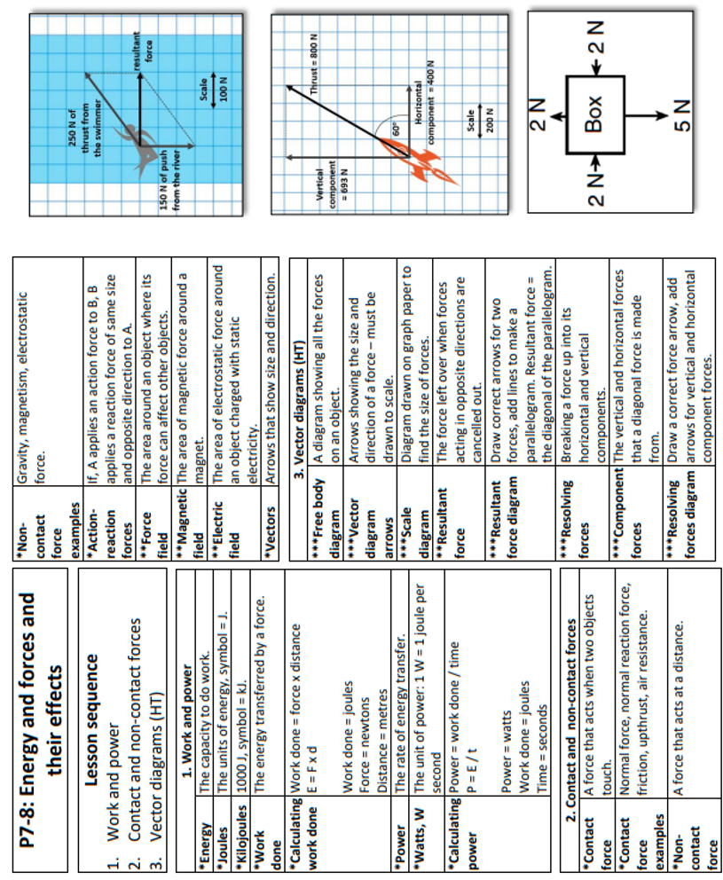
Science - Combined

Slide 57
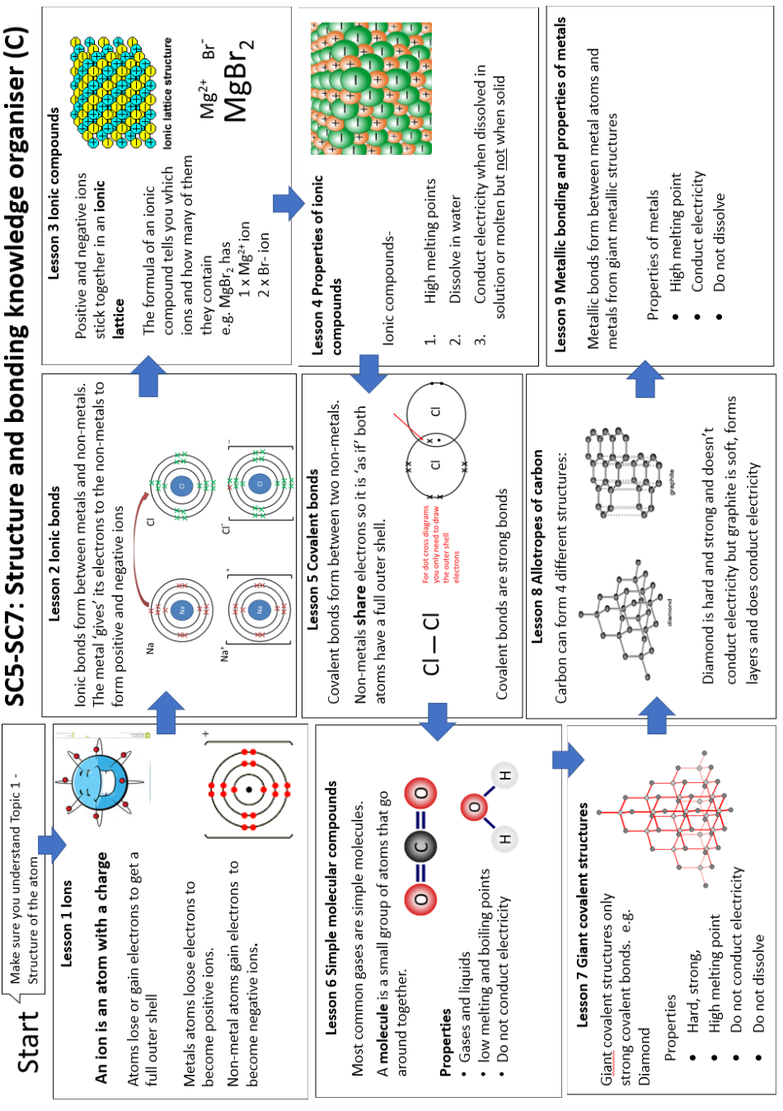
Science - Combined

Slide 58
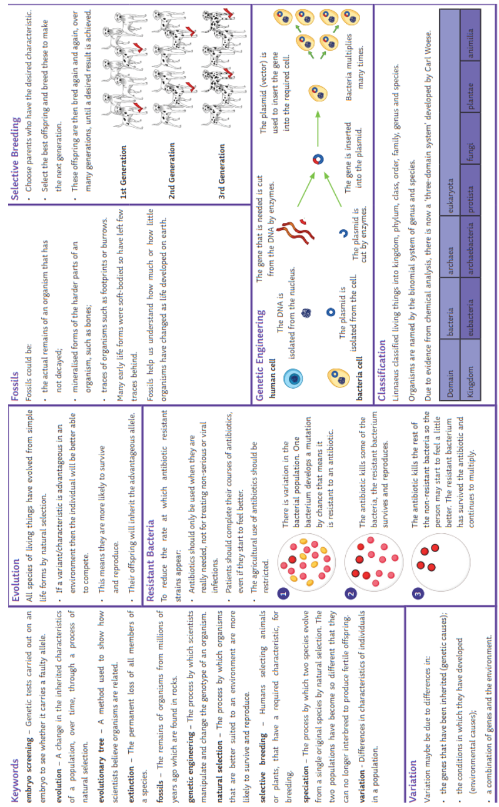
Science - Combined

Slide 59
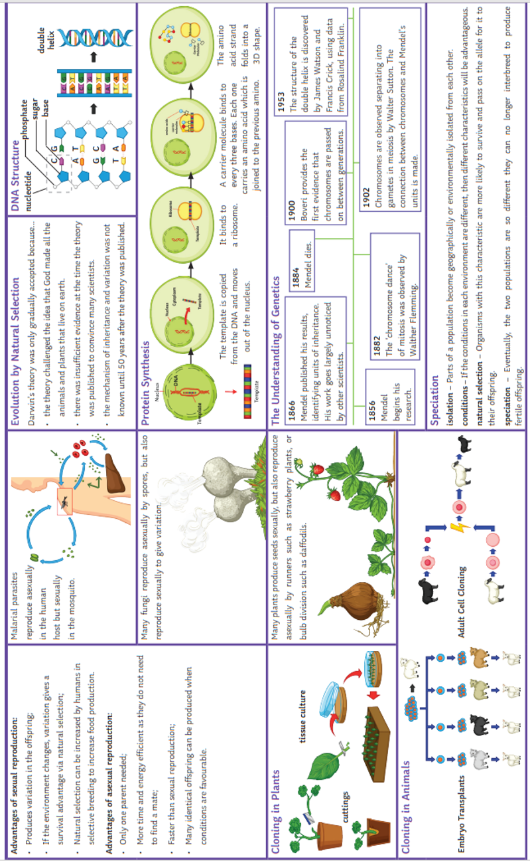
Science - Combined

Slide 60
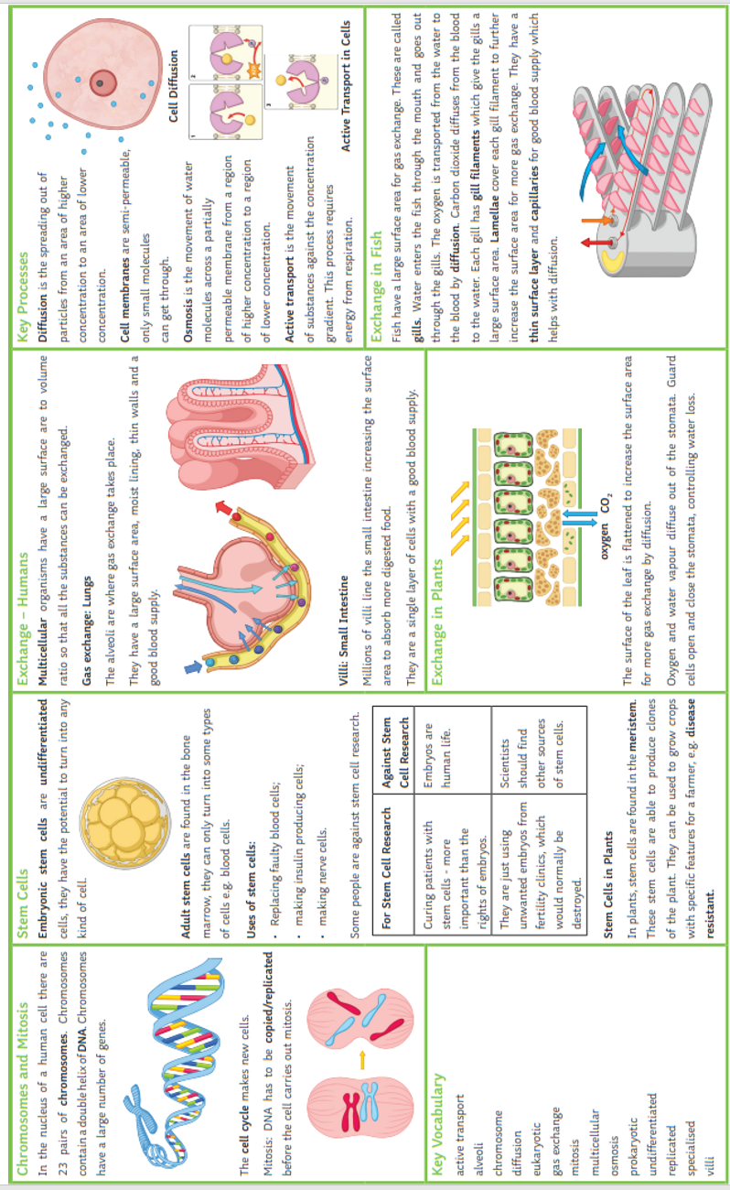
Science - Combined

Slide 61
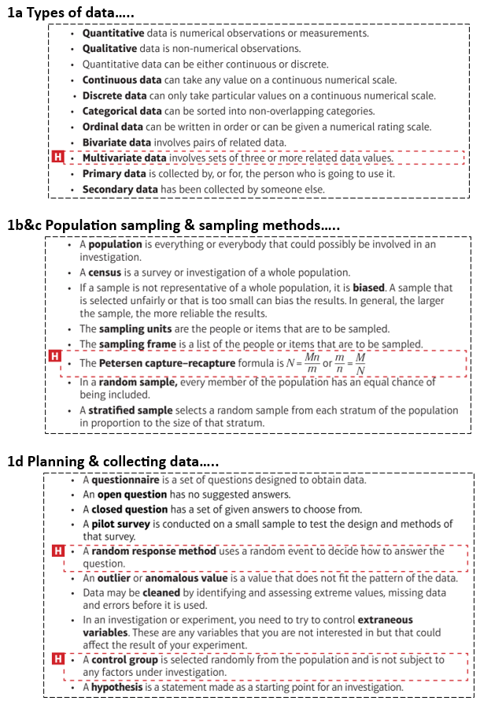
Statistics

