Slide 1




Wadham School
A Church of England Community School
Knowledge Organisers
Year 9
Term 1 & 2
2024-2025
Name.............................................................
Tutor group..............................
“Life in all its fullness” John 10:10

Slide 2


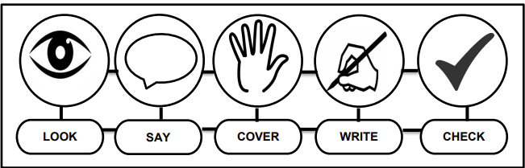



Using Your Knowledge Organiser
Look-Say-Cover-Write-Check
Retrieval practice using the look-say-cover-write-check technique, when done in regular small chunks, is one of the best ways you can learn relevant knowledge over time.
Working in Independent mode:
Look at the first bullet point or sentence
Read through it three to five times
Cover
Write it out exactly
Remove and check what you wrote and tick if correct
Repeat
When you get it 100% right, move on to the next chunk of information
Flash Cards Make flast cards with the definition on one side and key word on the other. | Self Quizing Write quizzes with answers to test yourself in the future. | Mind maps Create mindmaps linking key inforamtion you need to remember.

Slide 3
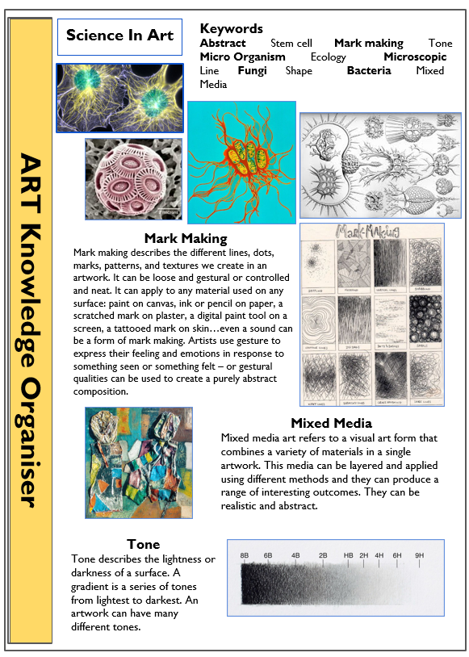
Art

Slide 4
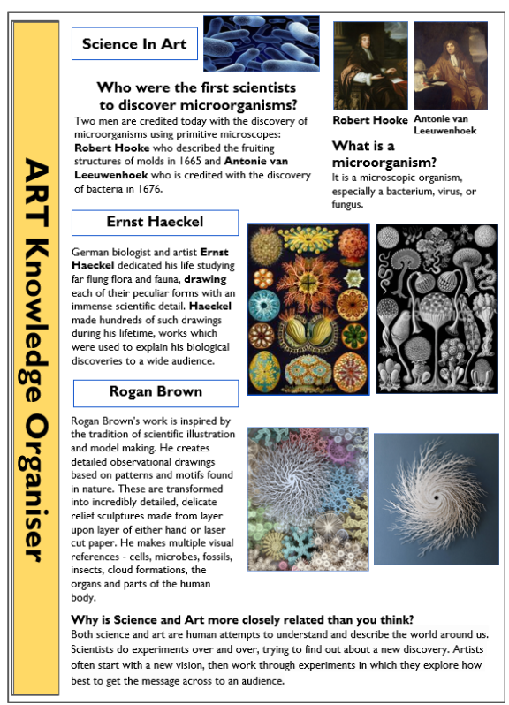
Art

Slide 5
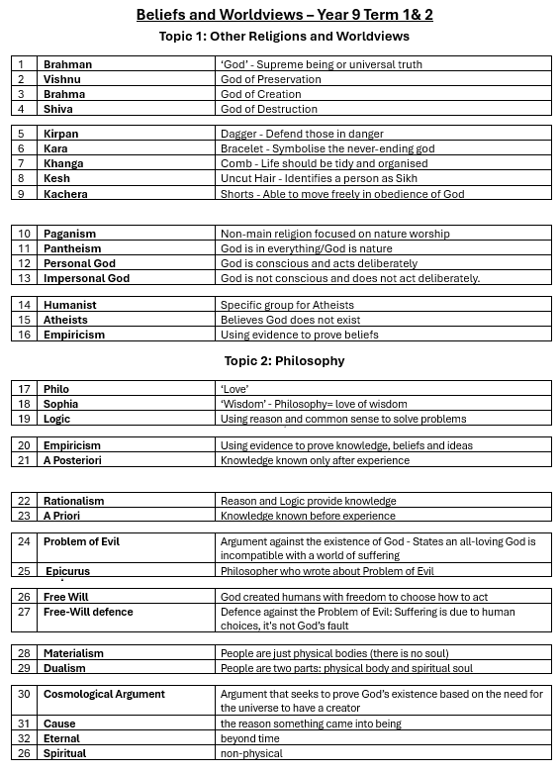
Beliefs and World Views

Slide 6
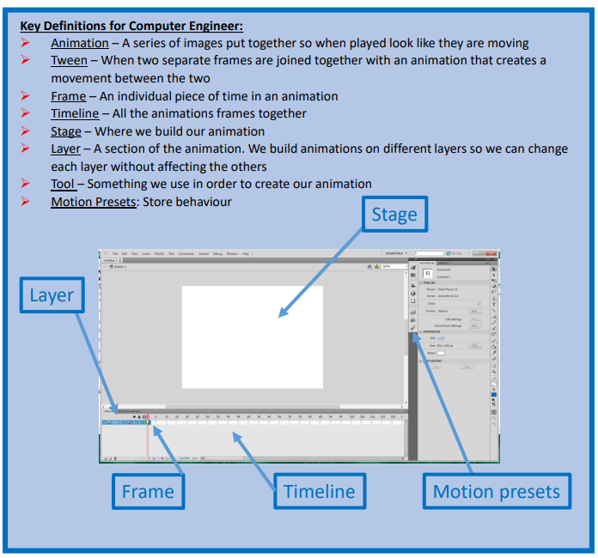
Computing

Slide 7


Year 9 Design and Technology
 | Keywords | Key information
1 | Fibre | Fibres are hair like strands that are natural or synthetic.
2 | Natural Fibres | Natural fibres come from plant, animal or insect sources.
3 | Synthetic Fibres | Synthetic fibres are man-made.
4 | Yarn | Fibres are spun to create long threads called yarns.
5 | Fabric | Fabric is produced by yarns which are knitted or woven together.
6 | Scales | Wool fibres have scales. Heat and agitation will cause these scales to shrink and interlock together to form a piece of fabric.
7 | Shrink | Become smaller in size.
8 | Felting needle | A tool with small barbs on the surface.
9 | Barbs | A rough surface on a felting needle which pulls wool fibres downwards and encourages them to interlock. The more barbs a tool has, the quicker fibres should bond together.
10 | Bonded Fabric | Are not woven or knitted. Made from fibres rather than yarns.
11 | Surface Design | The art that is applied to surfaces, such as fabric, wallpaper, home décor and clothes.
12 | Placement | The location of a design on an item.
13 | Motif | A significant icon or recurring idea in a design.
14 | Cool Colours | Blues, Greens and Purples. (Think Water!)
15 | Warm Colours | Pinks, Reds and Oranges. (Think Fire!)
16 | Complementary Colours | Colours which are opposite each other on the colour wheel. Orange and Blue; Green and Red; Yellow and Purple.
17 | Analogues Colours | Colours that are next to each other on the colour wheel. Green, yellow and orange are an example of an analogues colour scheme.
18 | Monochrome | A colour scheme that incorporates the main colour and only hues, tones, shades and tints of that one colour.
19 | Embellishment | Decorative detail which is added for a more interesting aesthetic appeal. Sequins are an example of an embellishment.
20 | Embroidery | Using stitches to form a decorative design.

Slide 8
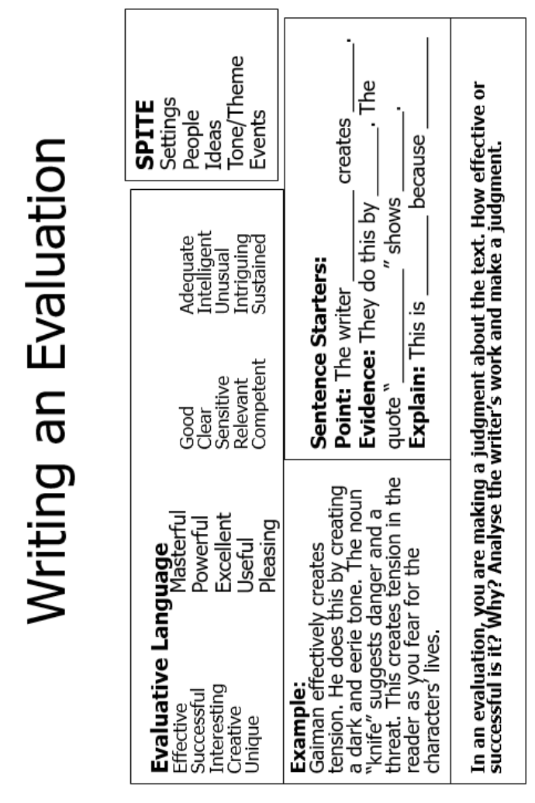
English

Slide 9
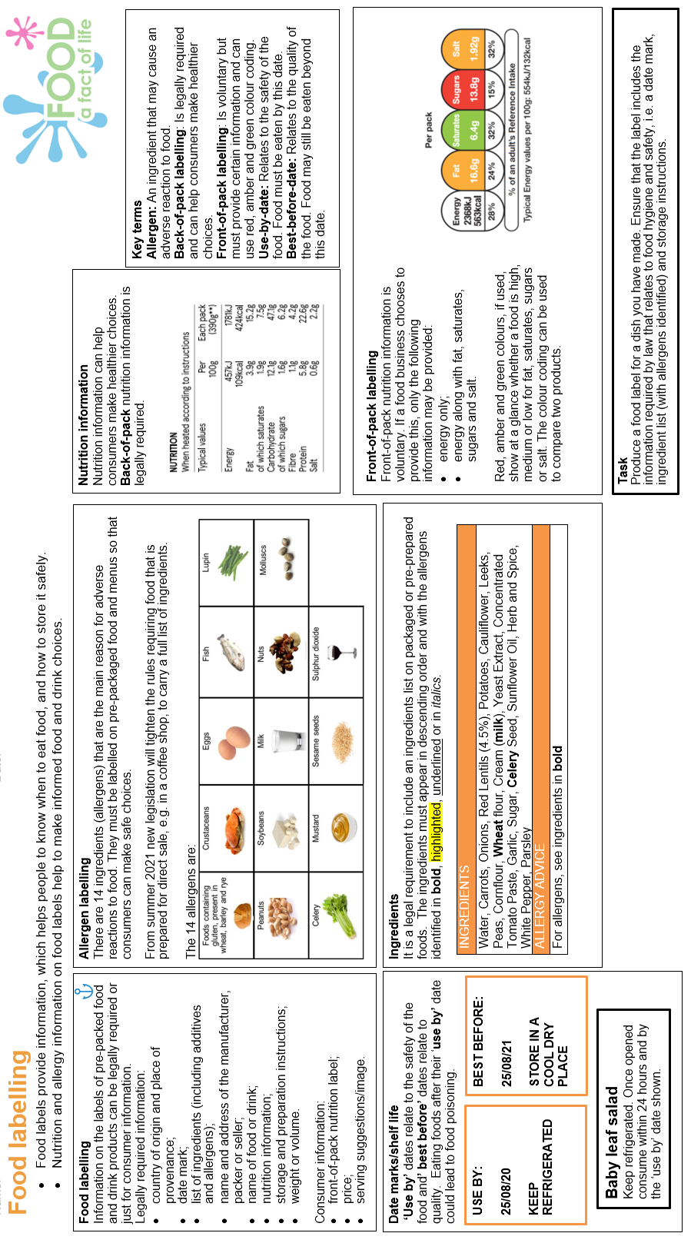
Food

Slide 10
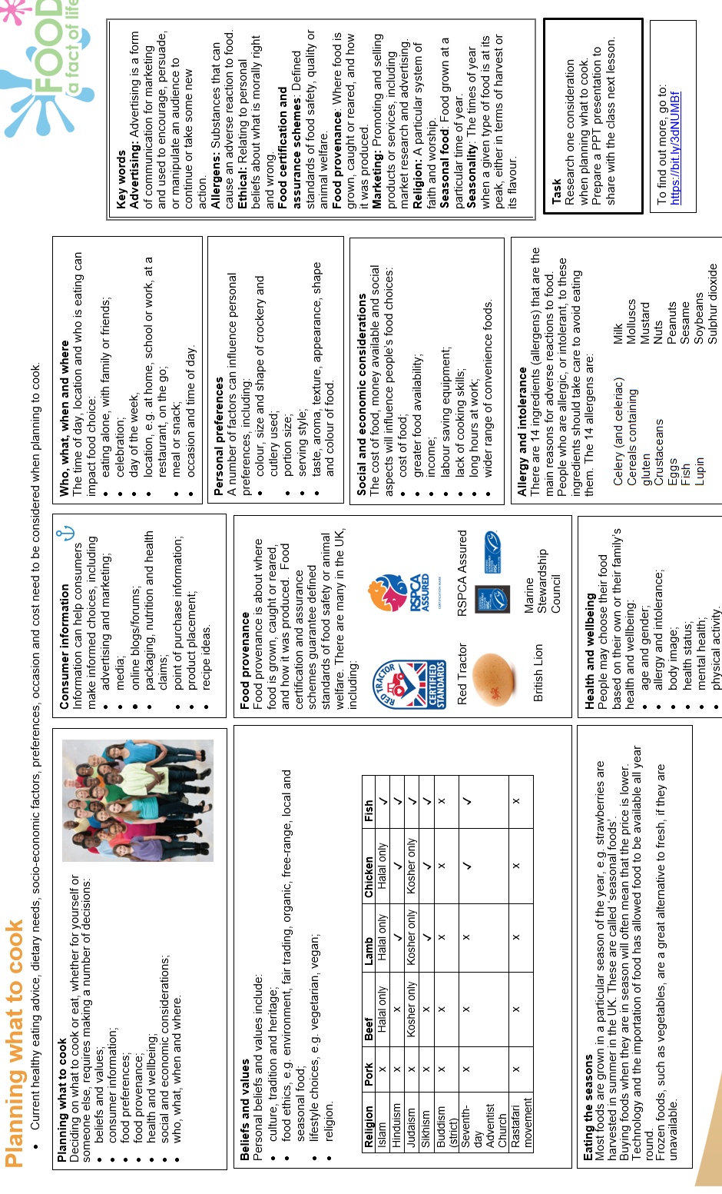
Food

Slide 11
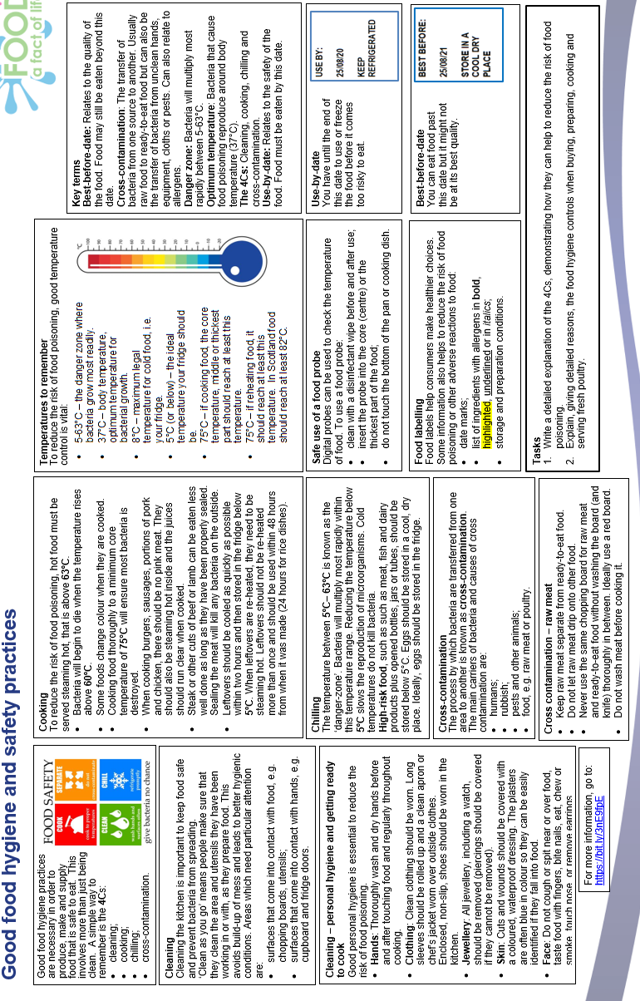
Food

Slide 12
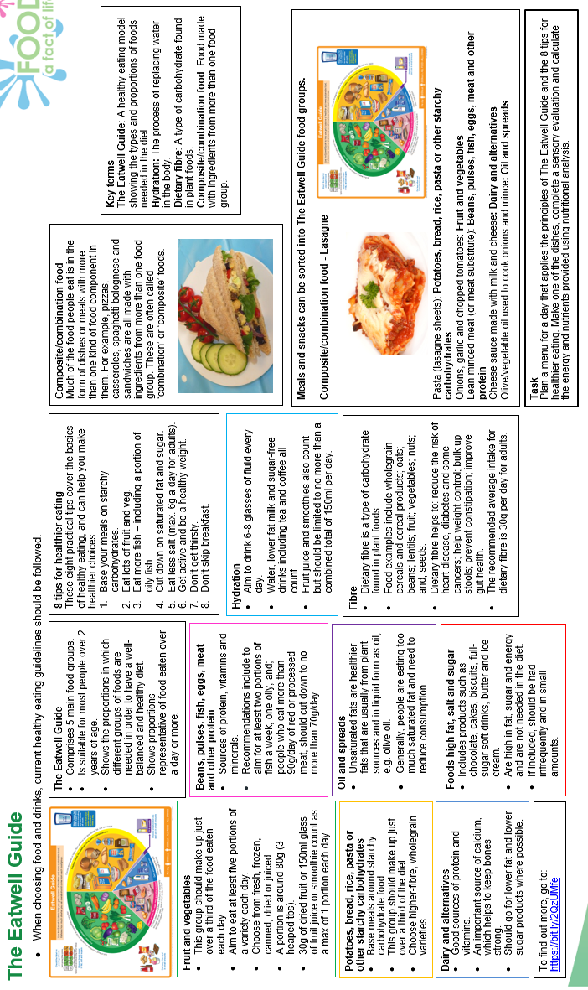
Food

Slide 13
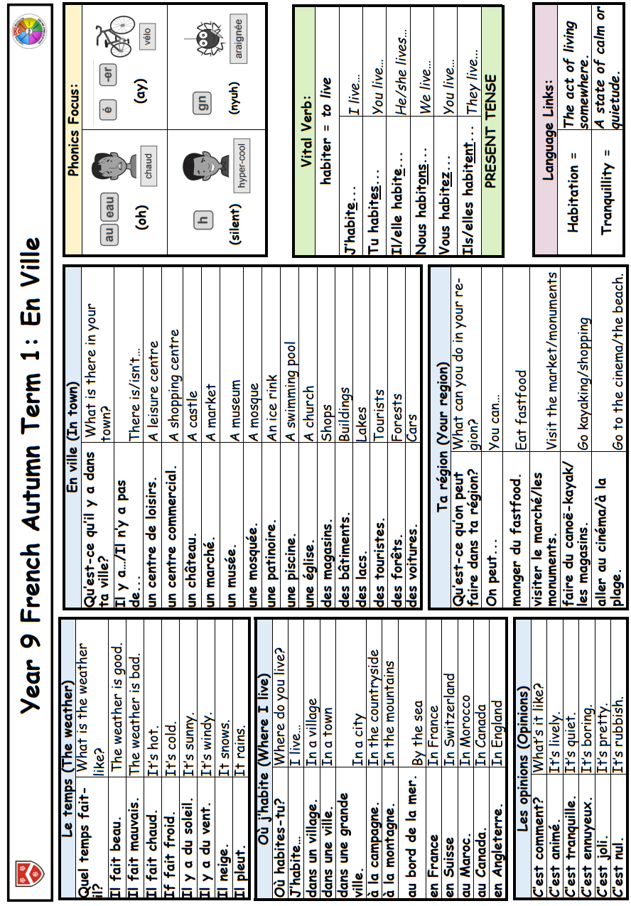

Slide 14
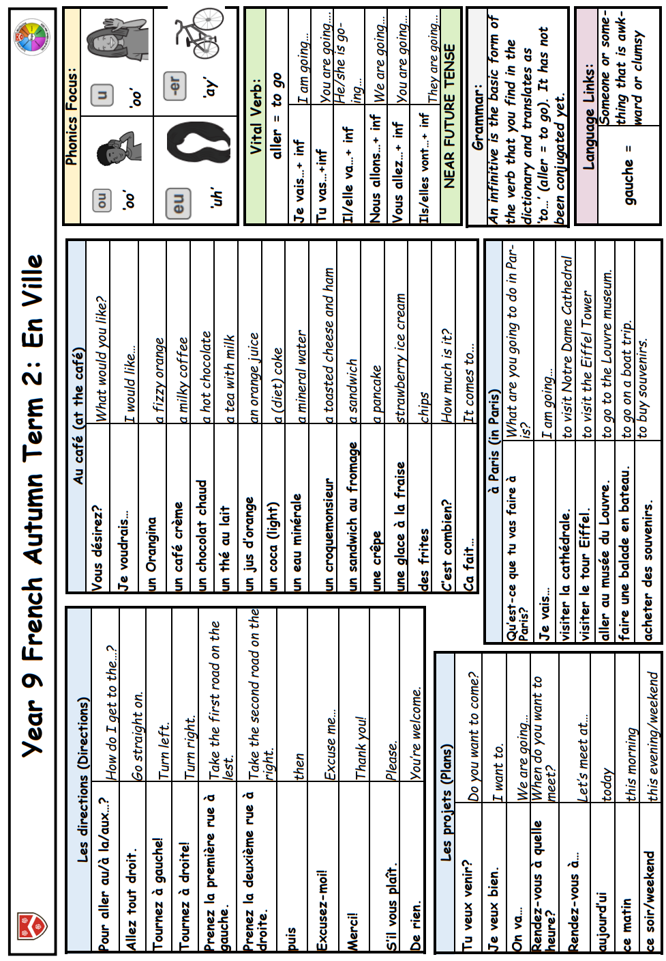

Slide 15
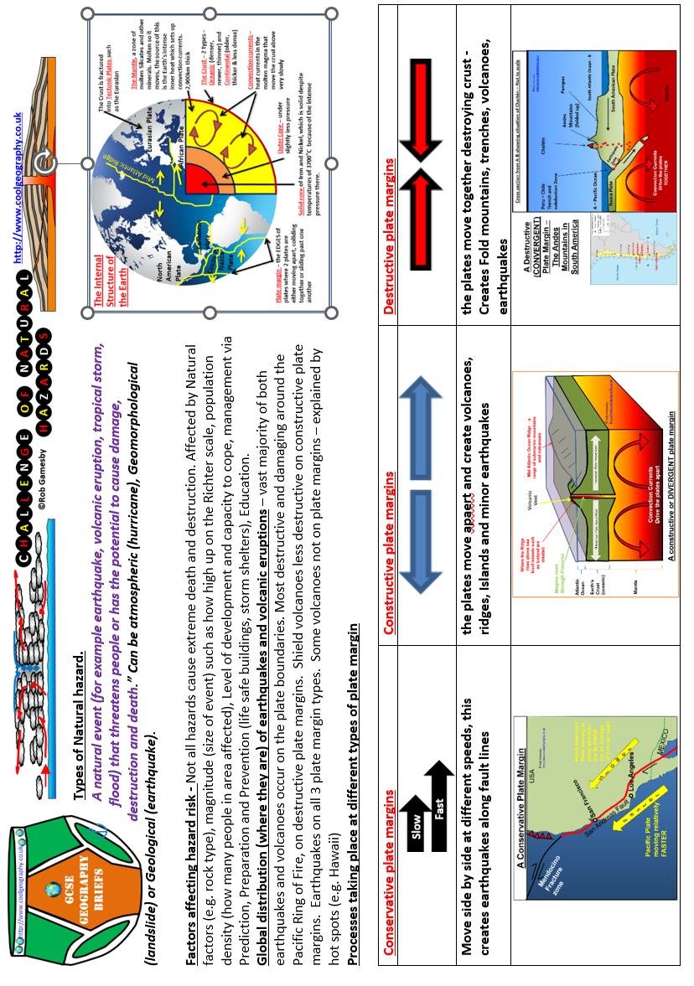
Geography

Slide 16
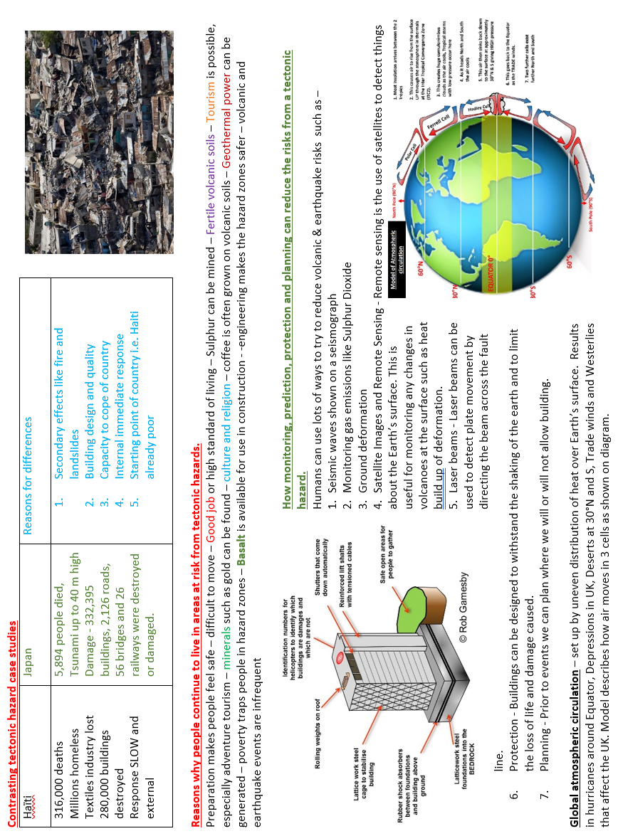
Geography

Slide 17
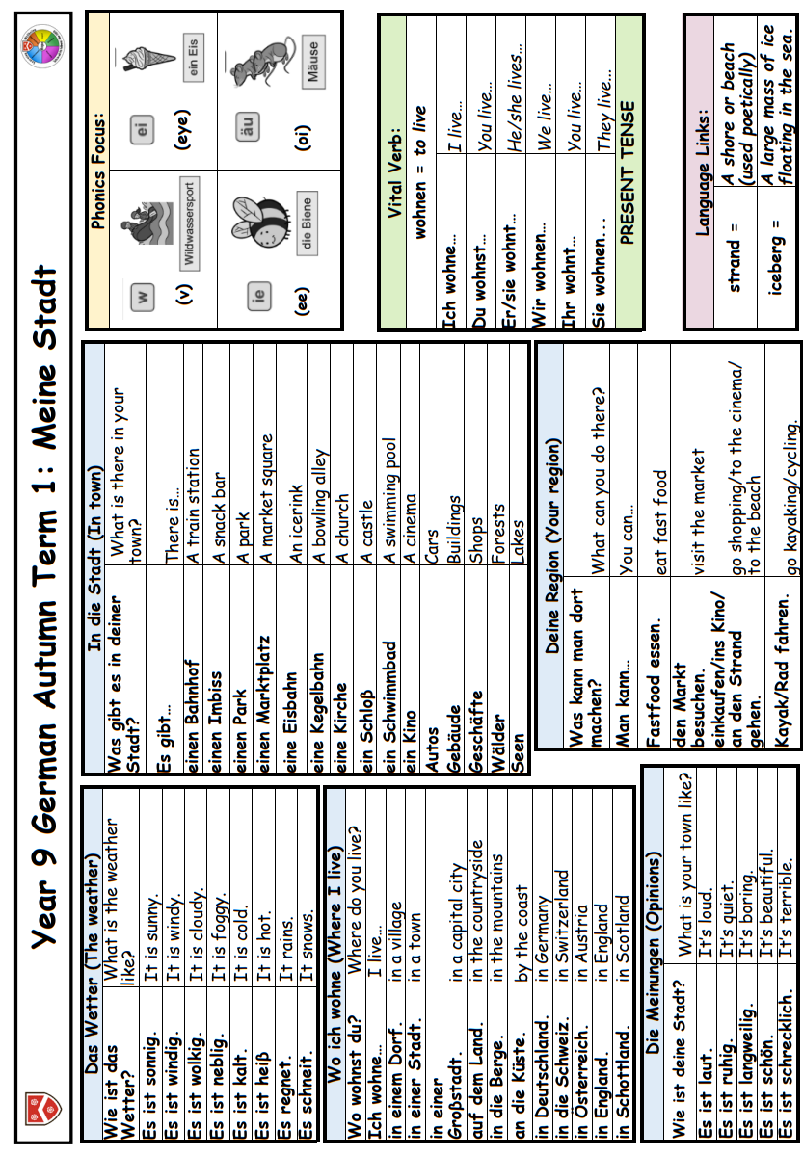

Slide 18
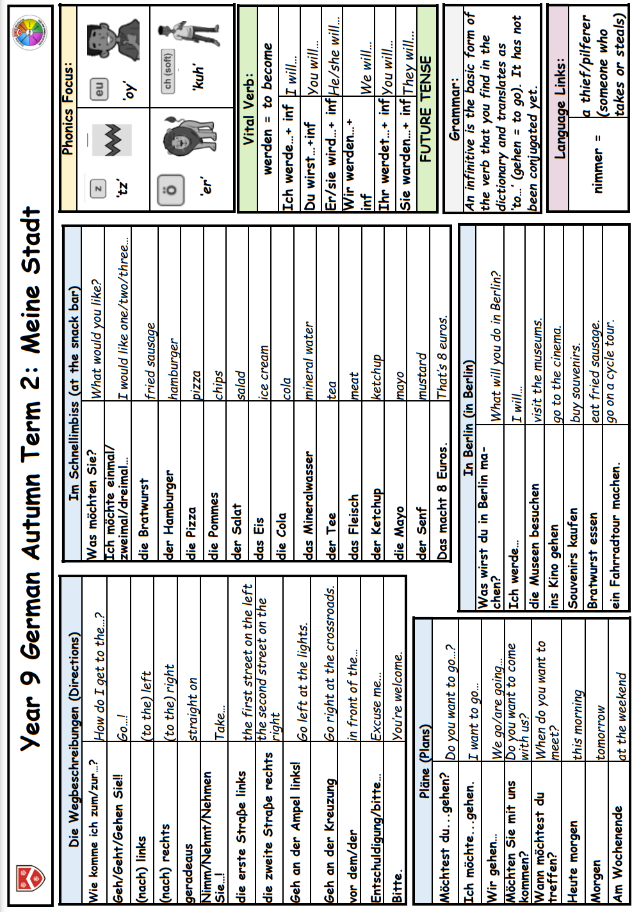

Slide 19
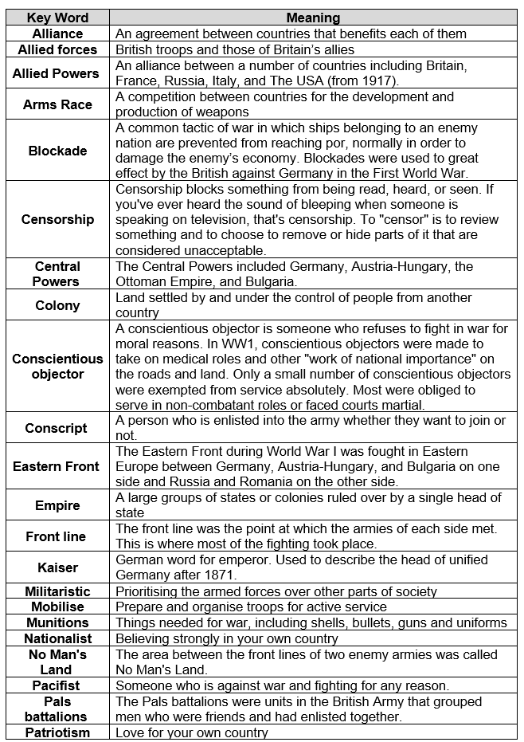
History

Slide 20
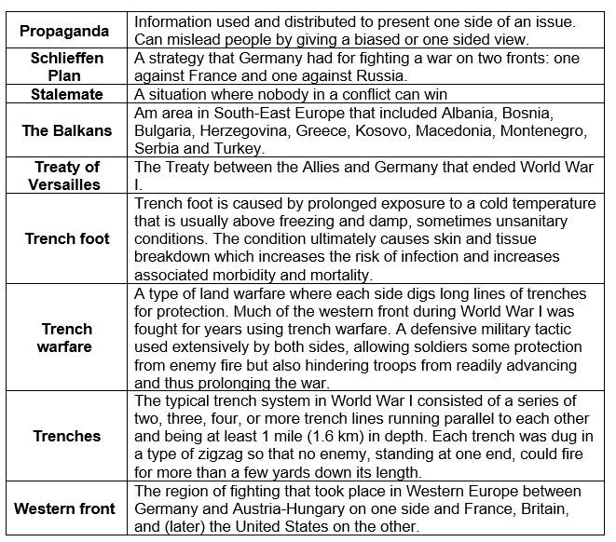
History

Slide 21
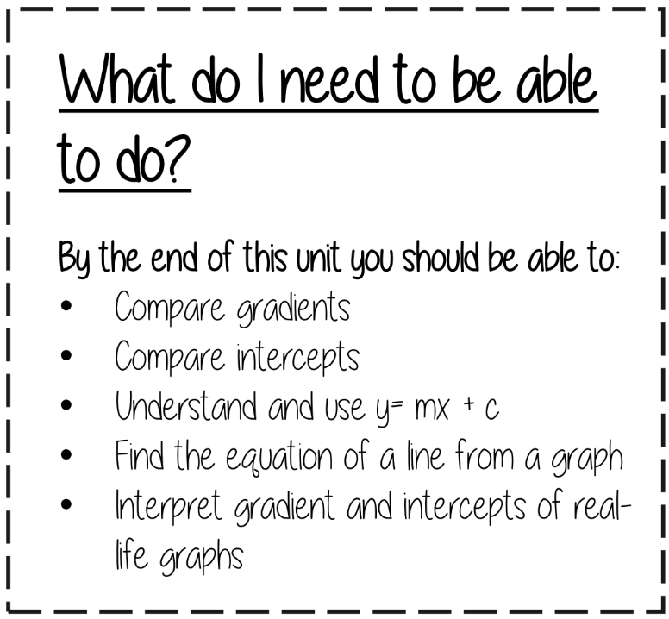

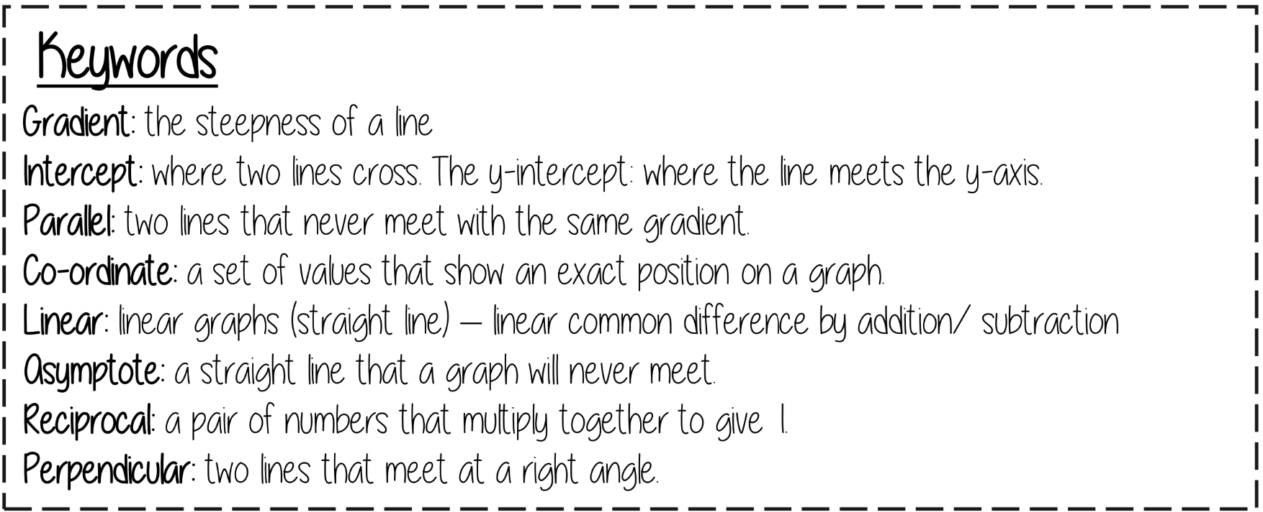
Mathematics
9.1 Straight line graphs…..
Plotting straight lines: M797, U741
Equations of straight lines: U669, U315
Real-life graphs: U638, U862
Additional higher content: U898
Additional higher content: M267, M543

Slide 22
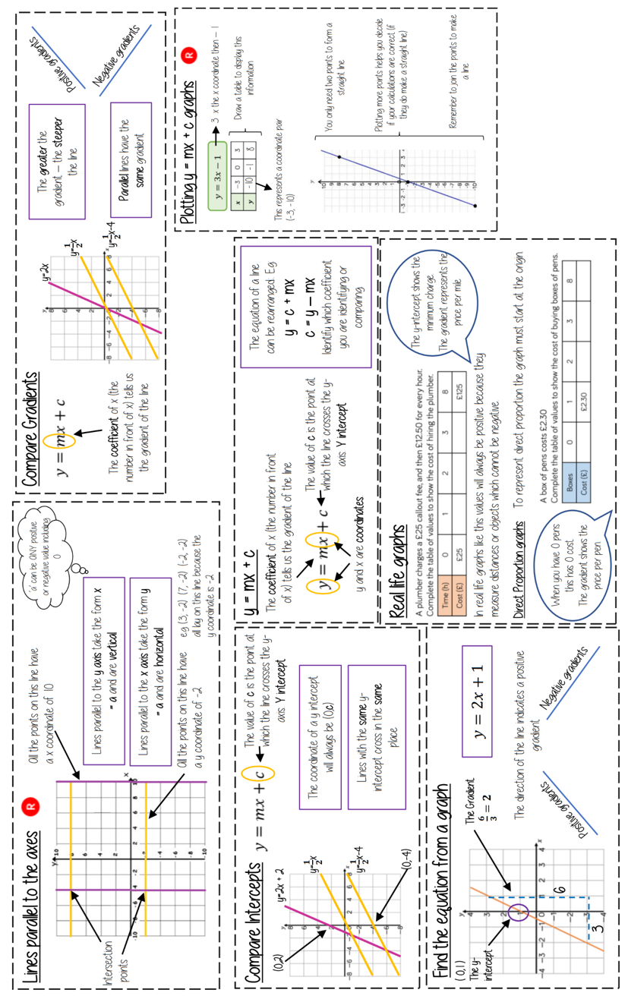
Mathematics

Slide 23
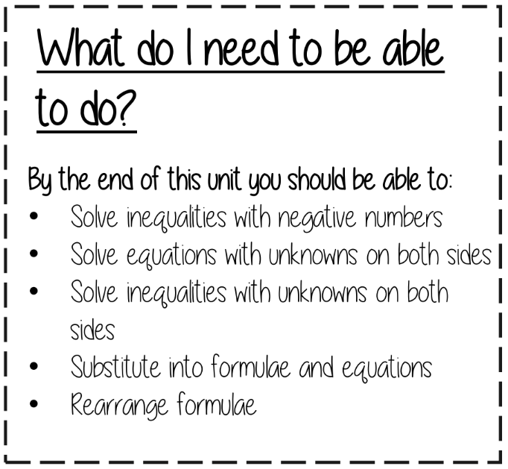
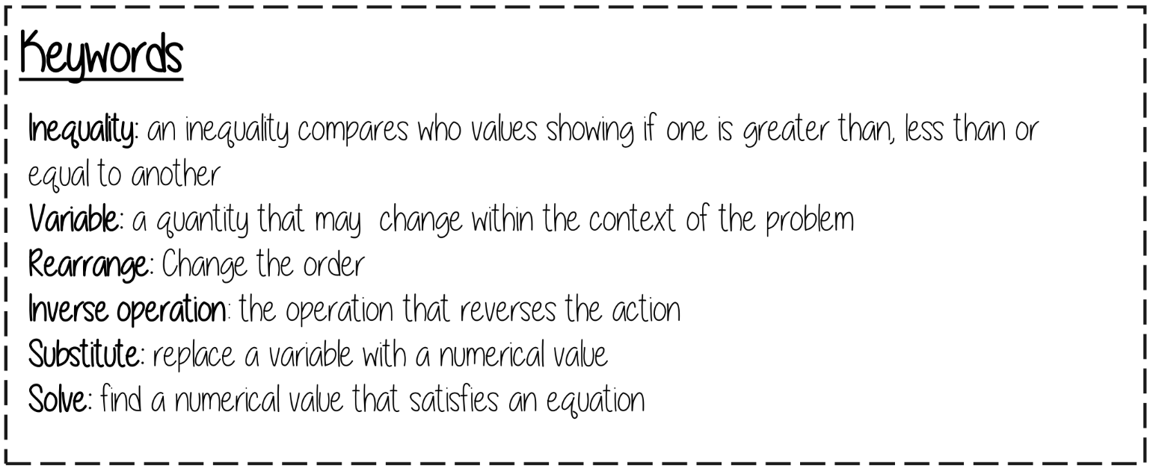
Mathematics
9.2 Forming & solving equations…..
Solving equations one step: U755
Solving equations harder: U325, U870, U599
Solving inequalities: U759, U738, U145, U337
Substituting & changing the subject: U556

Slide 24
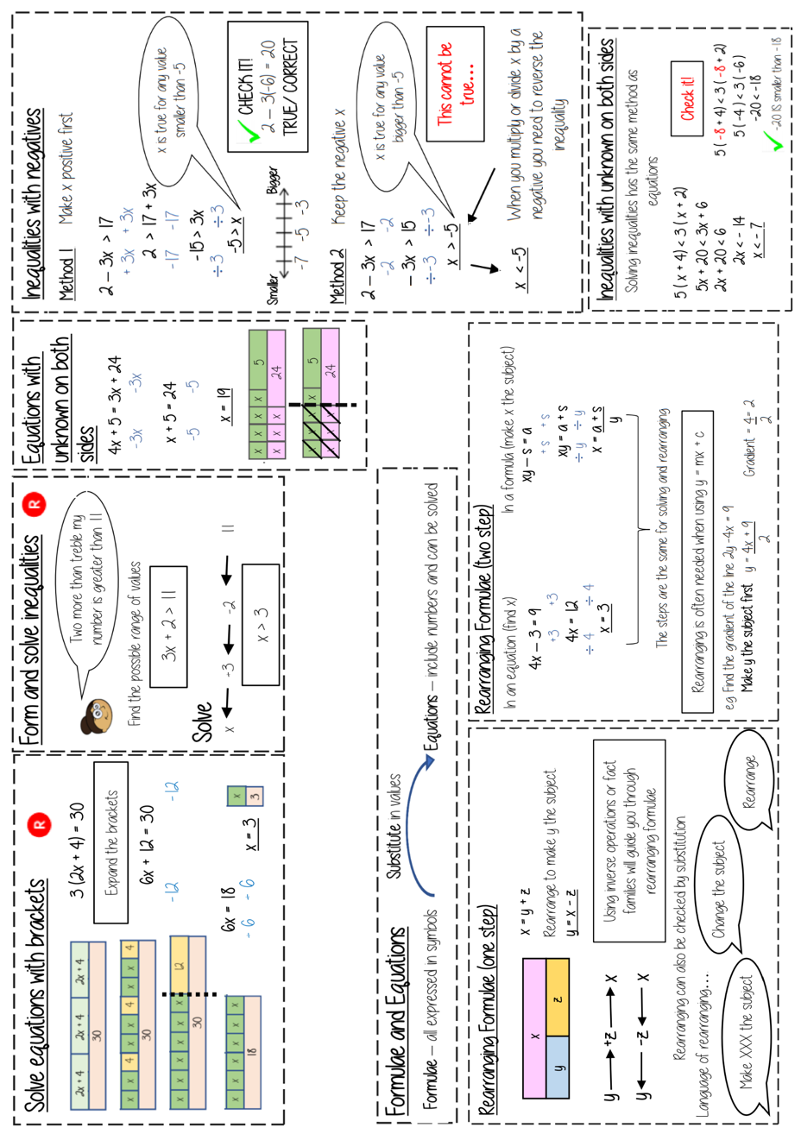
Mathematics

Slide 25
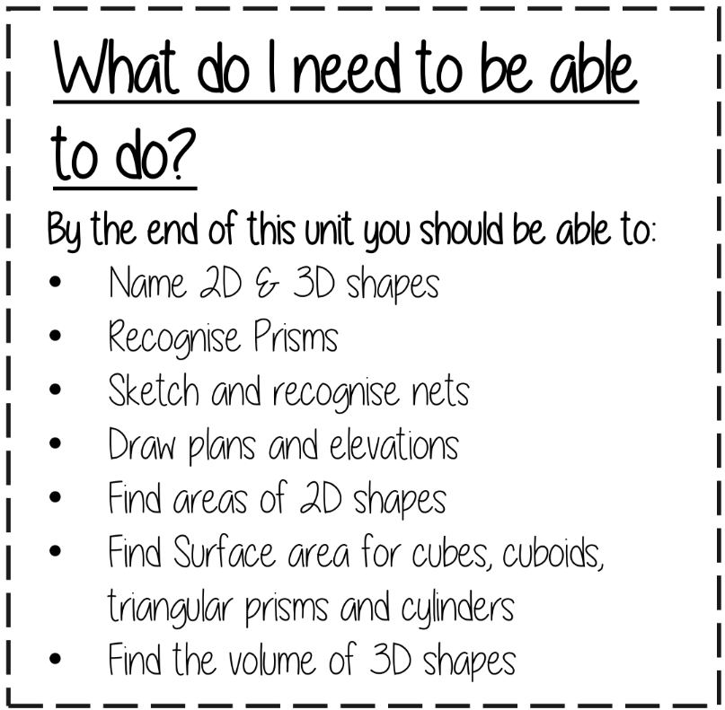
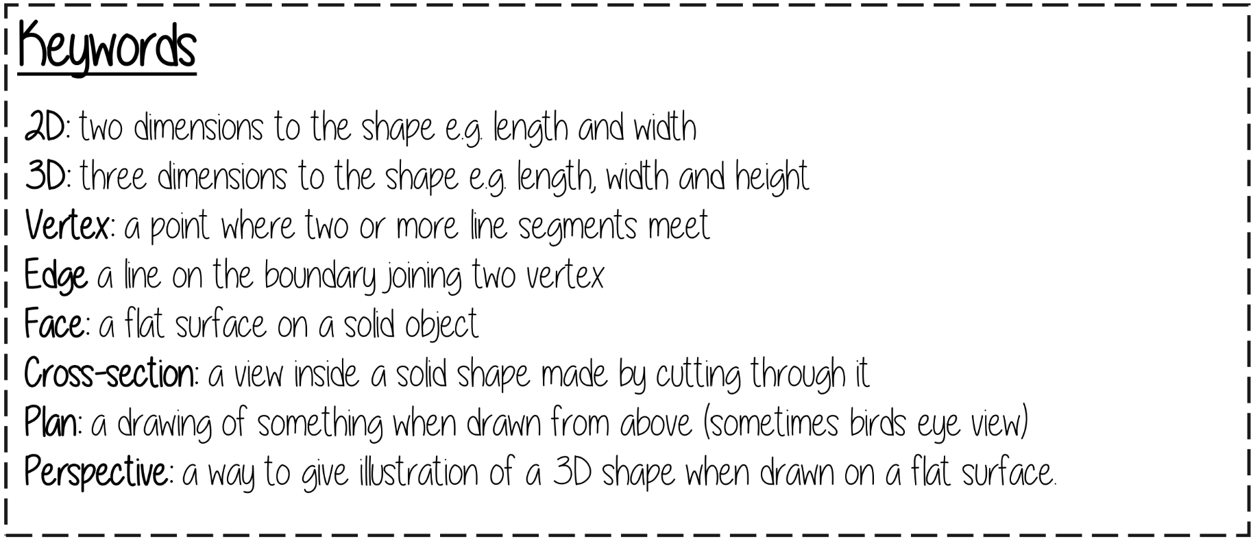
Mathematics
9.4 3D Shapes…..
Properties, nets & plans of 3D shapes: U719, U761, U743
Surface area: U929, U259, U464
Volume: U786, U174, U915
Additional higher content: U484, U116, U617

Slide 26
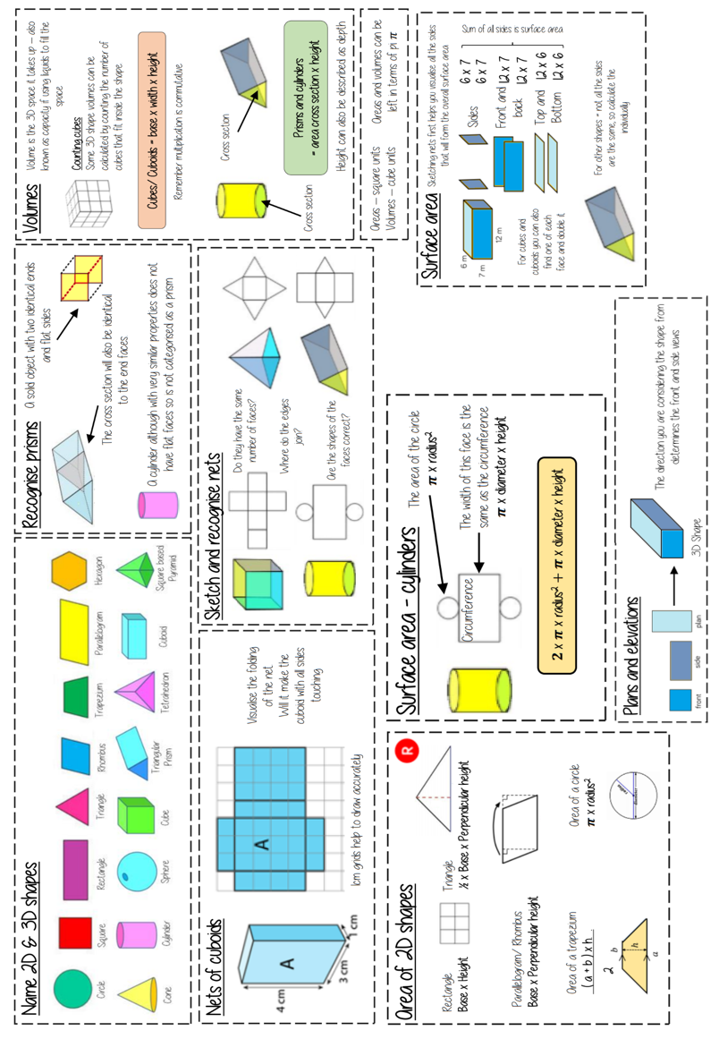
Mathematics

Slide 27
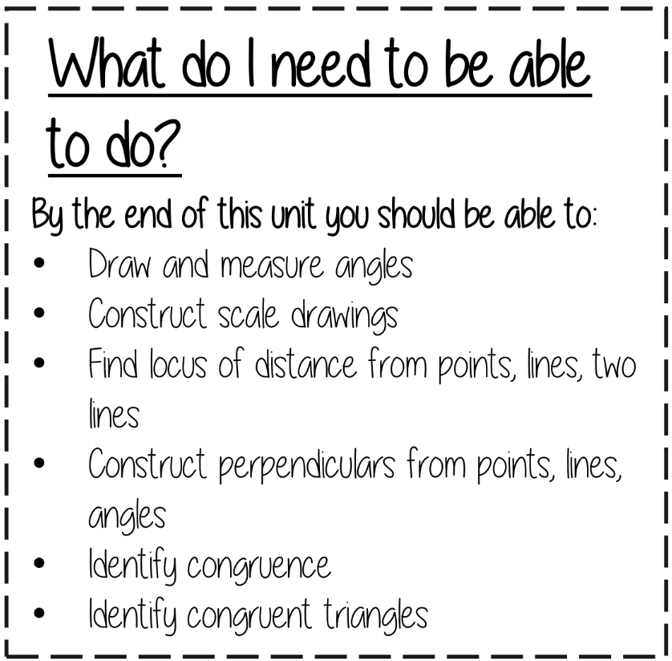
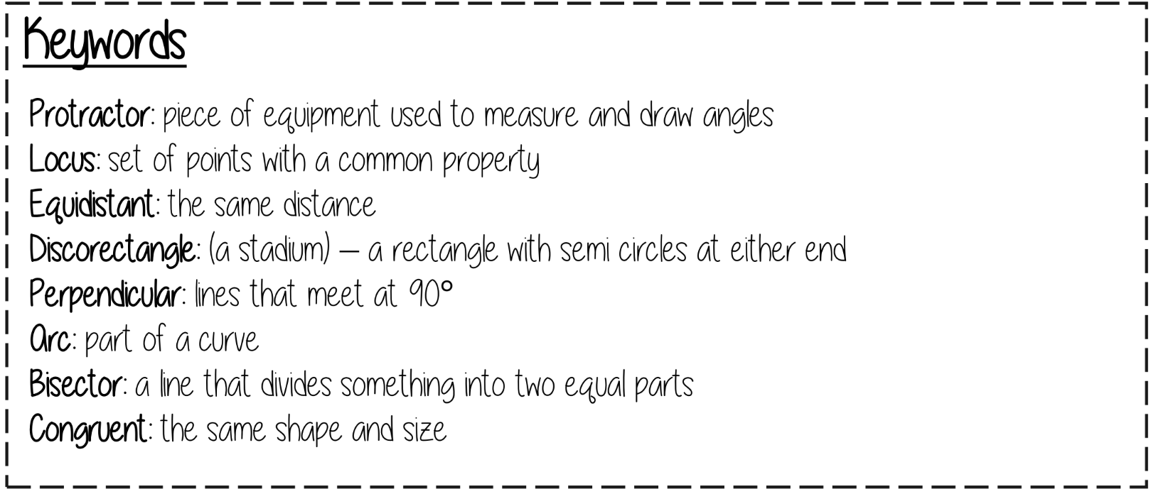
Mathematics
9.5 Constructions & congruency…..
Interpreting scale drawings: U257
Constructions: U678, U187, U787, U245, U979
Congruence: U790, U866
Higher level content: U820

Slide 28
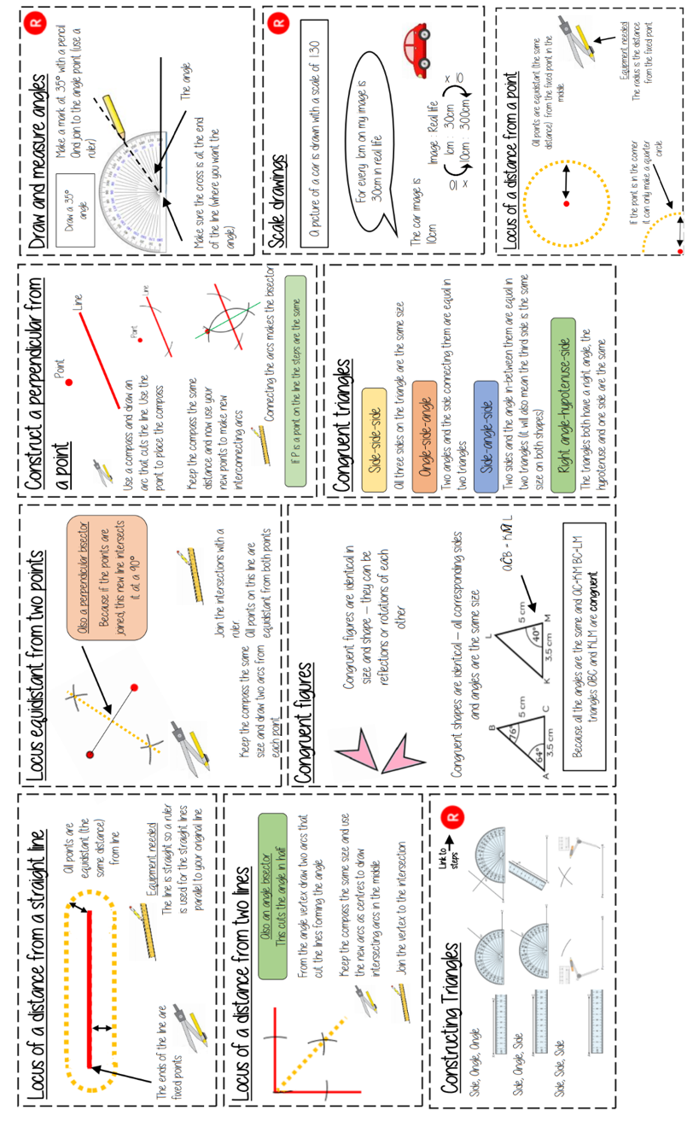
Mathematics

Slide 29
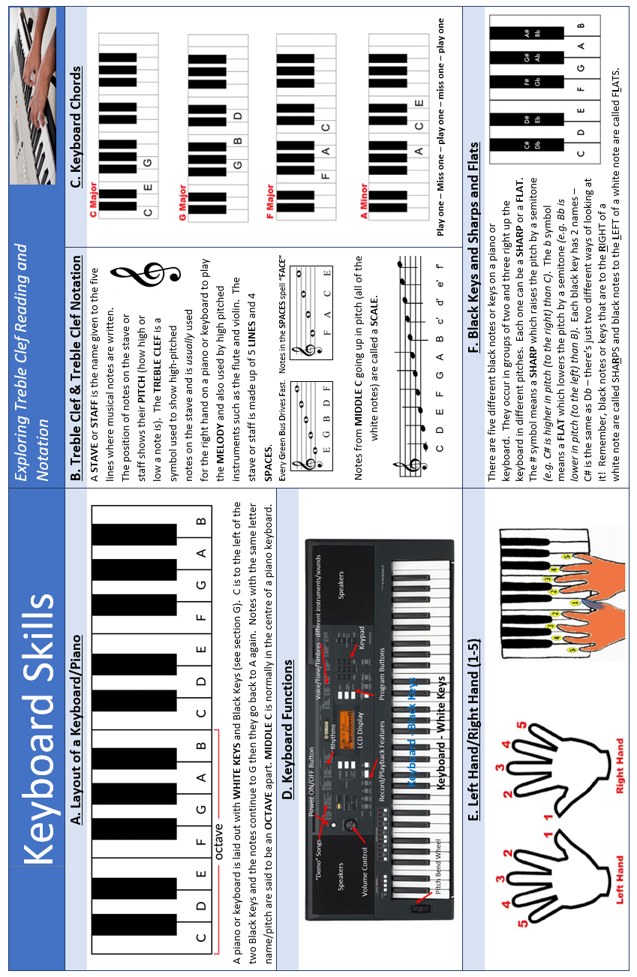
Music

Slide 30
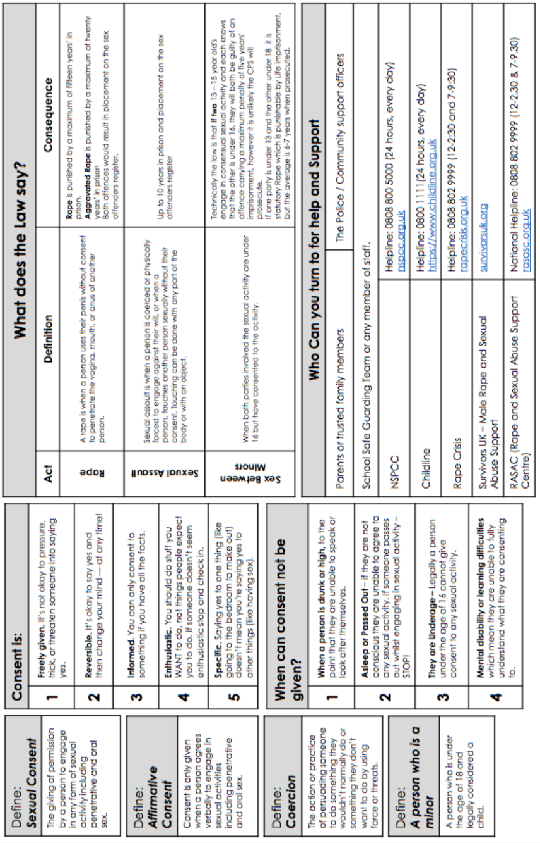
Personal Development

Slide 31
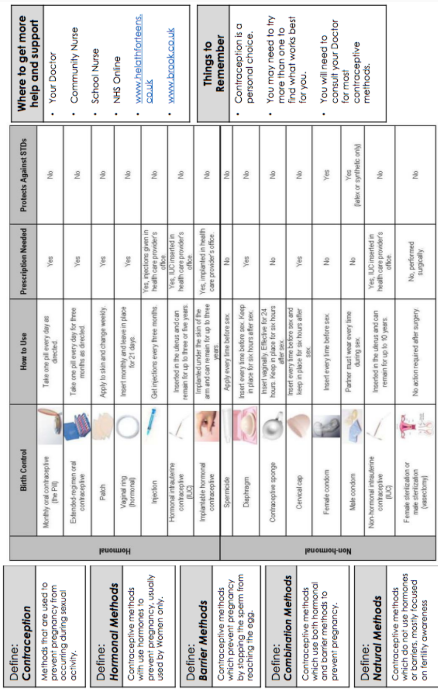
Personal Development

Slide 32
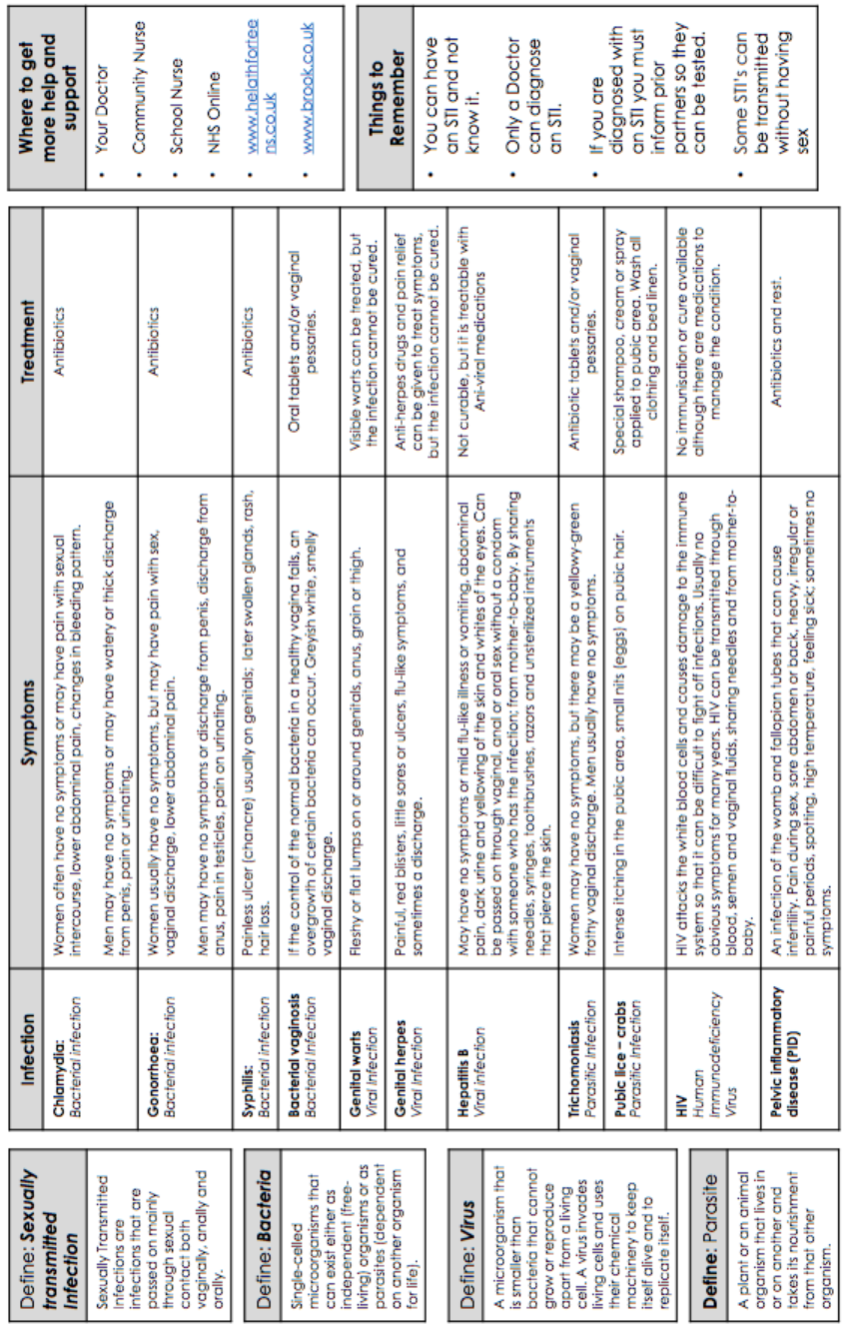
Personal Development

Slide 33
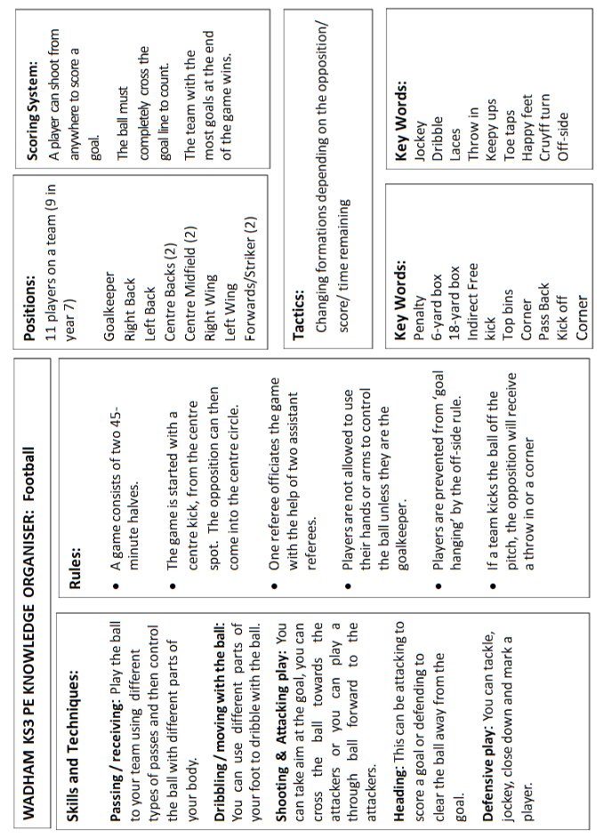
Physical Education

Slide 34
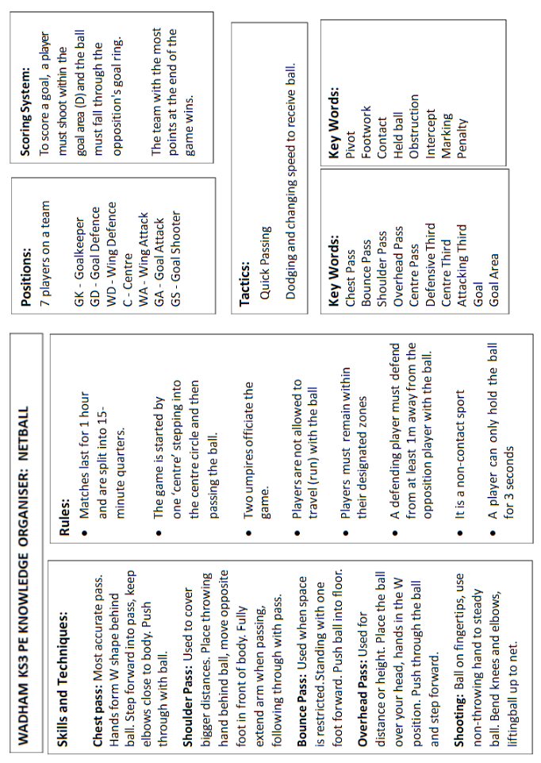
Physical Education

Slide 35
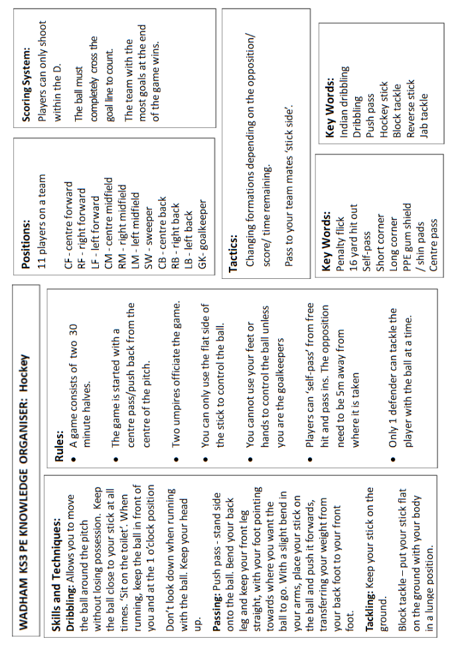
Physical Education

Slide 36
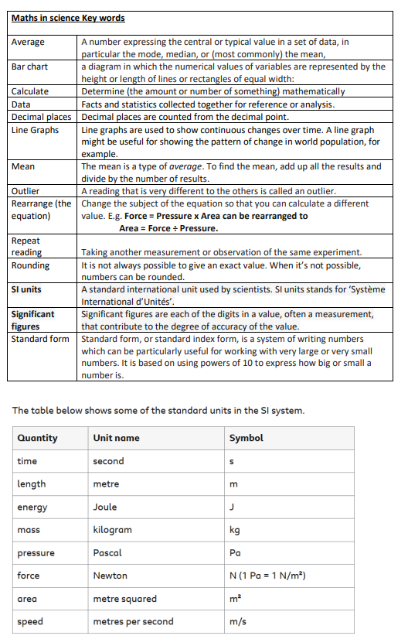
Science

Slide 37
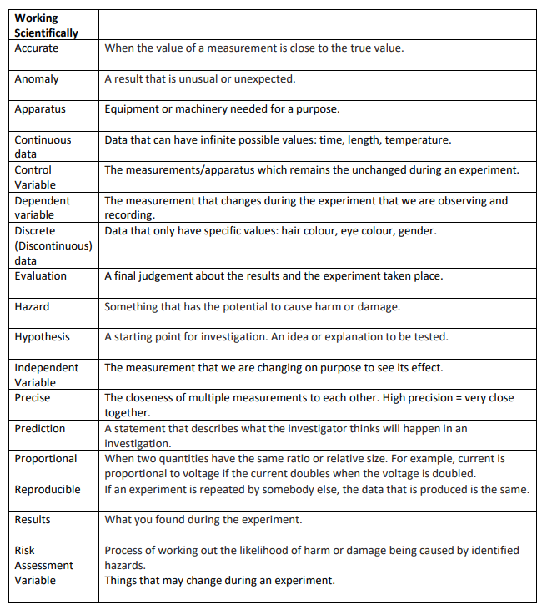
Science

Slide 38
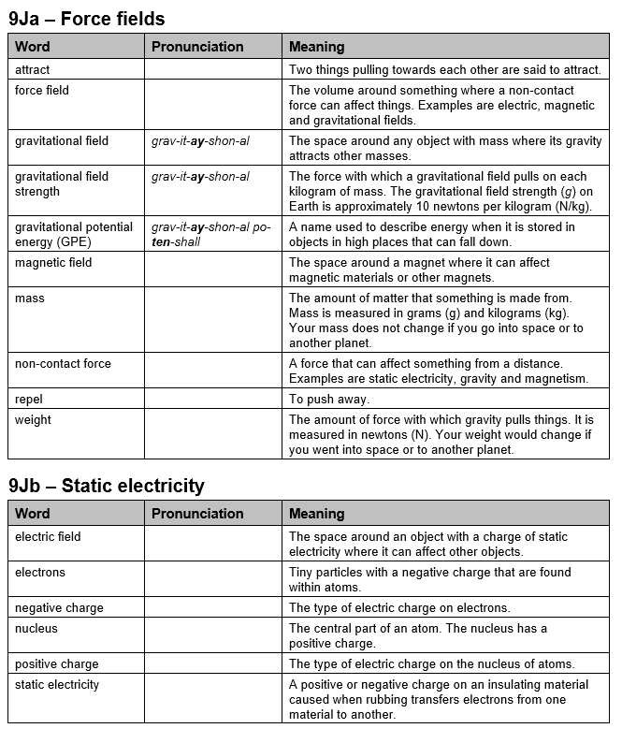
Science

Slide 39
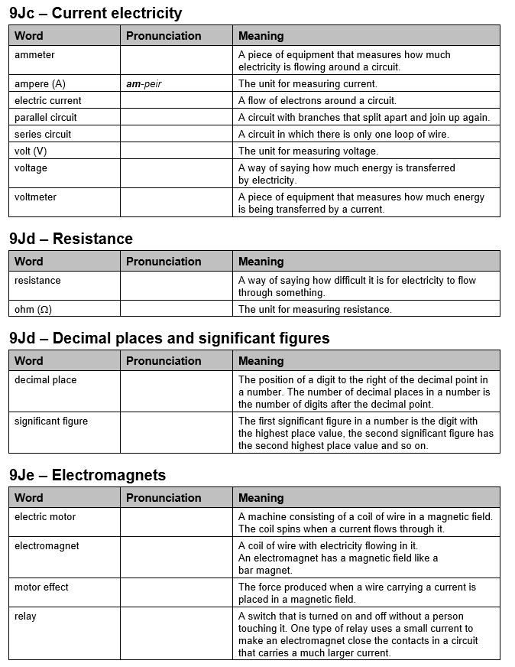
Science

Slide 40
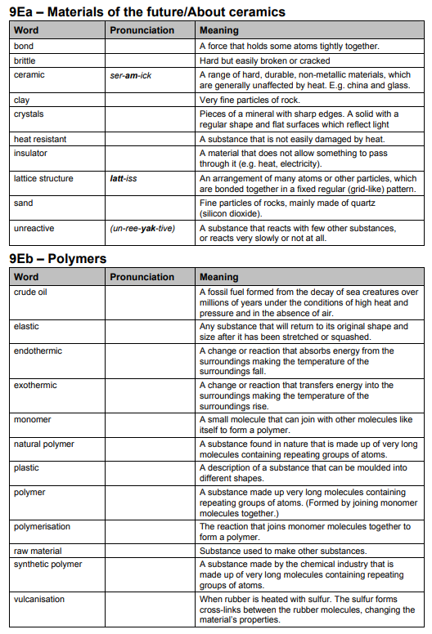
Science

Slide 41
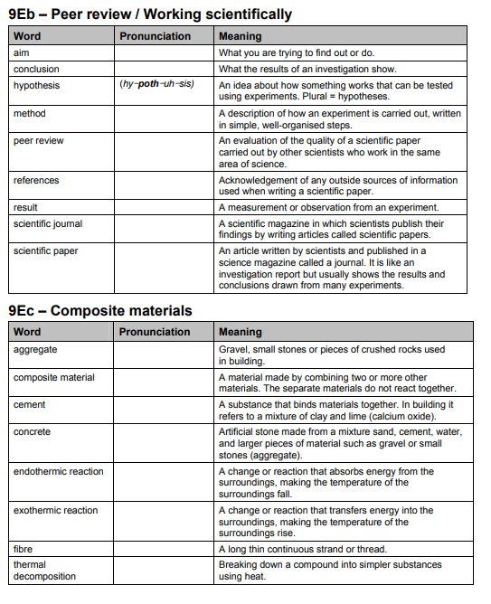
Science

Slide 42
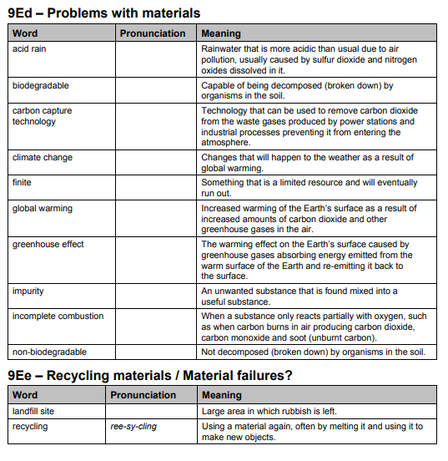
Science

Slide 43
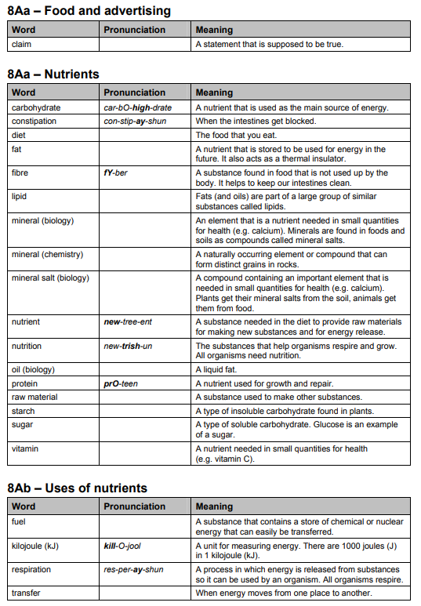
Science

Slide 44
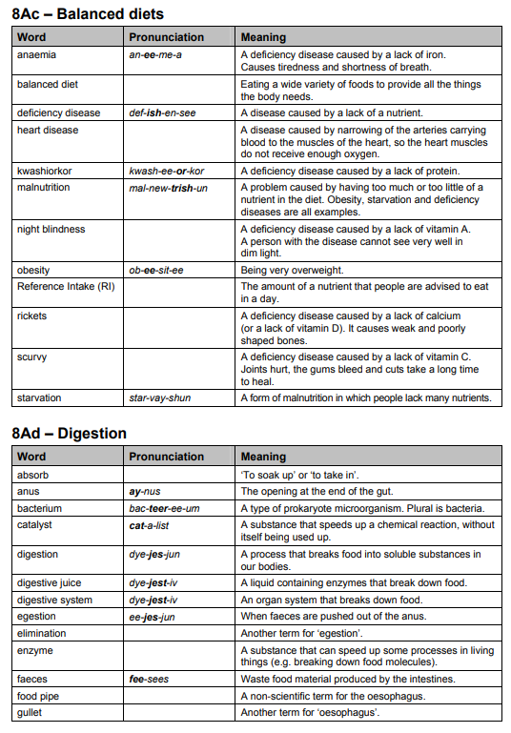
Science

Slide 45
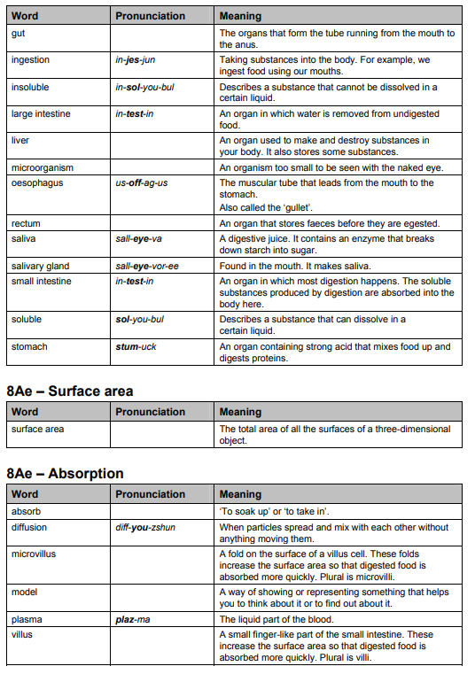
Science

Slide 46
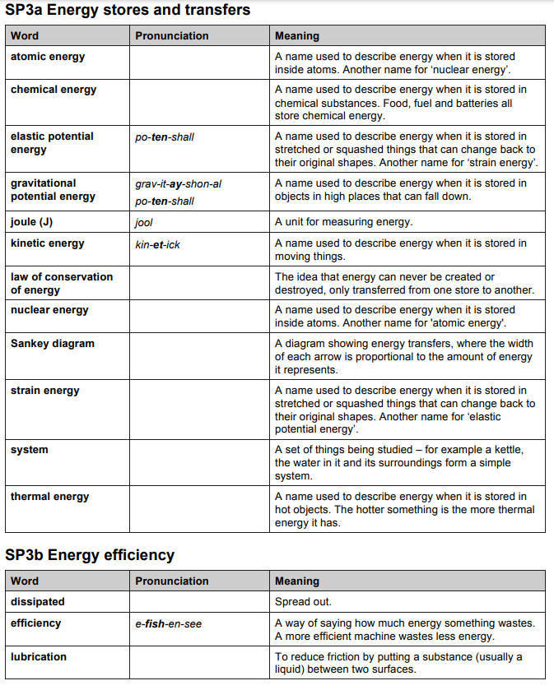
Science

Slide 47
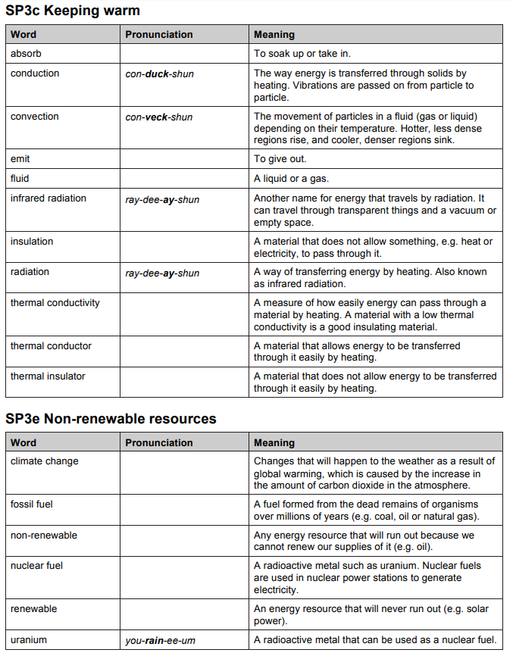
Science

Slide 48
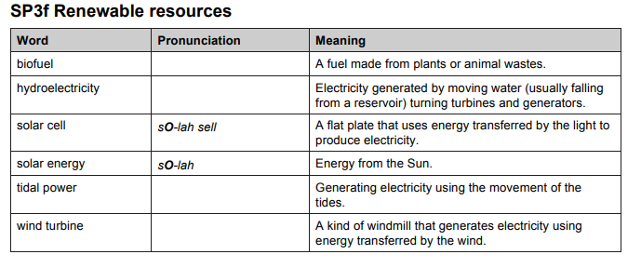
Science

