Slide 1




Wadham School
A Church of England Community School
Knowledge Organisers
Year 8
Term 1 & 2
2024-2025
Name.............................................................
Tutor group..............................
“Life in all its fullness” John 10:10

Slide 2


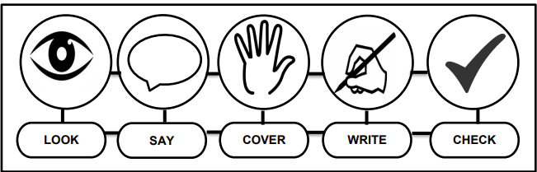


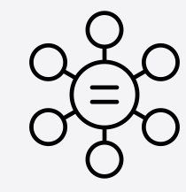
Using Your Knowledge Organiser
Look-Say-Cover-Write-Check
Retrieval practice using the look-say-cover-write-check technique, when done in regular small chunks, is one of the best ways you can learn relevant knowledge over time.
Working in Independent mode:
Look at the first bullet point or sentence
Read through it three to five times
Cover
Write it out exactly
Remove and check what you wrote and tick if correct
Repeat
When you get it 100% right, move on to the next chunk of information
Flash Cards Make flast cards with the definition on one side and key word on the other. | Self Quizing Write quizzes with answers to test yourself in the future. | Mind maps Create mindmaps linking key inforamtion you need to remember.

Slide 3
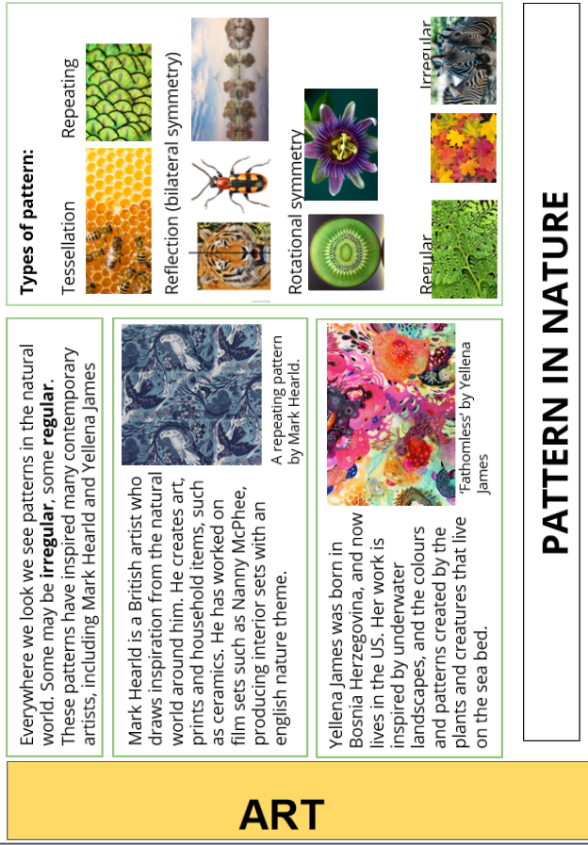
Art

Slide 4
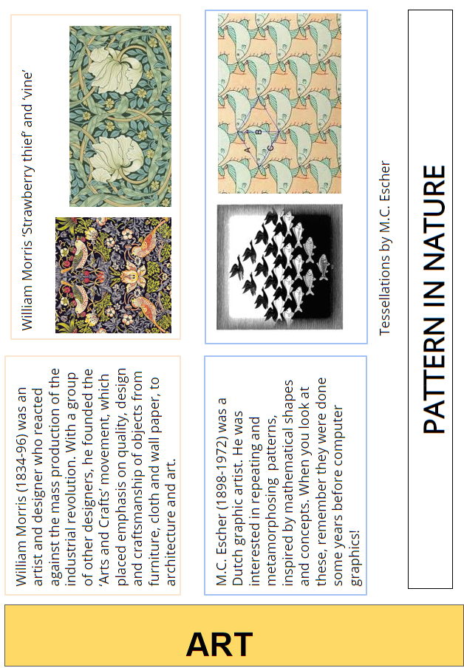
Art

Slide 5


Year 8 Design and Technology
Keyword | Core Knowledge
Architecture | Architecture is the art and technique of designing and building. It is both the process and the product of sketching, planning, designing and constructing buildings or other structures.
The Musuem of Tomorrow, Rio De Janeiro | The Museum of Tomorrow (Portuguese: Museu do Amanhã) is a science museum in the city of Rio de Janeiro, Brazil. It was designed by Spanish neofuturistic architect Santiago Calatrava, and built next to the waterfront at Pier Maua.
The Pixel Building, Melbourne | Located on a key urban site at the former CUB Brewery, Pixel is one of Melbourne and Australia's most significant and ambitious projects. The most publicly visible element is Pixel's colourful facade. A simple but intricate assembly of zero waste, recycled colour panels providing maximised daylight, shade, views and glare control.
Biomimicry | Biomimicry is the design and production of materials, structures and systems that are modelled on biological entities and processes. Sydney Opera House is an example of biomimicry.
Anthropometric Data | The study of the human body, it's measurement and proportions.
Location Research | Researching the area where the product will be located to ensure that it meets local requirements and context.
Primary Market Research | Data that is collected first-hand for a specific purpose.
Design Brief | Is a statement that outlines the expectations of project.
Paper | Measured in grams per square metre (gsm). Common weights range from 60-170gsm
Card and Board | Card weights range from 200gsm – 350gsm. Board is selected by thickness and measured in microns.
Foam Core | An inner foam core with a paper face. Rigid and Stiff. Commonly used for model making and mounting artworks.
Corrugated Card | Two layers of lightweight card containing a fluted layer for strength. Used for impact protection. Fully degradable and recyclable.
Orthographic Drawing | Has 3 main views: a plan view, front and side view. Should be drawn accurately and to a specified scale.
Scale | A drawing of an object will have its real size enlarged or reduced by a certain amount or specified scale. On a drawing the scale is represented as a ratio. For example, 1cm drawn to represent 1m (100cm) would be written as 1:100.

Slide 6
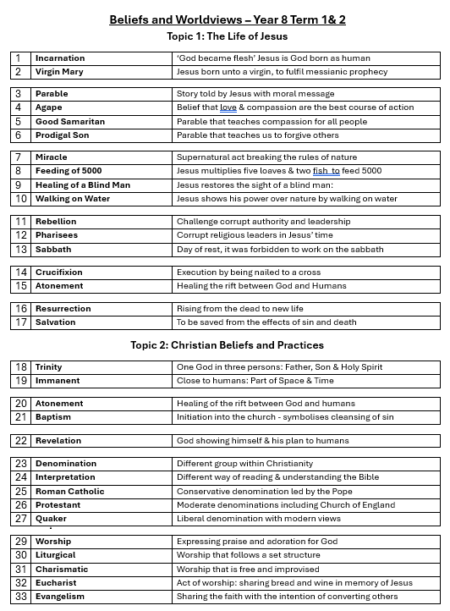
Beliefs and World Views

Slide 7
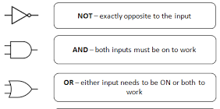
Computing
Computer | An electromechanical device which receives input, processes it and produces and output
Device | A piece of electrical or mechanical equipment made for a particular purpose
Program | A sequence of instructions written in a programming language that a computer can execute or interpret
Software | A set of programs used to operate computers and perform specific tasks
Hardware | The physical components of a computer
Data | Individual facts or statistics
Processor | The part of the computer that interprets and carries out instructions
Main memory | The part of the computer that stores data that is currently being used by the processor
Operating system | Specialised software that communicates with computer hardware to allow other programs to run
Logical operator | The name of a logic circuit (AND, OR, NOT)
Logical expression | A text based method of describing a logic circuit
Truth table | A way of describing the output of a logic circuit for all possible inputs
Logic gate | A physical device which performs a logical operation
Logic circuit | Two or more logic gates connected together to solve a problem or perform a task
Artificial intelligence (AI) | Any machine that performs tasks that typically require intelligence in humans (suggestion - there’s no agreed definition)
Boolean logic

Slide 8
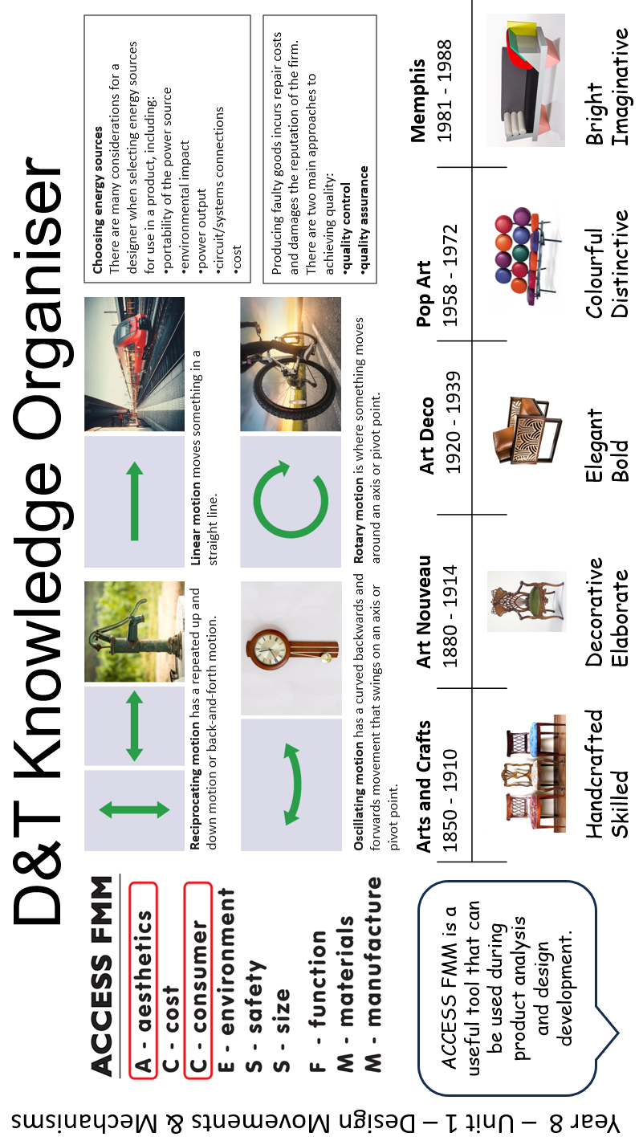
Design and Technology

Slide 9
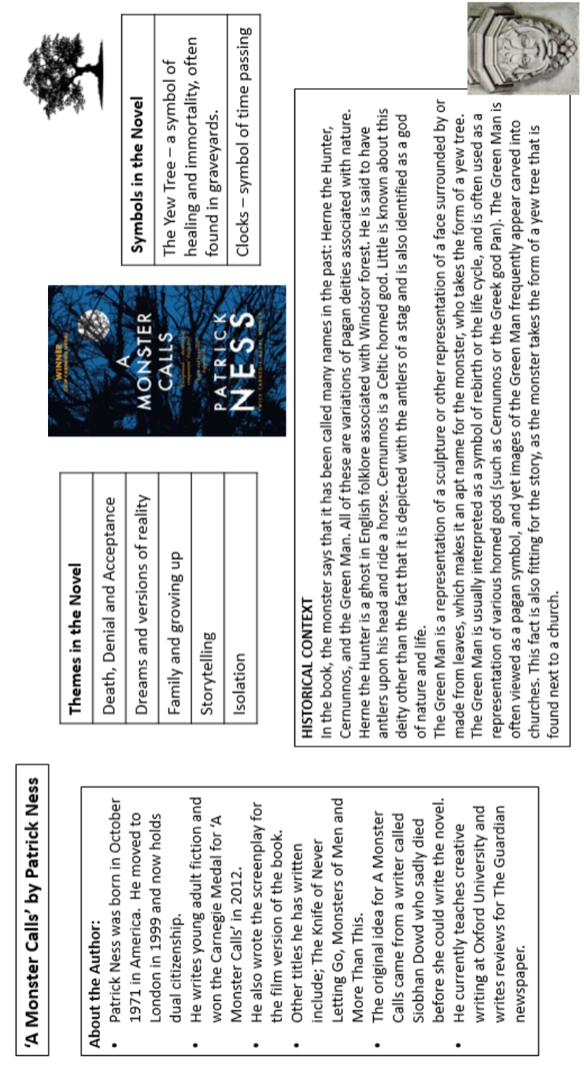
English

Slide 10
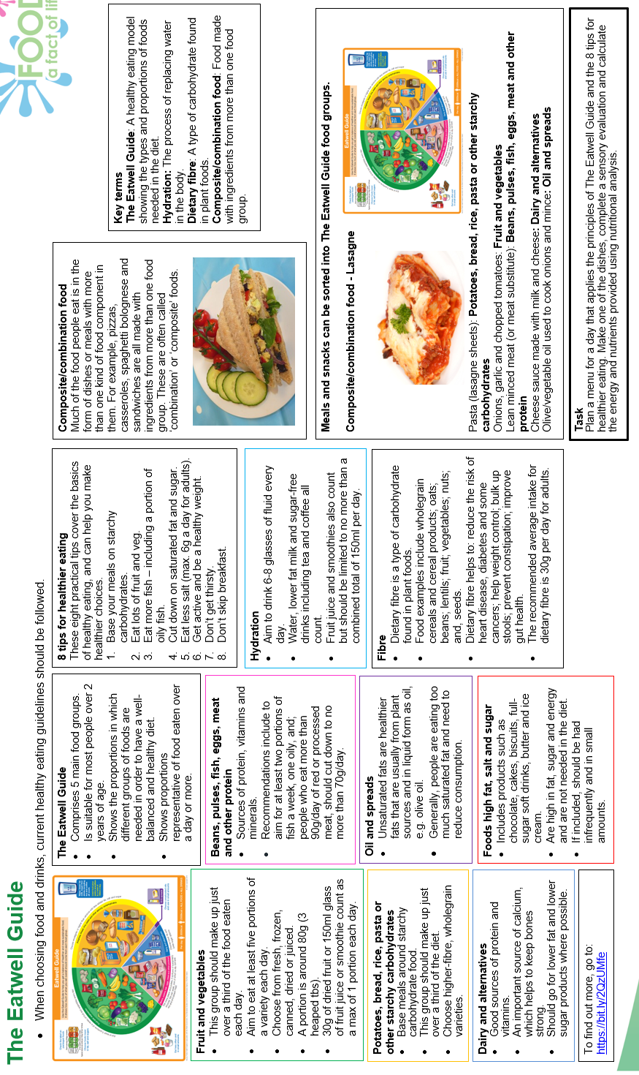
Food

Slide 11
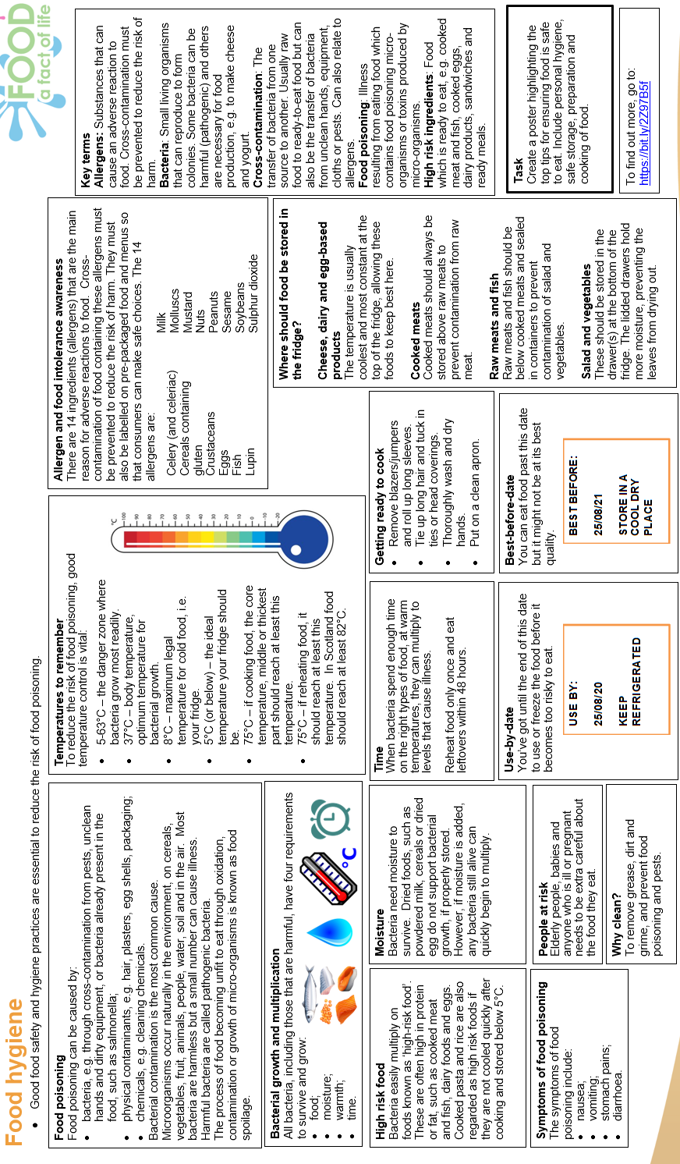
Food

Slide 12
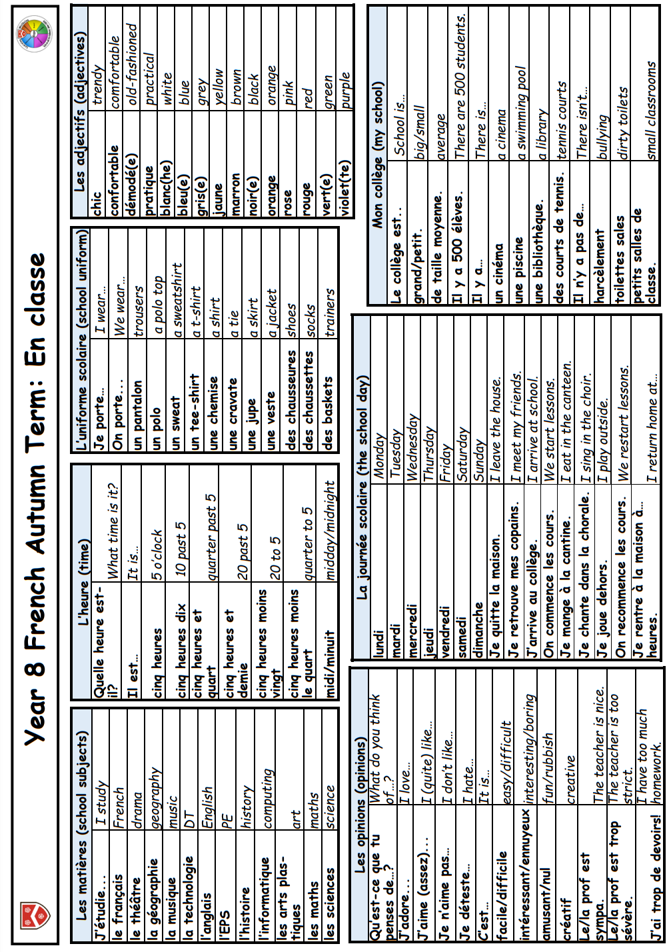
French

Slide 13
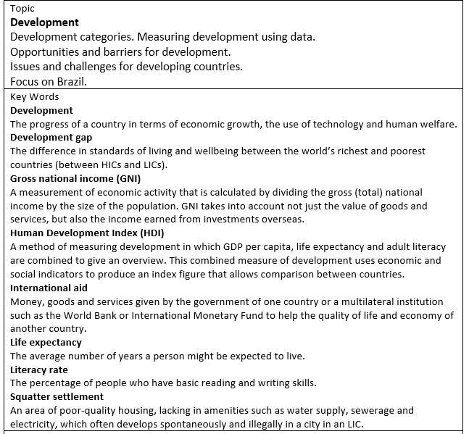
Geography

Slide 14
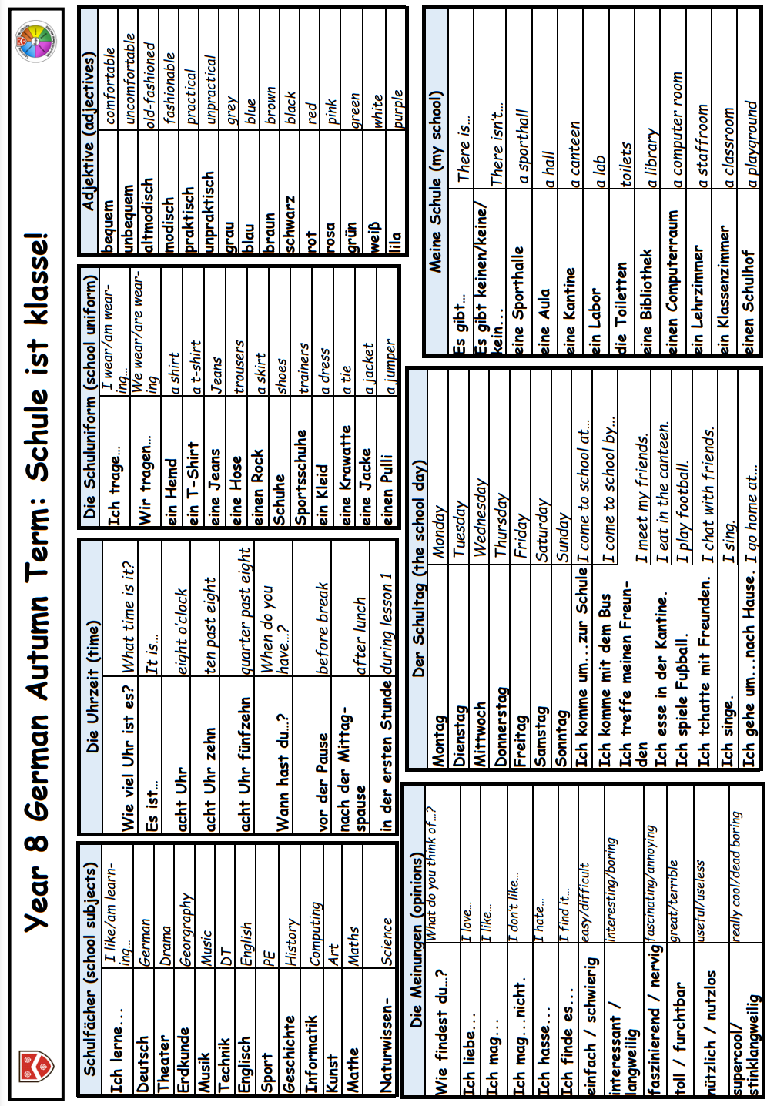
German

Slide 15
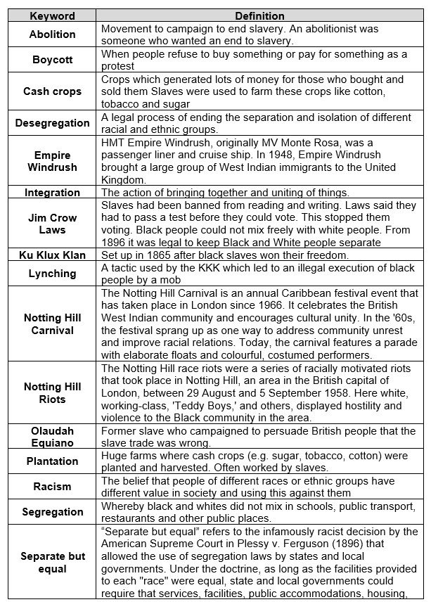
History

Slide 16
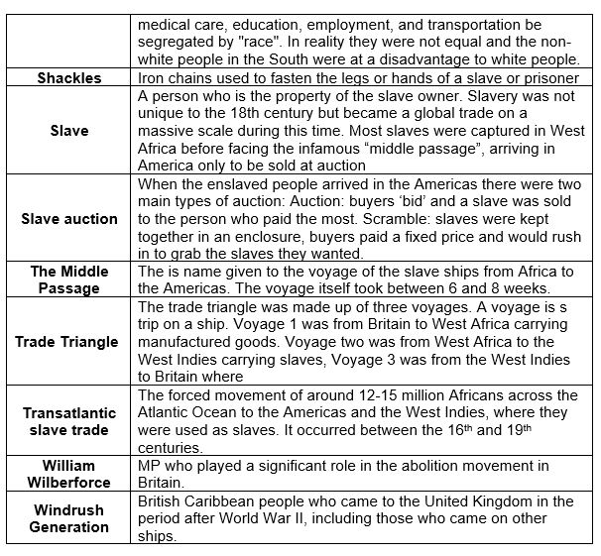
History

Slide 17




Mathematics
Ratio and Scale
Ratio | a statement of how two numbers compare
Equal Parts | all parts in the same proportion, or a whole shared equally
Proportion | a statement that links two ratios
Order | to place a number in a determined sequence
Part | a section of a whole
Equivalent | of equal value
Factors | integers that multiply together to get the original value
Scale | the comparison of something drawn to its actual size.
Representing a ratio
“For every 5 boys there are 3 girls”
Double Number Line
This is the “whole” – boys and girls together
This represents the 5 boys
5:3
This is the “whole” – boys and girls together
This represents the 5 boys
This represents the 3 girls
This represents the 3 girls
Order is Important
Ratio 1:n (or n:1)
“For every dog there are 2 cats”
This is asking you to cancel down until the part indicated represents 1.
Dogs: Cats
1:2
Show the ratio 4:20 in the ratio of 1:n
The question states that this part has to be 1 unit.
Therefore
Divide by 4
4 : 20
This side has to be divided by 4 too – to keep in proportion
The ratio has to be written in the same order as the information is given.
e.g. 2:1 would represent 2 dogs for every 1 cat.
1 : 5
*H* the n part does not have to be an integer for this type of question
Simplifying a ratio
Cancel down the ratio to its lowest form
Find the biggest common factor that goes into all parts of the ratio
For 6 and 4 the biggest factor (number that multiplies into them is 2)
“For every 6 days of rain there are 4 days of sun”
6:4
÷ by 2
rain
sun
3:2
“For every 3 days of rain there are 2 days of sun” – when this happens twice the ratio becomes 6:4.

Slide 18




Mathematics
Units are important:
x10
x100
x1000
x1000
x1000
When using a ratio – all parts should be in the same units
mm cm m km
g kg
÷100
÷1000
ml L
÷10
÷1000
÷1000
Sharing a whole into a given ratio
Finding a value given 1:n (or n:1)
James and Lucy share £350 in the ratio 3:4.
Work out how much each person earns
Inside a box are blue and red pens in the ratio 5:1.
If there are 10 red pens how many blue pens are there?
Model the Question
James
Model the Question
James: Lucy
3 : 4
£350
Blue : Red
5 : 1
Blue pens
Find the value of one part
Lucy
= one part
= 10 pens
One unit
= 10 pens
Whole: £350
7 parts to share between
(3 James, 4 Lucy)
£350 ÷ 7 = £50
Red pens
= one part
= £50
Put back into the question
Put back into the question
Blue : Red
5 : 1
50: 10
Blue pens = 5 x 10 = 50 pens
James: Lucy
3 : 4
£150:£200
James = 3 x £50 = £150
x 10
x 10
x 50
x 50
£350
Red pens = 1 x 10 = 10 pens
Lucy = 4 x £50 = £200
There are 50 Blue Pens
Ratio as a fraction
Trees: Flowers
3 : 7
Trees
Ratio
There are 3 parts for trees
Flowers
Fraction of trees
Number of parts of in group
3
Total number of parts
Fraction
10
Tree parts 3 + Flower parts 7 = 10
Pi ∏
Circumference
Diameter
The ratio of a circles circumference to its diameter

Slide 19

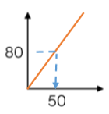
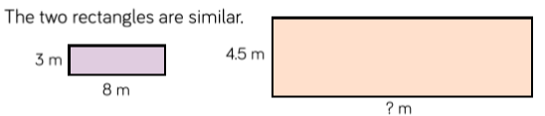
Mathematics
Multiplicative Change
Proportion | a statement that links two ratios
Variable | a part that the value can be changed
Axes | horizontal and vertical lines that a graph is plotted around
Approximation | an estimate for a value
Scale Factor | the multiple that increases/ decreases a shape in size
Currency | the system of money used in a particular country
Conversion | the process of changing one variable to another
Scale | the comparison of something drawn to its actual size.
Direct Proportion
As one variable changes the other changes at the same rate.
This is a multiplicative change
4 cans of pop = £2.40
4 cans of pop = £2.40
x 3
12 cans of pop = £7.20
x 0.5
4 cans of pop = £2.40
x 3
x 0.5
Sometimes this is easiest if you work out how much one unit is worth first
e.g. 1 can of pop = £0.60
2 cans of pop = £1.20
This multiplier is the same
In the same way that this would be for ratio
Conversion Graphs
Compare two variables
kilometres
This is always a straight line because as one variable increases so does the other at the same rate
To make conversions between units you need to find the point to compare – then find the associated point by using your graph.
Using a ruler helps for accuracy
Showing your conversion lines help as a “check” for solutions
Labelling of both axes is vital
miles
Ratio between similar shapes
Angles in similar shapes do not change.
e.g. if a triangle gets bigger the angles can not go above 180⁰
Corresponding sides
3m : 4.5m
Note
Simplify to the
same ratio
÷ 3
x 8
8m : 12m
÷ 3
x 8
1 m : 1.5 m
1 m : 1.5 m

Slide 20



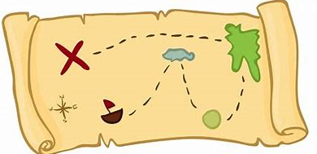
Mathematics
Understand Scale Factor
Draw and interpret scale diagrams
A picture of a car is drawn with a scale of 1:30
3 x 1.5 = 4.5
For every 1cm on my image is 30cm in real life
This is a multiplicative change
Missing length
8 x 1.5 = 12m
Use corresponding sides to calculate a scale factor
The car image is 10cm
Scale factor can also be calculated by:
x 10
Image : Real life
1cm : 30cm
10cm : 300cm
Bigger corresponding side
x 10
Smaller corresponding side
x SF
Big corresponding side
The car in real life is 210cm
Small corresponding side
Image : Real life
1cm : 30cm
7cm : 210 cm
x 7
x 7
÷ SF
Interpret maps with scale factors
÷ 10
÷ 100
÷ 1000
mm cm m km
x 10
x 100
x 1000
Ratios need to be in the same units
1 cm : 250m
250 x 100 = 25000
1 cm : 25000cm
For every 1cm on my map is 25000cm in real life.

Slide 21

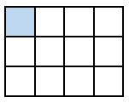










Mathematics
Multiplying and Dividing Fractions
Numerator | the number above the line on a fraction. The top number. Represents how many parts are taken
Denominator | the number below the line on a fraction. The number represent the total number of parts..
Whole | a positive number including zero without any decimal or fractional parts.
Commutative | an operation is commutative if changing the order does not change the result.
Unit Fraction | a fraction where the numerator is one and denominator a positive integer.
Non-unit Fraction | a fraction where the numerator is larger than one.
Dividend | the amount you want to divide up.
Divisor | the number that divides another number.
Quotient | the answer after we divide one number by another. e.g. dividend÷ divisor = quotient
Reciprocal | a pair of numbers that multiply together to give 1
Representing a fraction
Multiplying unit fractions
Numerator
Denominator
Parts shaded
Number of parts represented
Numerator
1
1
x
1
=
4
12
3
3
5
Modelled:
Number of parts to make up the whole Denominator
3
Total number of parts in the diagram
ALL PARTS of a fraction are of equal size
4
Repeated addition = multiplication by an integer
2
2
2
2
2
4 x
+
+
+
8
Revisit
When adding fractions with the same denominator
= add the numerators
5
5
5
5
5
5
How many parts are shaded?
Integer
(Whole number)
What each part represents
=
Each part represents
1
5

Slide 22



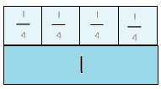
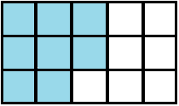












Mathematics
Multiplying non-unit fractions
Shade in 3 parts
Repeat it on this many rows
3
6
x
2
=
12
Parts shaded
4
3
Modelled:
3
Total number of parts in the diagram
This many columns
This many rows
4
Quick Multiplying and Cancelling down
The reciprocal
When you multiply a number by its reciprocal the answer is always 1
The 3 and the 9 have a common factor and can be simplified
Reciprocals for division
e.g
1
4
The reciprocal of 3 is and vice versa
3
x
1
5
9
3
3
x
=
1
=
4
20
x
1
5
Quick Solving
Multiply the numerators
Multiply the denominators
4
3
3
1 x 4
=
1
1
1
Multiplying by a reciprocal gives the same outcome
5 x 3
15
+
+
=
1
3
3
3
Dividing an integer by an unit
fraction
Dividing any fractions
Remember to use reciprocals
“There are 4 quarters in 1 whole.
Therefore, there are 20 quarters in 5 wholes”
÷
3
2
Multiplying by a reciprocal gives the same outcome
5
4
÷
2
4
1
x
1
=
4
5
3
4
How many quarters are in 1?
÷
1
Represented
8
5
=
20
=
4
15

Slide 23
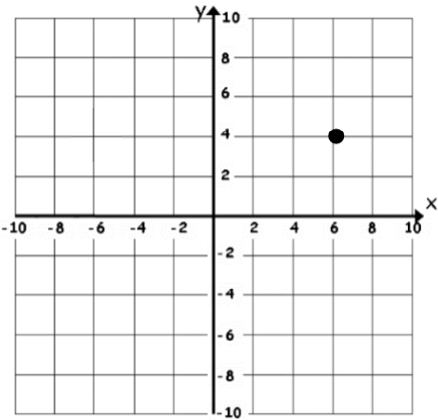
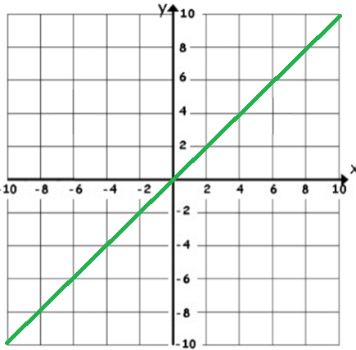
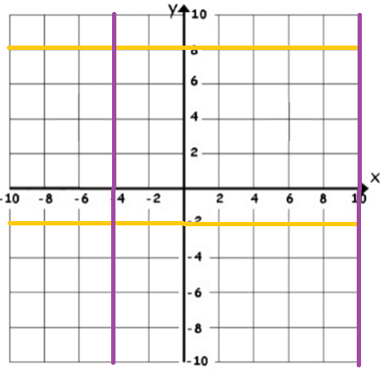
Mathematics
Working in the Cartesian plane
Quadrant | four quarters of the coordinate plane.
Coordinate | a set of values that show an exact position.
Horizontal | a straight line from left to right (parallel to the x axis) `
Vertical | a straight line from top to bottom (parallel to the y axis)
Origin | (0,0) on a graph. The point the two axes cross
Parallel | Lines that never meet
Gradient | The steepness of a line
Intercept | Where lines cross
Coordinates in four quadrants
Recognise and use the line y=x
y-axis
Coordinate (x, y)
(6, 4)
From the origin this coordinate is 6 places along the positive x axis and 4 places up the positive y axis.
x-axis
This means the x and the y coordinate have the same value
Always the position on the x axis first
Always the position on the y axis second
(x, y)
Examples of coordinates on this line: (0, 0) (-3, -3) (8, 8)
(a, 0)
Will be always be a point on the x axis. (a can be any number)
The axes scale is important – if the scale is the same y = x will be a straight line at 45⁰
(0, a)
Will be always be a point on the y axis. (a can be any number)
Lines parallel to the axes
All the points on this line have a x coordinate of 10
‘a’ can be ANY positive or negative value including 0
Lines parallel to the y axis take the form x = a and are vertical
Intersection
points
Lines parallel to the x axis take the form y = a and are horizontal
e.g. (3, -2) (7, -2) (-2, -2)
all lay on this line because the
y coordinate is -2
All the points on this line have a y coordinate of -2

Slide 24
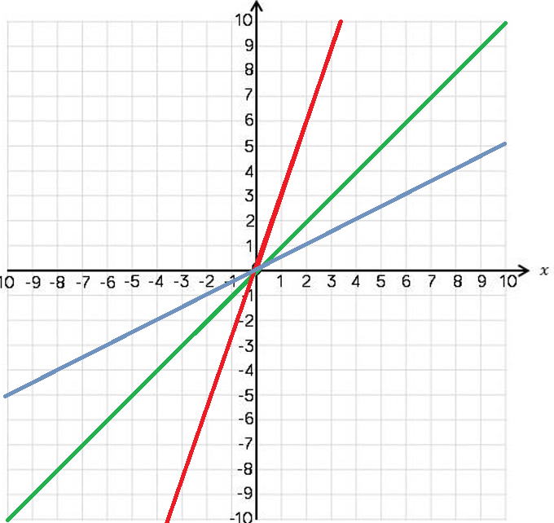
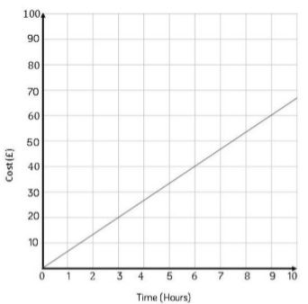
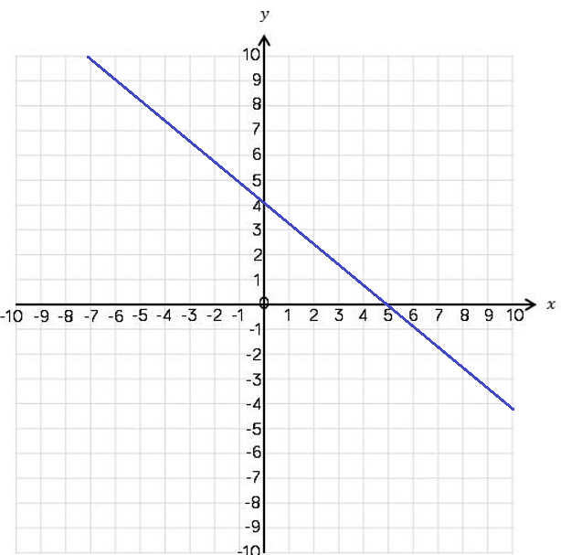
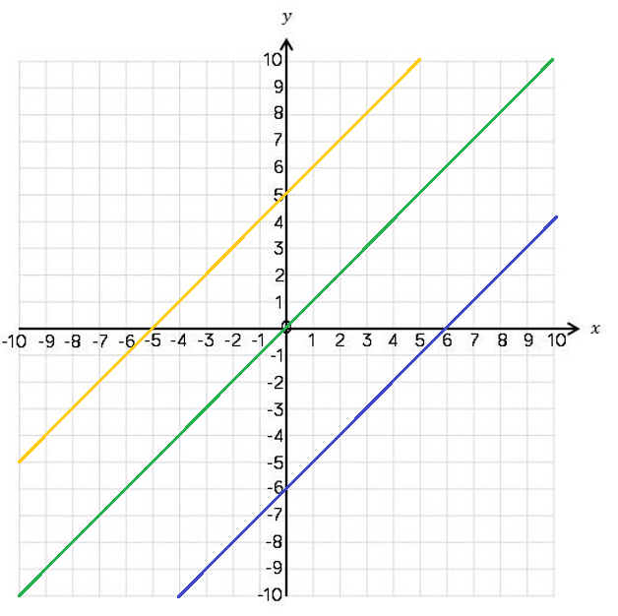
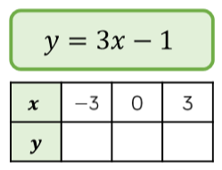
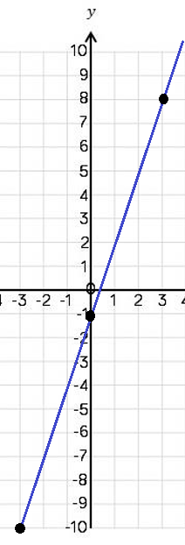
Mathematics
Recognise and use the lines y=kx
y = 3x
The value of k changes the steepness of the line
y = x
Note: y =x is the same asy=1x
y = ½ x
The bigger the value of k the steeper the line will be.
The closer to 0 the value of k the closer the line will be to the x axis.
They will always go through (0,0)
Direct Proportion ysing y=kx
Lines with negative gradients
The line must be straight to be directly proportional – variables increase at the same rate k
Any straight-line graph with a negative x value has a negative gradient.
E.g. y = -2x
y = -x y + x = 12
Direct proportion graphs always start at (0,0) as they are describing relationships between two variables
Direction of all negative gradients
Lines in the form y = x + a
Plotting y = mx + c graphs
3 x the x coordinate then – 1
y = x
Draw a table to display this information
y = x + 5
All the lines are parallel because the gradients are the same
-10
-1
8
This represents a coordinate pair
(-3, -10)
y = x - 6
y = x + a
You only need two points to form a straight line
This is the line y=x when the y and x coordinate are the same
This shows the translation of that line.
e.g. y = x + 5
Is the line y=x moved 5 places up the graph
Plotting more points helps you decide if your calculations are correct (if they do make a straight line)
5 has been added to each of the x coordinates
Remember to join the points to make a line

Slide 25
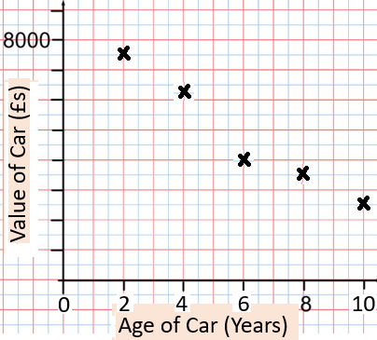
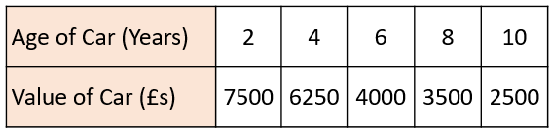
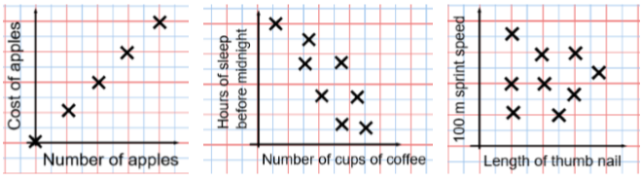
Mathematics
Representing Data
Variable | a quantity that may change within the context of the problem.
Relationship | the link between two variables (items). E.g. Between sunny days and ice cream sales
Correlation | the mathematical definition for the type of relationship..
Origin | where two axes meet on a graph.
Line of best fit | a straight line on a graph that represents the data on a scatter graph.
Outlier | a point that lies outside the trend of graph.
Quantitative | numerical data
Qualitative. | descriptive information, colours, genders, names, emotions etc
Continuous | quantitative data that has an infinite number of possible values within its range
Discrete | quantitative or qualitative data that only takes certain values.
Frequency | the number of times a particular data value occurs.
Draw and interpret a scatter graph.
……………………………………..
All axes should be labelled
This data may not be given in size order
The data forms information pairs for the scatter graph
Not all data has a relationship
The link between the data can be explained verbally
“This scatter graph show as the age of a car increases the value decreases”
The axis should fit all the values on and be equally spread out
Linear Correlation
Positive Correlation
Negative Correlation
No Correlation
As one variable increases so does the other variable
As one variable increases the other variable decreases
There is no relationship between the two variables

Slide 26
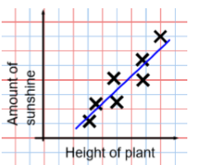
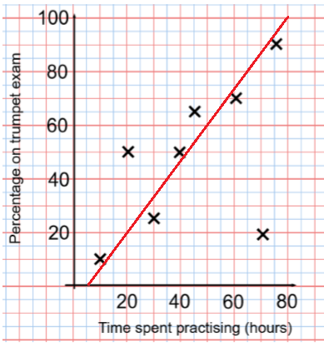
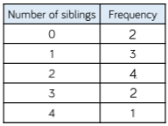
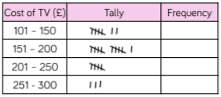
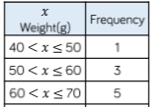
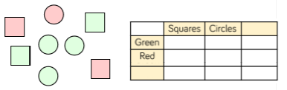
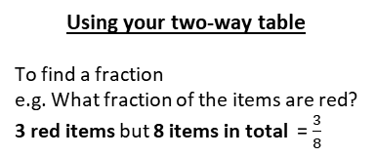
Mathematics
The line of best fit
The Line of best fit is used to make estimates about the information in your scatter graph
Things to know:
The line of best fit DOES NOT need to go through the origin (The point the axes cross)
There should be approximately the same number of points above and below the line (It may not go through any points)
The line extends across the whole graph
It is only an estimate because the line is designed to be an average representation of the data
It is always a straight line.
Using a line of best fit
Extrapolation is where we use our line of best fit to predict information outside of our data.
**This is not always useful – in this example you cannot score more that 100%. So revising for longer can not be estimated**
Interpolation is using the line of best fit to estimate values inside our data point.
e.g. 40 hours revising predicts a percentage of 45.
This point is an “outlier”
It is an outlier because it doesn’t fit this model and stands apart from the data
Ungrouped Data
The table shows the number of siblings students have. The answers were
3, 1, 2, 2, 0, 3, 4, 1, 1, 2, 0, 2
Grouped Data
The number of times an event happened
If we have a large spread of data it is better to group it. This is so it is easier to look for a trend. Form groups of equal size to make comparison more valid and spread the groups out from the smallest to the largest value.
2 people have 3 siblings so there are 6 siblings in total
Discrete Data
The groups do not overlap
7
11
5
3
2 people had 0 siblings. This means there are 0 siblings to be counted here
We do not know the exact value of each item in a group – so an estimate would be bused to calculate the overall total (Midpoint)
Best represented by discrete data. (Not always a number)
OVERALL there are
0 + 3 + 8 + 6 + 4
Siblings = 21 siblings
Continuous Data
To make sure all values are included inequalities represent the subgroups
e.g. this group includes every weight bigger that 60Kg, up to and including 70Kg.
Representing data in two-way tables
Two-way tables represent discrete information in a visual way that allows you to make conclusions, find probability or find totals of sub groups
There are 2 green squares
There are 5 green shapes
Using your two-way table
To find a fraction
e.g. What fraction of the items are red? 3 red items but 8 items in total = $\frac{3}{8}$
2
3
Total
5
There are 8 items in total
Total
2
1
3
4
4
8

Slide 27


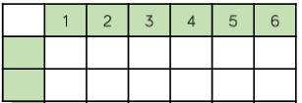
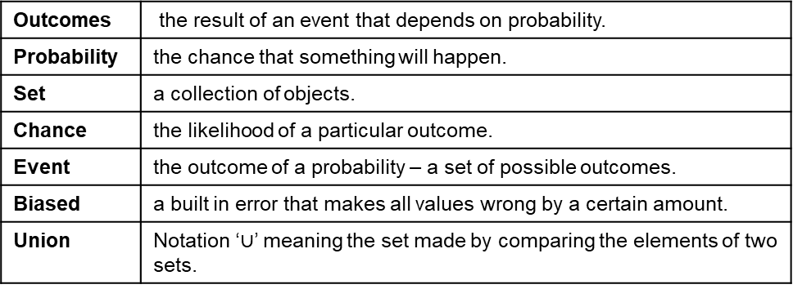
Mathematics
Tables and Probability
Outcomes | the result of an event that depends on probability.
Probability | the chance that something will happen.
Set | a collection of objects.
Chance | the likelihood of a particular outcome.
Event | the outcome of a probability – a set of possible outcomes.
Biased | a built in error that makes all values wrong by a certain amount.
Union | Notation ‘$∪$’ meaning the set made by comparing the elements of two sets.
Construct sample space diagrams
This is the set notation to list the outcomes S =
The possible outcomes from rolling a dice
In between the { } are a;; the possible outcomes
Sample space diagrams provide a systematic way to display outcomes from events
The possible outcomes
from tossing a coin
H
1,H
2,H
3,H
4,H
5,H
6,H
S = { 1H, 2H, 3H, 4H, 5H, 6H, 1T, 2T, 3T, 4T, 5T, 6T}
T
1,T
2,T
3,T
4,T
5,T
6,T
Probability from sample space
What is the probability that an outcome has an even number and a tails?
P (Even number and Tails)
Numerator:
the event
The possible outcomes from rolling a dice
= 3 .
12
This is the set notation that represents the question P
Denominator:
the total number
of outcomes
H
1,H
2,H
3,H
4,H
5,H
6,H
The possible outcomes
from tossing a coin
There are three even numbers with tails
T
1,T
2,T
3,T
4,T
5,T
6,T
In between the ( ) is the event asked for
There are twelve possible outcomes
Probability from two-way tables
The event
 | Car | Bus | Walk | Total
Boys | 15 | 24 | 14 | 53
Girls | 6 | 20 | 21 | 47
Total | 21 | 44 | 35 | 100
= 21 .
100
P (Girl walk to school)
The total in the set
The total number of items

Slide 28
Mathematics
Probability from Venn diagrams
100 students were questioned if they played badminton or went to swimming club.
40 went swimming, 25 went to badminton and 11 went to both.
This whole curve includes everyone that went swimming.
Because 11 did both we calculate just swimming by 40- 11
The number outside represents those that did neither badminton or swimming
= 29 .
100
Swimming
Badminton
P (Just swimming)
The intersection represents both.
Swimming AND badminton
46
11
14
100 – 29 – 11 – 14
29
This whole curve includes everyone that went to badminton.
Because 11 did both we calculate just badminton by 25 - 11
Product Rule
x
The number of items in event a
The number of items in event b

Slide 29
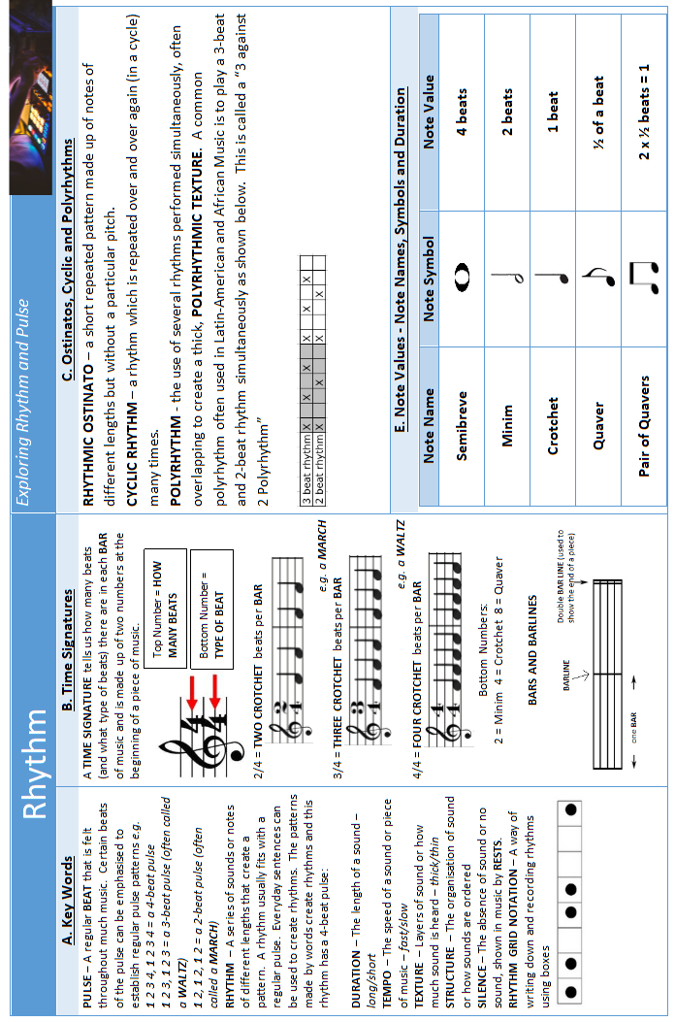
Music

Slide 30
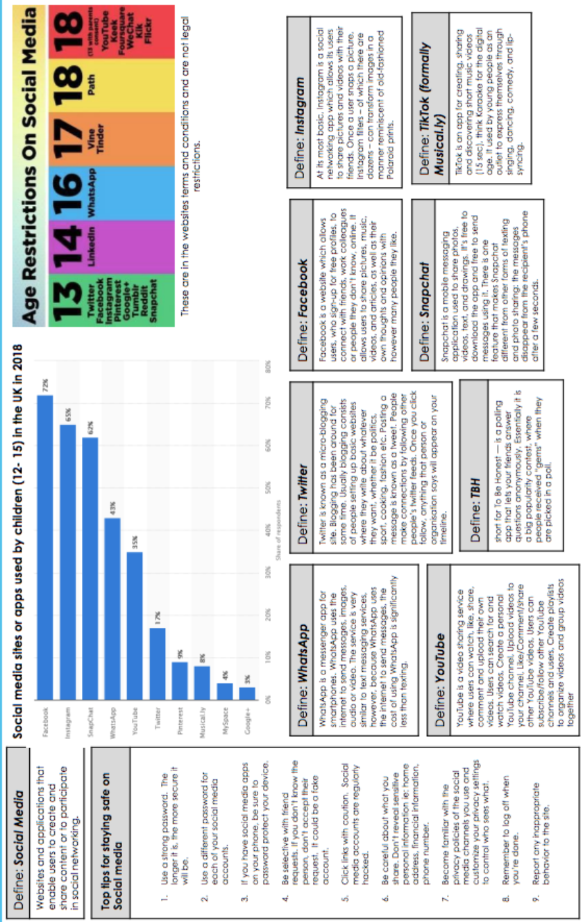
Personal Development

Slide 31
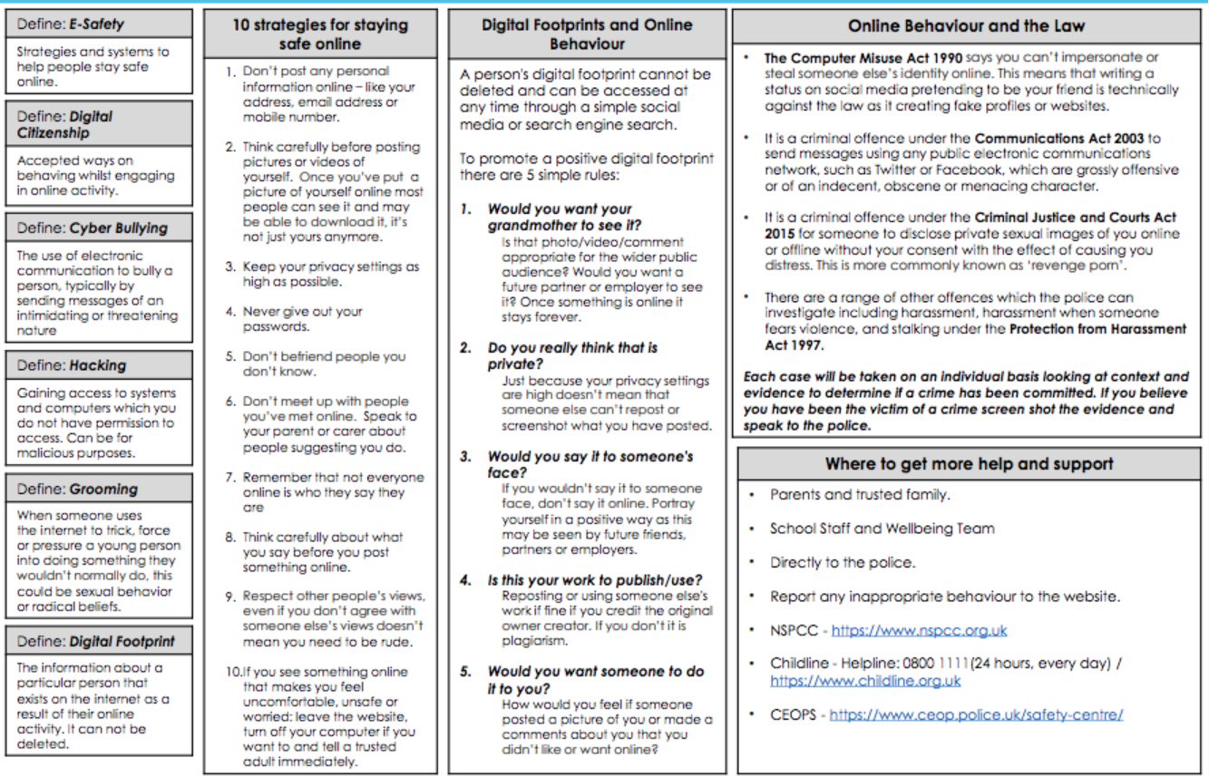
Personal Development

Slide 32

Personal Development

Slide 33
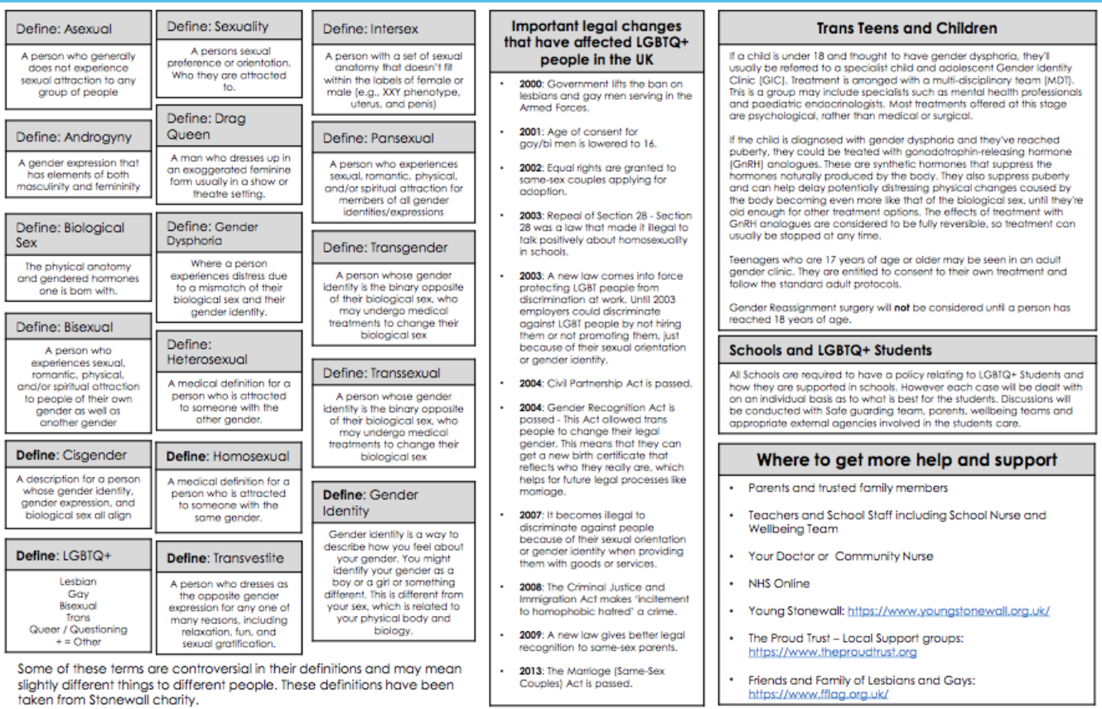
Personal Development

Slide 34
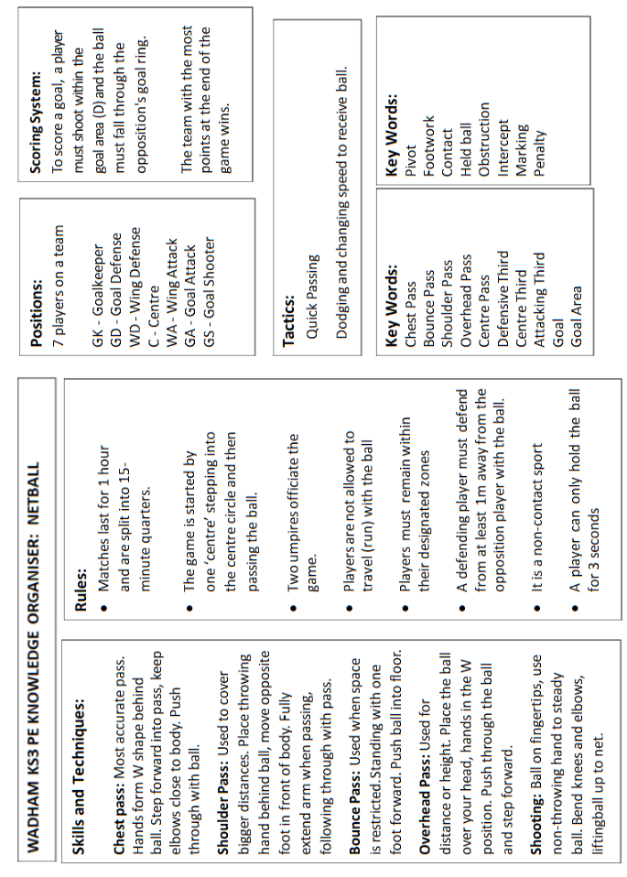
Physical Education

Slide 35
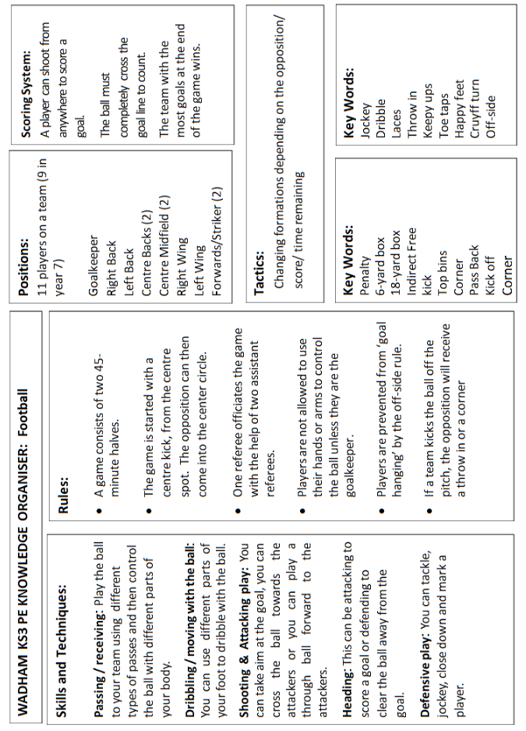
Physical Education

Slide 36
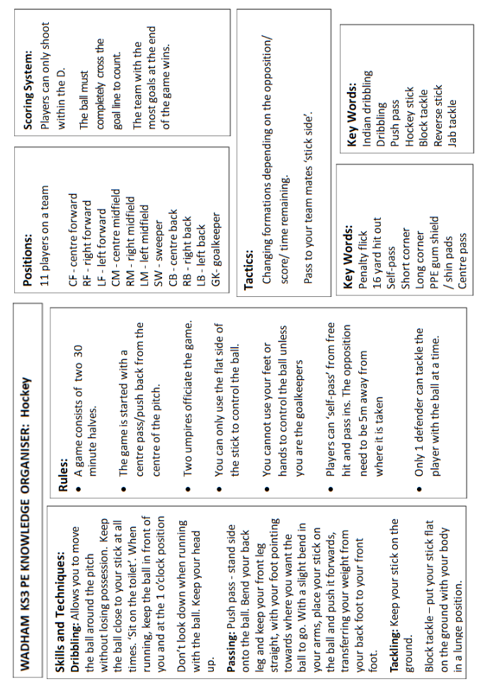
Physical Education

Slide 37
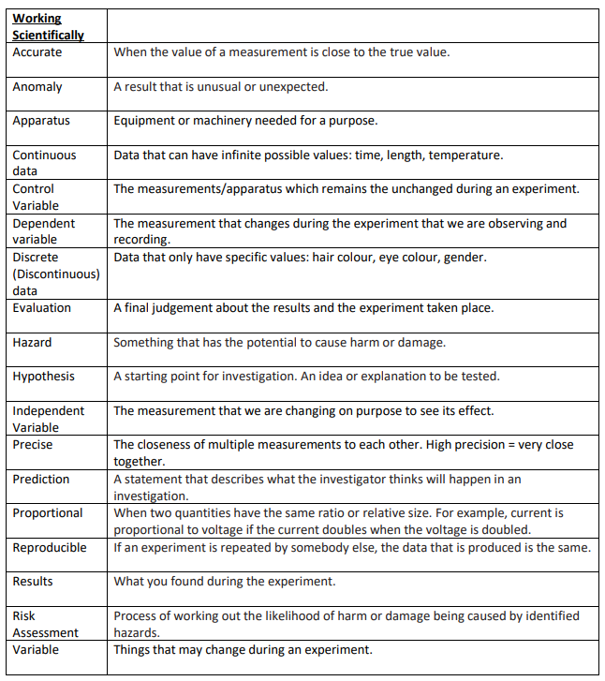
Science

Slide 38


Science

Slide 39


Science

Slide 40

Science

Slide 41

Science

Slide 42

Science

Slide 43

Science

