Slide 1



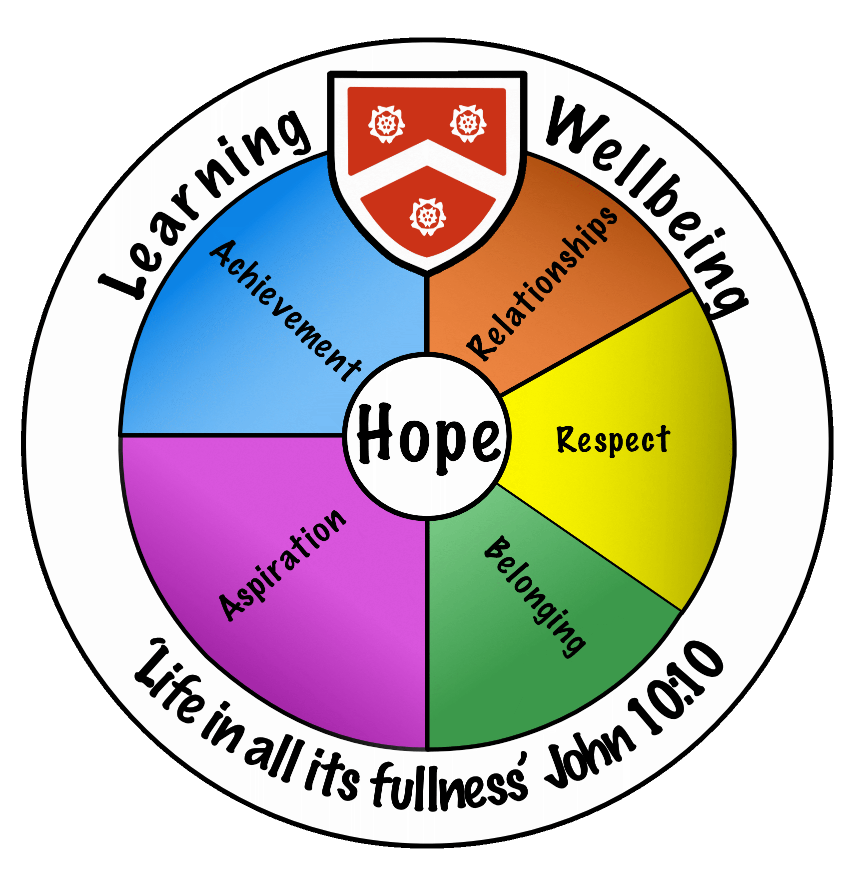
Wadham School
A Church of England Community School
Knowledge Organisers
Year 7
Term 1 & 2
2024-2025
Name.............................................................
Tutor group..............................
“Life in all its fullness” John 10:10

Slide 2


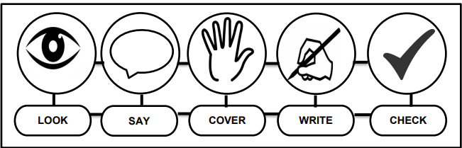


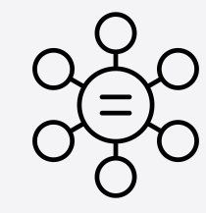
Using Your Knowledge Organiser
Look-Say-Cover-Write-Check
Retrieval practice using the look-say-cover-write-check technique, when done in regular small chunks, is one of the best ways you can learn relevant knowledge over time.
Working in Independent mode:
Look at the first bullet point or sentence
Read through it three to five times
Cover
Write it out exactly
Remove and check what you wrote and tick if correct
Repeat
When you get it 100% right, move on to the next chunk of information
Flash Cards Make flast cards with the definition on one side and key word on the other. | Self Quizing Write quizzes with answers to test yourself in the future. | Mind maps Create mindmaps linking key inforamtion you need to remember.

Slide 3
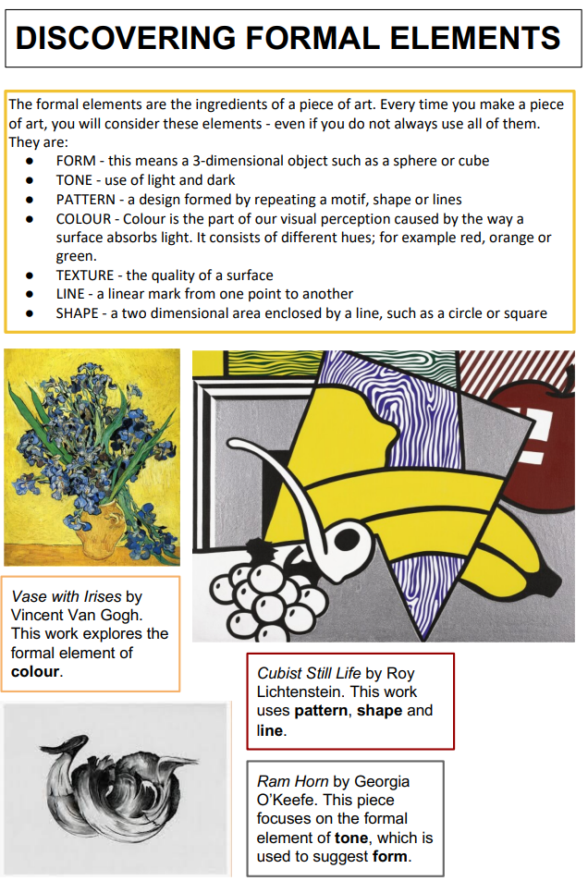
Art

Slide 4
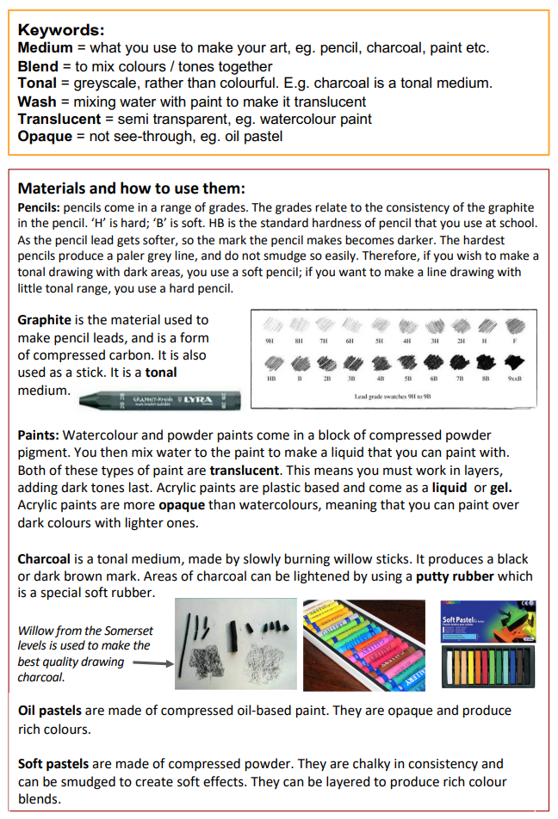
Art

Slide 5
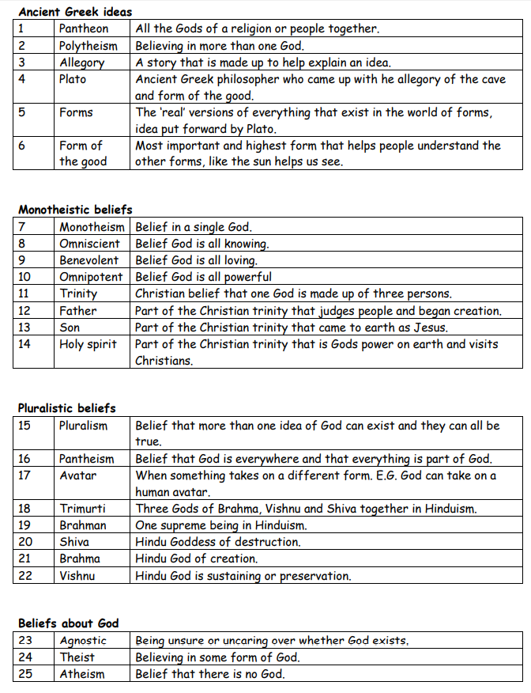
Beliefs and World Views

Slide 6
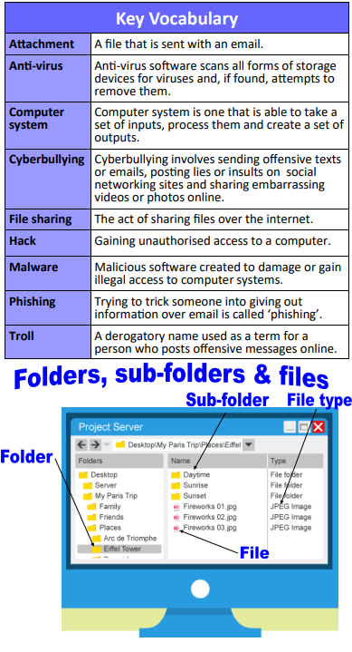
Computing

Slide 7


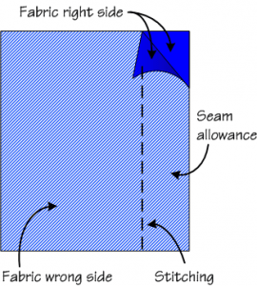


Year 7 Design and Technology
Keyword | Core Knowledge
Sewing machine | Sewing machines are used to sew fabrics together using thread.
Tie-Dye | Tie-Dye is a resist technique. ​Elastic bands are used to act as a resist.​ Dye can not stain the fabric where the elastic bands are placed.
Seam Allowance | Seam allowance is the extra fabric between the seamline and the edge of the fabric when two (or more) pieces of fabric are sewn together.
Hem | A hem in sewing is a garment finishing method, where the edge of a piece of cloth is folded and sewn to prevent unravelling of the fabric and to adjust the length of the piece in garments, such as at the end of the sleeve or the bottom of the garment.
Embellish | In textiles, embellishment refers to the addition of decorative elements using visual arts. It enhances the appearance of garments or fashion accessories, adding value without necessarily serving a functional purpose.
Applique | Is an embellishment technique. This technique involves adding or taking away layers of fabric to create a surface design.
Plain Seam
A needle has an eye for thread to go through, a pin doesn't.

Slide 8
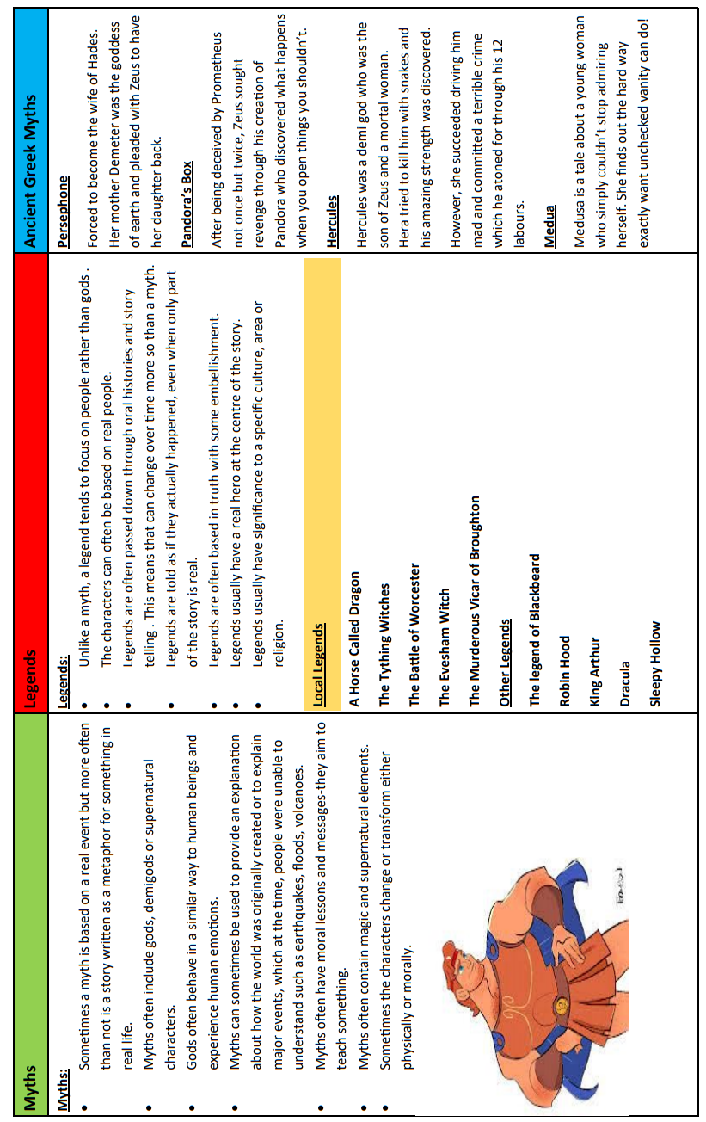
English
Myths, legends, sacred stories and fairy tales

Slide 9
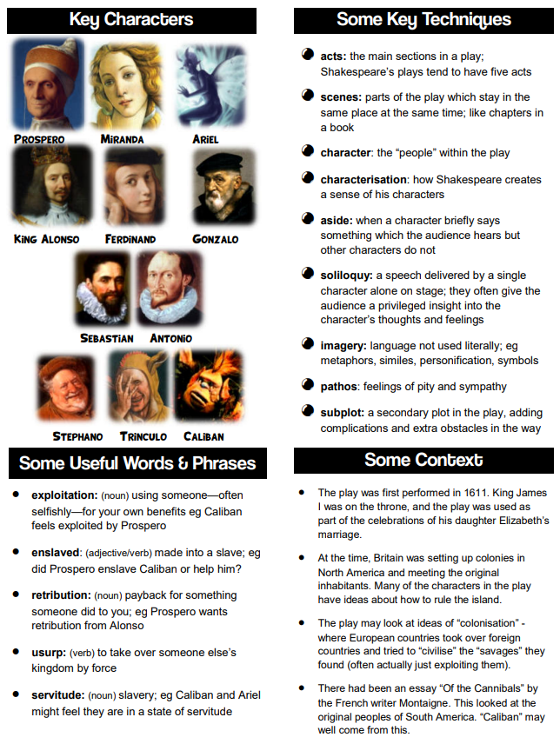
English
The Tempest

Slide 10
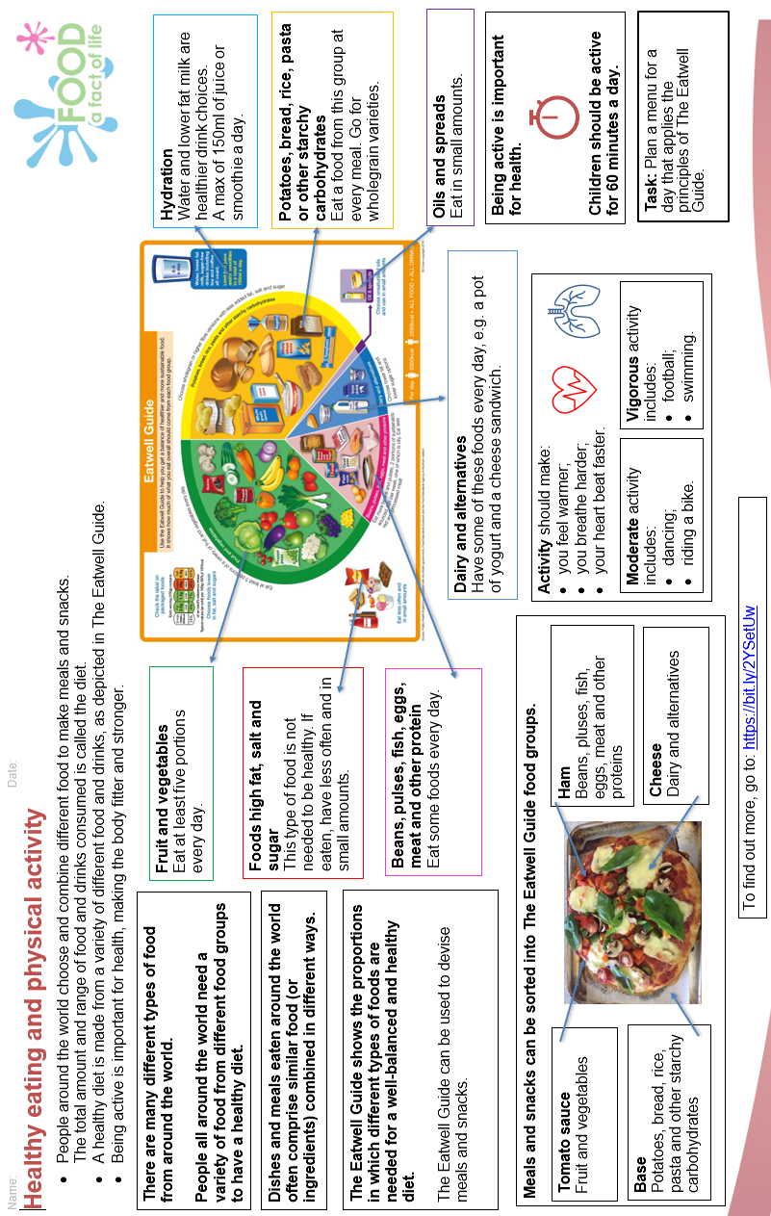
Food

Slide 11
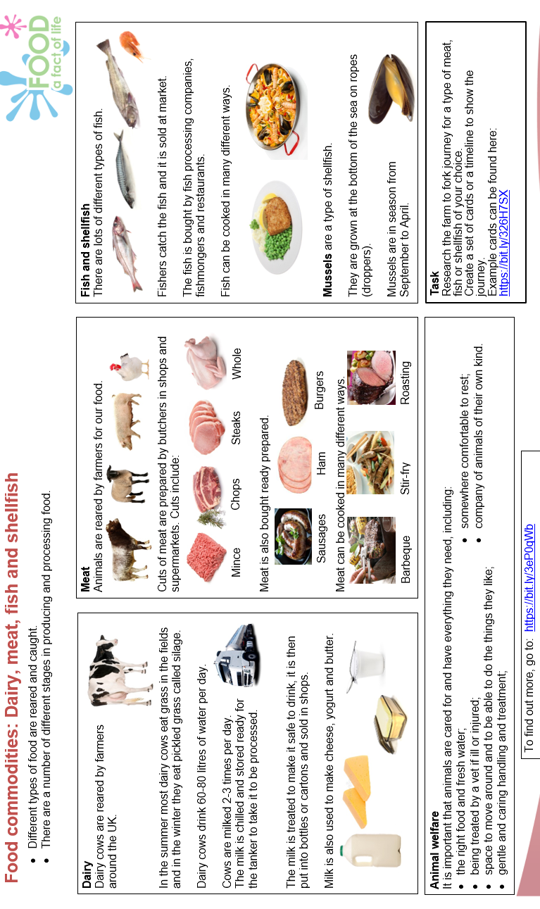
Food

Slide 12
Year 7 French: Je me présente
En classe | In the classroom
Merci | Thank you
2. S’il vous plaît | Please
3. J’ai un problème. | I have a problem.
4. Je ne sais pas. | I don’t know.
5. Répétez | Repeat
6. J’ai fini | I’ve finished.
7. J’ai oublié mon stylo. | I’ve forgotten my pen.
8. Comment dit-on…en anglais? | How do you say…in English?
9. Comment dit-on…en français? | How do you say…in French?
10. Puis-je aller aux toilettes? | Can I go to the toilet?
11. Puis-je utiliser mon portable? | Can I use my phone?
12. C’est vrai. | It’s true.
13. C’est faux. | It’s false.
Les mois | Months
24. janvier | January
25. février | February
26. mars | March
27. avril | April
28. mai | May
29. juin | June
30. juillet | July
31. août | August
32. septembre | September
33. octobre | October
34. novembre | November
35. décembre | December
36. Mon anniversaire, c’est le… | My birthday is…
Les descriptions | Descriptions
37. J’ai les yeux… | I have…eyes.
38. J’ai les cheveux… | I have…hair.
39. Je suis…/Je ne suis pas | I am…/I am not
40. petit(e)/grand(e) | short/tall
41. méchant(e) | nasty
42. patient(e) | patient
43. intelligent(t) | clever
44. fort(e) | strong
45. timide | shy
46. amusant(e) | funny
47. bavard(e) | chatty
48. très/assez/un peu | very/quite/a bit
Les salutations | Greetings
14. Bonjour | Hello
15. Salut | Hi
16. Au revoir | Goodbye
17. Comment ça va? | How are you?
18. Ça va très bien. | Very good.
19. Ça va très mal. | Very bad.
20. Comment tu t’appelles? | What is your name?
21. Je m’appelle… | My name is…
22. Quel âge as-tu? | How old are you?
23. J’ai onze/douze ans. | I am 11/12 years old.
Vital verbs
avoir (to have) | être (to be)
J'ai (I have) | Je suis (I am)
Tu as (You have) | Tu es (You are)
Il/elle/on a (He/she/we have) | Il/elle/on est (He/she/we are)
Nous avons (We have) | Nous sommes (We are)
Vous avez (You have) | Vous êtes (You are)
Ils/elles ont (They have) | Ils/elles sont (They are)
Phonics Focus: | Phonics
[sfc] = silent final consonant trois | [e] = /uh/ petit
[ç] = /s/ Ça va? | [i] = /ee/ musique

Slide 13
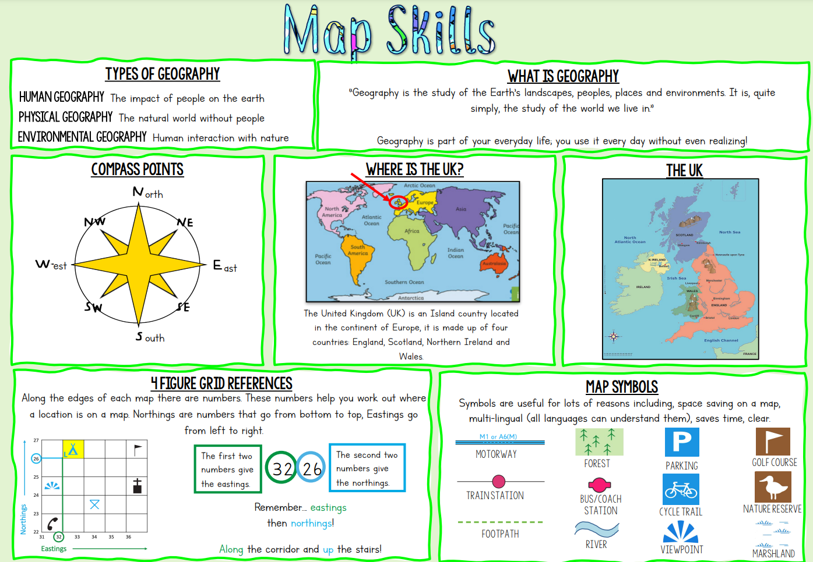
Geography

Slide 14
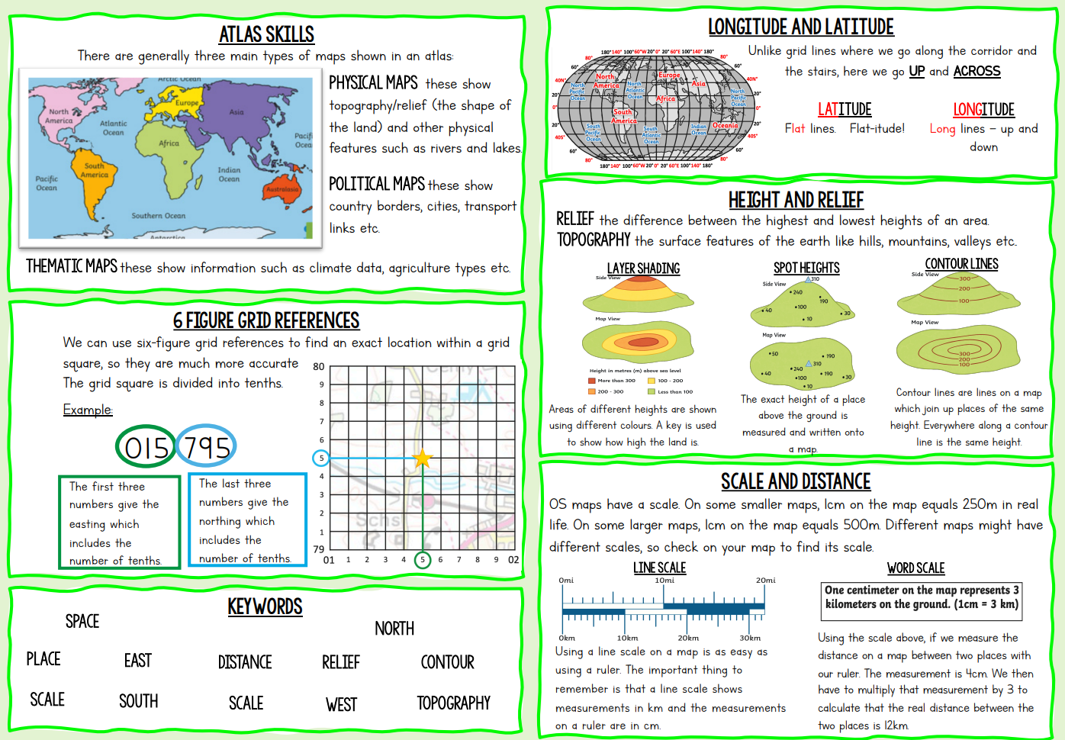
Geography

Slide 15
Year 7 German: Meine Welt und ich
In die Klasse | In the classroom
Danke | Thank you
2. Bitte | Please
3. Ich habe ein Problem. | I have a problem.
4. Ich weiß es nicht. | I don’t know.
5. Ich bin fertig. | I’ve finished.
6. Ich habe meinen Kuli vergessen. | I’ve forgotten my pen.
7. Wie sagt man…auf Englisch? | How do you say…in English?
8. Wie sagt man…auf Deutsch? | How do you say…in German?
9. Kann ich auf die Toilette gehen? | Can I go to the toilet?
10. Kann ich mein Handy benutzen? | Can I use my phone?
11. Das ist richtig. | It’s true.
12. Das ist falsch. | It’s false.
Les mois | Months
23. Januar | January
24. Februar | February
25. März | March
26. April | April
27. Mai | May
28. Juni | June
29. Juli | July
30. August | August
31. September | September
32. Oktober | October
33. November | November
34. Dezember | December
35. Ich habe am…..Geburtstag. | My birthday is…
Beschreibungen | Descriptions
36. Ich habe…Augen. | I have…eyes.
37. Ich habe…Haare. | I have…hair.
38. Ich bin…/Ich bin nicht… | I am…/I am not
39. klein/groß | short/tall
40. sportlich | sporty
41. musikalisch | Musical
42. intelligent | clever
43. kräftig | strong
44. schüchtern | shy
45. lustig | funny
46. gesprächig | chatty
47. sehr/ganz/ein bisschen | very/quite/a bit
Grüße | Greetings
13. Guten Tag | Hello
14. Hallo | Hi
15. Auf Wiedersehen | Goodbye
16. Wie geht es dir? | How are you?
17. Mir geht es sehr gut. | Very good.
18. Mir geht es nicht sehr good. | Not good.
19. Wie heißt du? | What is your name?
20. Ich heiße… | My name is…
21. Wie alt bist du? | How old are you?
22. Ich bin elf/zwölf Jahre alt. | I am 11/12 years old.
Vital verbs
haben (to have) | sein (to be)
Ich habe (I have) | Ich bin (I am)
Du hast (You have) | Du bist (You are)
Er/sie hat (He/she has) | Er/sie ist (He/she is)
Wir haben (We have) | Wir sind (We are)
Ihr habt (You have - group) | Ihr seid (You are - group)
Sie/sie (You formal/they have) | Sie/sie sind (You formal/they are)
Phonics Focus: | Phonics
[sfc] = silent final consonant trois | [e] = /uh/ petit
[ç] = /s/ Ça va? | [i] = /ee/ musique

Slide 16
History
Knowledge Organiser: Year 7 Normans and the Battle of Hastings
Keyword | Definition
Anglo Saxon | The name ‘Anglo-Saxon’ comes from the Angles and the Saxons, two of the North European tribes that invaded and lived in Britain from the fifth century onwards
Bailey | Outer area that surrounded the motte. This was where houses, stables and so on were built
Barons | Member of the lowest order of the British nobility (Lord).
Cavalry | Military units or soldiers mounted on horseback, formerly an important element in the armies of all major powers. Being on horse helped them move quickly around a battlefield
Domesday book | The Domesday book is Britain's earliest public record. It contains the results of a huge survey of land and landholding commissioned by William I in 1085. Domesday is by the far the most complete record of pre-industrial society to survive anywhere in the world and provides a unique window on the medieval world.
Farming | Farming is the activity of growing crops or keeping animals on a farm. It was the major industry in Britain during the Middle Ages and the majority of people in the country were employed on farms or supporting the people who did
Fyrd | The name given to a group of soldiers formed from a tribe. Existed from about 605AD in Anglo-Saxon England. Local in character, it imposed military service upon every able-bodied free male.
Heir | A person who has the legal right to receive somebody's property, money or title when that person dies
Hierarchy | A system in which people or things are put at various levels or ranks according to their importance. For example, in a typical family system, the parents have the most authority, followed by the children, then followed by the pets.
Keep | Secure building which housed the Norman earls or those important people that needed shelter!
Motte | Earth mound in which the keep was built on.
Norman | A native or inhabitant of Normandy. The Normans would rule and control England after 1066
Rebellion | Fighting against something you disagree with.
Rural | A rural area is an open swath of land that has few homes or other buildings, and not very many people. A rural areas population density is very low. Most people in Medieval England were rural as they didn’t live in cities or urban areas at this point
Shield Wall | Barrier created by soldiers standing shoulder to shoulder, holding their shields in front of them so that they formed a wall
Tactics | A plan or method of employing forces in combat to achieve victory
Viking | Vikings is the modern name given to seafaring people originally from Scandinavia who from the late 8th to the late 11th centuries raided, pirated and attacked Britain.
Witan | A group of important people in Anglo Saxon England. They met to counsel the king on matters such as judicial problems. The Witan's most powerful role came if there was doubt about who would be the next king. Then the Witan could meet and make a recommendation or decision, but in most cases the real decision was made by whoever had the most military support. The Witan encouraged the powerful men of England to support Harold Godwinson against the external threats from Norway and Normandy in 1066.

Slide 17




Mathematics
Sequences
Sequence | items or numbers put in a pre-decided order
Term | a single number or variable
Position | the place something is located
Rule | instructions that relate two variables
Linear | the difference between terms increases or decreases by the same value each time
Non-linear | the difference between terms increases or decreases in different amounts
Difference | the gap between two terms
Arithmetic | a sequence where the difference between the terms is constant
Geometric | a sequence where each term is found by multiplying the previous one by a fixed non zero number
Describe and continue a sequence diagrammatically
Predict and check terms
What will the next number be? Can you draw this?
3
5
7
1
3
5
+2
+2
+2
+2
CHECK – draw the next terms
Count the number of circles or lines in each image
9
11
13
Continue Linear Sequences
Predictions:
Look at your pattern and consider how it will increase.
e.g. How many lines in pattern 6?
Prediction - 13
If it is increasing by 2 each time - in 3 more patterns there will be 6 more lines
7, 11, 15, 19…
How do I know this is a linear sequence?
It increases by adding 4 to each term.
How many terms do I need to make this conclusion?
At least 4 terms – two terms only shows one difference not if this difference is constant. (a common difference).
How do I continue the sequence?
You continue to repeat the same difference through the next positions in the sequence.
Explain term-to-term rule How you get from term to term

Slide 18

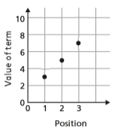

Mathematics
Sequence in a table and graphically
Linear and Non Linear Sequences
Position: the place in the sequence
Linear Sequences – increase by addition or subtraction and the same amount each time
1
2
3
“The term in position 3
has 7 squares”
Non-linear Sequences – do not increase by a constant amount – quadratic, geometric and Fibonacci.
Do not plot as straight lines when modelled graphically
The differences between terms can be found by addition, subtraction, multiplication or division.
3
5
7
Term: the number or variable
(the number of squares in each image)
Graphically
In a table
Fibonacci Sequence – look out for this type of sequence
0
1
1
2
3
5
8
…
Because the terms increase by the same addition each time this is linear – as seen in the graph
Each term is the sum of the previous two terms.
Continue non-linear Sequences
1, 2, 4, 8, 16 …
How do I know this is a non-linear sequence?
It increases by multiplying the previous term by 2. – this is a geometric sequence because the constant is multiply by 2
How many terms do I need to make this conclusion?
At least 4 terms – two terms only shows one difference not if this difference is constant. (a common difference).
How do I continue the sequence?
You continue to repeat the same difference through the next positions in the sequence.
Explain term-to-term rule
How you get from term to term
Try to explain this in full sentences not just with mathematical notation.
Use key maths language – doubles, halves, multiply by two, add four to the previous term etc.
To explain a whole sequence you need to include a term to begin at…
The next term is found by tripling the previous term.
The sequence begins at 4.
4, 12, 36., 108…
x3
x3
x3
First term

Slide 19

Algebraic notation
Mathematics
Function | a relationship that instructs how to get from an input to an output.
Input | the number/ symbol put into a function.
Output | the number/ expression that comes out of a function.
Operation | a mathematical process
Inverse | the operation that undoes what was done by the previous operation. (The opposite operation)
Commutative | the order of the operations do not matter.
Substitute | replace one variable with a number or new variable.
Expression | a maths sentence with a minimum of two numbers and at least one math operation (no equals sign)
Evaluate | work out
Linear | the difference between terms increases or decreases by the same value each time
Sequence | items or numbers put in a pre-decided order
Single function machines
Using letters to represent numbers
INPUT
The number that goes IN
OUTPUT
The number that comes out
5 + 5 + 5
y + y + y + y
20 ÷ h
3 x 5
y x 4
This box gives the calculation instruction
5 x 3
4 x y
Addition and multiplication can be done in any order
Commutative calculations
4y
To find the input from the output
Use the INVERSE operation
4 lots of ‘y’
20 shared into ‘h’ number of groups
Single function machines (algebra)
Find functions from expressions
INPUT
OUTPUT
OUTPUT
a
x 10
10a
INPUT
?
14x
3c
30c
7x
÷ 10
Find the relationship between the input and the output
Sometimes there can be a number of possible functions.
e.g. +7x or x 2 could both be solutions to the above function machine
To find the input from the output
Use the INVERSE operation
Substitution into expressions
Two step function machines
4y
4 lots of ‘y’
OUTPUT
If y = 7 this means the expression is asking for 4 ‘lots of’ 7
INPUT
7 + 7 + 7 +7
OR
7 x 4
= 28
OR
4 x 7
e.g. : y – 2
= 7 – 2 = 5
Calculate the value at the end of each operation
For the input use the INVERSE operations

Slide 20

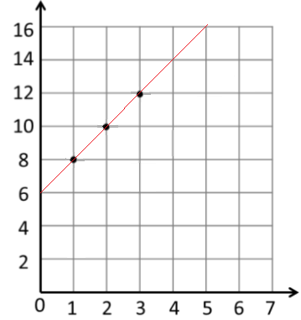
Mathematics
Two step function machines (algebra)
b
x 5
5b
+ 4
5b + 4
IMPORTANT
Calculate the value at the end of each operation
÷ 5
- 4
c
c+4
5(c + 4)
NOTE:
The whole first output is multiplied by 5
+ 4
x 5
= 5c + 20
- 4
÷ 5
Find functions from expressions
f + 5
3
NOTE: the difference in the two expressions
f + 5
3
f add 5 then
divide by 3
f divided by
then add 5
f
x 5
+ 3
f
+ 5
÷ 3
Sometimes it helps to try to explain the expression in word – and consider what has happened to the input
Substitution into an expression
2(x + 3)
Forming a sequence
2(x + 3)
INPUT
+ 3
x 2
OUTPUT
INPUT
1
2
3
Add 3 to the input
then times 2
OUTPUT
8
10
12
The substitution is the ‘input’ value
The OUTPUT becomes the sequence
If x = 10
10 + 3 = 13….. 13 x 2 = 26
Take the function and generate a sequence
Put the expression into a function machine
Representing functions graphically
Not all graphs will be linear only those with an integer value for x.
Powers and fractions generate differently shaped graphs.
Take the function and generate a sequence
2(x + 3)
INPUT
x 2
+ 3
OUTPUT
y=2(x + 3)
To represent graphically the input becomes x co-ordinates and the output becomes y co-ordinates
OUTPUT
INPUT (x)
3
1
2
12
8
10
OUTPUT (y)
INPUT
This becomes a co-ordinate pair
(2, 10) to plot on a graph
NOTE:
Because this is a linear graph you can predict other values

Slide 21
Mathematics
Equality and Equivalence
Equality | two expressions that have the same value
Equation | a mathematical statement that two things are equal
Equals | represented by ‘=‘ symbol – means the same
Solution | the set or value that satisfies the equation
Solve | to find the solution.
Inverse | the operation that undoes what was done by the previous operation. (The opposite operation)
Term: | a single number or variable
Like | variables that are the same are ‘like’
Coefficient | a multiplicative factor in front of a variable e.g. 5x (5 is the coefficient, x is the variable)
Expression | a maths sentence with a minimum of two numbers and at least one math operation (no equals sign)
13
7
14
Model the information
20
10
t
t
t
20 – 7 = 13
20 – 13 = 7
t + t + t = y
3 x t = y
3t = y
y – t – t = t
y ÷ 3 = t
y ÷ t = 3
13 + 7 = 20
7 + 13 = 20
Fact Family
There is more to this than just
spotting the answer
Solve one step equations ( x/÷)
f = 5
4
5
5
5
5
Don’t forget you know how to use function machines
59
f ÷ 4 = 5
f ÷ 5 = 4
5
x 4
f
5 x 4 = f
4 x 5 = f
f
÷ 4
There is more to this than just
spotting the answer
Solve one step equations ( x/÷)
Equality
2 + 14 = 5 + 5 + 6
The sum on the left has the same result as the sum on the right
“Is equal to”
16
16
Saying it out loud sometimes helps you to understand equality
Fact Families
Use a bar model to display the relationships between terms and numbers.
7
14
y
13
Fact Family
20
x
10
t
t
t
20 – 7 = 13
20 – 13 = 7
t + t + t = y
3 x t = y
3t = y
t + t + t = y
3 x t = y
3t = y
y – t – t = t
y ÷ 3 = t
y ÷ t = 3
13 + 7 = 20
7 + 13 = 20

Slide 22



Mathematics
Solve one step equations (+/-)
There is more to this than just
spotting the answer
x + 42 = 59
x
42
x + 42 = 59
42 + x = 59
x
+ 42
59
59 – x = 42
59 – 42 = x
59
Fact Family
-42
Solve one step equations ( x/÷)
Don’t forget you know how to use function machines
f = 5
4
5
5
5
5
5
x 4
f
f ÷ 4 = 5
f ÷ 5 = 4
÷ 4
5 x 4 = f
4 x 5 = f
f
Like and unlike terms
Equivalence
Collecting like terms symbol
Like terms are those whose variables are he same
Check equivalence by substitution
e.g. m=10
The symbol means equivalent to.
and
3
are like terms
the variable is the same
5m
2 x 2m
7m – 3m
It is used to identify equivalent expressions
5 x 10
= 50
2 x (2x10)
= 2 x 20
= 40
(7x10) – (3x10)
= 70 – 30
= 40
Collecting like terms
Only like terms can be combined
and
3
are unlike terms
Equivalent expressions
4x +5b –2x +10b
the variables are NOT the same
Repeat this with various values for m to check
4x +5b –2x +10b
Examples and non-examples
5m
2x
+ 15b
Like terms
Un-like terms
Common misconceptions
y, 7y
2x², x²
ab, 10ba
5, -2
y, 7x
2x², 2c²
ab, 10a
5, -2t
2 x 2m
4m
2x + 3x² + 4x 6x + 3x²
Note here ab and ba are commutative operations, so are still like terms
7m – 3m
Although they both have the x variable x2 and x terms are un-like terms so can not be collected
4m

Slide 23
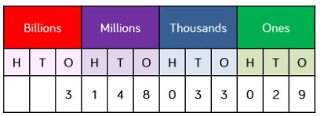

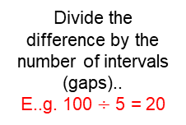
Mathematics
Ordering integers and Decimals
Approximate | To estimate a number, amount or total often using rounding of numbers to make them easier to calculate with
Integer | a whole number that is positive or negative
Interval | between two points or values
Median | A measure of central tendency (middle, average) found by putting all the data values in order and finding the middle value of the list.
Negative | Any number less than zero; written with a minus sign.
Place holder | We use 0 as a place holder to show that there are none of a particular place in a number
Place value | The value of a digit depending on its place in a number. In our decimal number
Range | The difference between the largest and smallest numbers in a set
Significant figure | A digit that gives meaning to a number. The most significant digit (figure) in an integer is the number on the left. The most significant digit in a decimal fraction is the first non-zero number after the decimal point.
Integer Place Value
Intervals on a number line
Divide the difference by the number of intervals (gaps)..
E..g. 100 $÷$ 5 = 20
20
40
60
80
Placeholder
Range
Three billion, one hundred and forty eight million, thirty three thousand and twenty nine
1 billion 1, 000, 000, 000
1 million 1. 000, 000
Spread of the values
3 9 8 12
Range: Biggest value – Smallest value
12 – 3 = 9
Range = 9
Rounding to the nearest power of ten
If the number is halfway between we “round up”
5495 to the nearest 1000
5475 to the nearest 10
5475 to the nearest 100
5000
6000
5400
5500
5470
5480

Slide 24
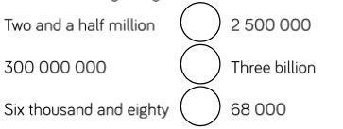
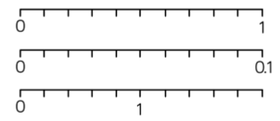


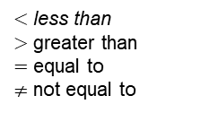
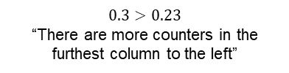
Mathematics
Median
Example 1
3 9 8 12
The middle value
Example 2
150 154 148
137 160 158
Median: put the in order
137 148 150 154 158 160
There are 2 middle numbers
Find the midpoint
152
Compare integers using $<, >, =, ≠$
$<$ less than
$>$ greater than
$=$ equal to
$≠$ not equal to
$$=$$
$$=$$
$$<$$
Decimals
ones | tenths | hundredths
We say
“nought point five two”
0 ones, 5 tenth and 2 hundredths
0 + 0.1 + 0.1 + 0.1 + 0.1 + 0.1 + 0.01 + 0.01
= 0 + 0.5 + 0.02
= 0.52
Five tenths and two hundredths
Comparing decimals
$$0.3>0.23$$
“There are more counters in the furthest column to the left”
Decimal intervals on a number line
One whole spit into 10 parts makes tenths = 0.1
One tenth split into 10 parts makes hundredths = 0.01
Ones | Tenths | hundredths
0.1
0.2
0.3
0.4
0.5
0.6
0.7
0.8
0.9
0.02
0.04
0.06
0.08
Ones | Tenths | hundredths
0.2
0.4
0.6
0.8
1.2
1.4
1.6
1.8
2
Round to 1 significant figure
Round to the first non zero number
Comparing the values both with the same number of decimal places is another way to compare the number of tenths and hundredths
370 to 1 significant figure is 400
37 to 1 significant figure is 40
3.7 to 1 significant figure is 4
0.37 to 1 significant figure is 0.4
0.00000037 to 1 significant figure is 0.0000004

Slide 25
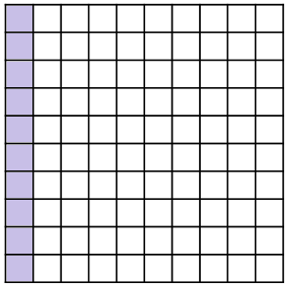

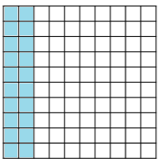


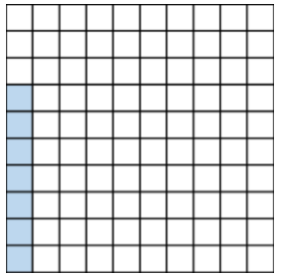
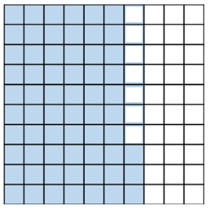



Mathematics
Fraction, Decimal and Percentage Equivalence
Fraction | how many parts of a whole we have
Decimal | a number with a decimal point used to separate ones, tenths, hundredths etc.
Percentage | a proportion of a whole represented as a number between 0 and 100
Place value | the numerical value that a digit has decided by its position in the number
Placeholder | a number that occupies a position to give value
Interval | a range between two numbers
Tenth | one whole split into 10 equal parts
Hundredth | one whole split into 100 equal parts
Sector | a part of a circle between two radius (often referred to as looking like a piece of pie)
Recurring | a decimal that repeats in a given pattern
Tenths and hundredths
One hundredth (one whole split into 100 equal parts)
= = 0.01
ones | tenths | hundredths
One Whole = 1
0 ones, 5 tenth and 2 hundredths
0 + 0.1 + 0.1 + 0.1 + 0.1 + 0.1 + 0.01 + 0.01
= 0 + 0.5 + 0.02
= 0.52
$$\frac{1}{100}$$
$$\frac{1}{10}$$
One tenth (one whole split into 10 equal parts) = = 0.1
On a number line
Fifths
One whole – split into 10 equal parts
Twenty hundredths
One Whole = 1
One tenth
One tenth = = 0.1
$$\frac{1}{10}$$
One tenth – split into 10 equal parts
One Whole = 1
One hundredth = = 0.01
Two tenths = one fifth
$$\frac{1}{100}$$
One fifth (one whole split into 5 equal parts) = = 0.2
$$\frac{1}{5}$$
Percentages on a hundred grid
6 tenths
100% = a whole = 100 hundredths
6 tenths and 3 hundredths
63 hundredths
63%
7 hundredths
7 hundredths
7 out of 100
7%
3 hundredths

Slide 26
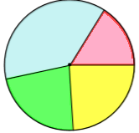


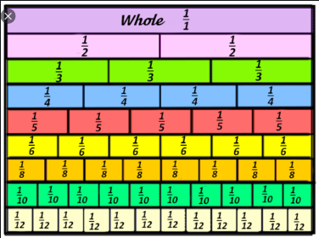


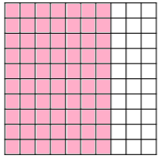

Mathematics
Quarters
Simple pie charts
Split into 10 parts
= 10% = 36⁰
One quarter (one whole split into 4 equal parts) = = 0.25
$$\frac{1}{4}$$
Twenty five hundredths
One whole
One Whole = 1
Split into 2 parts
= 50% = 180⁰
One quarter = 0.25
A pie chart has 360⁰ so all FDP calculations are out of 360
Split into 5 parts
= 20% = 72⁰
Equivalent fractions
Represent equivalence with fraction walls
Fractions – on a diagram
The denominator is represented by EQUALLY sized parts – this is split into quarters
Fractions – on a number line
One whole split into 18 equal parts
18 is the denominator
This point is at the 6th part 6 is the numerator
6
3
1
18
9
3
Convert FDP
70 out of 100 squares
70 “hundredths”
= 7 “tenths”
0.7
70
This also means
70 ÷ 100
70 hundredths
= 70%
100
Using a
calculator
× 100 converts to a percentage
1
= 0.3333333
= $0.\dot{3}$
Convert to a decimal
3
This will give you the answer in the simplest form
The dot above the 3

Slide 27
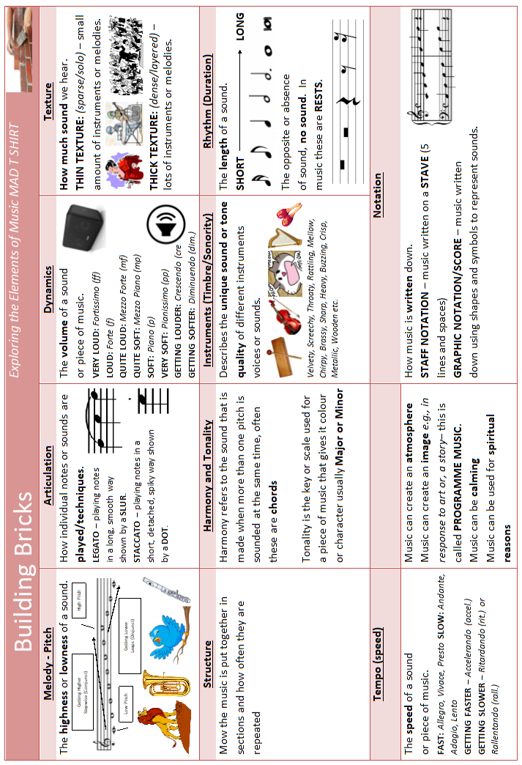
Music

Slide 28
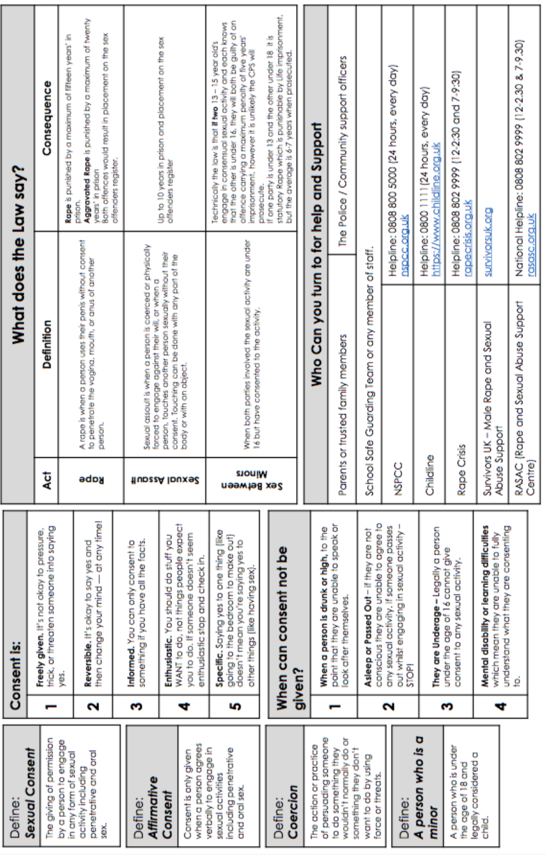
Personal Development

Slide 29

Personal Development

Slide 30
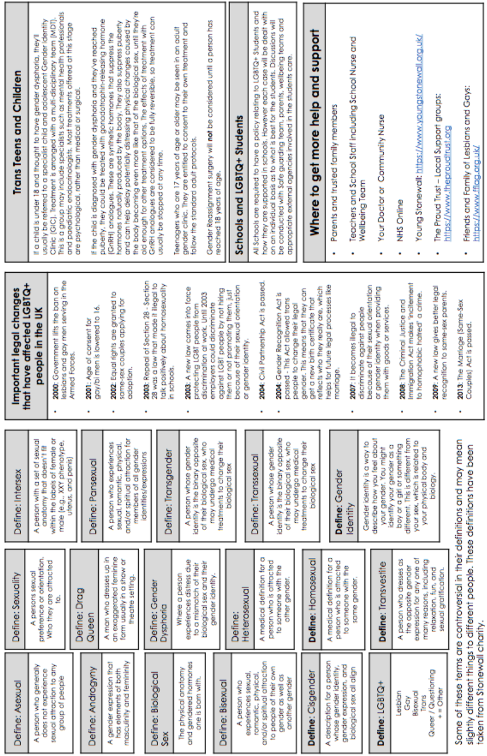
Personal Development

Slide 31
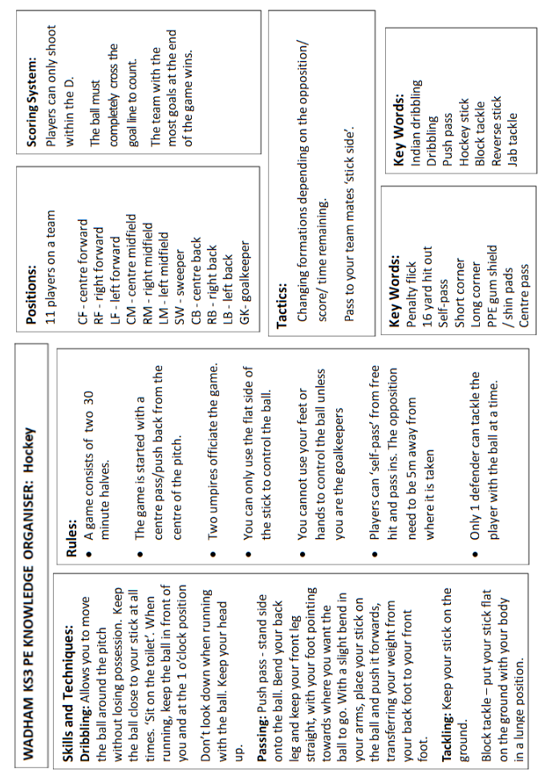
Physical Education

Slide 32
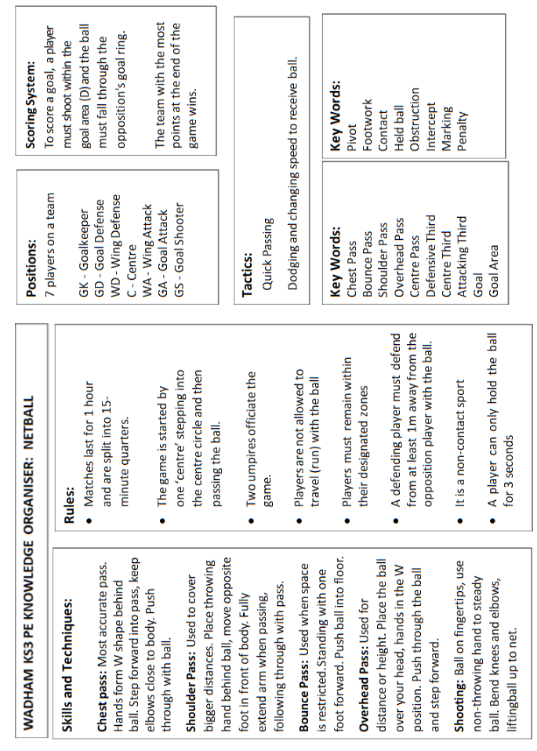
Physical Education

Slide 33
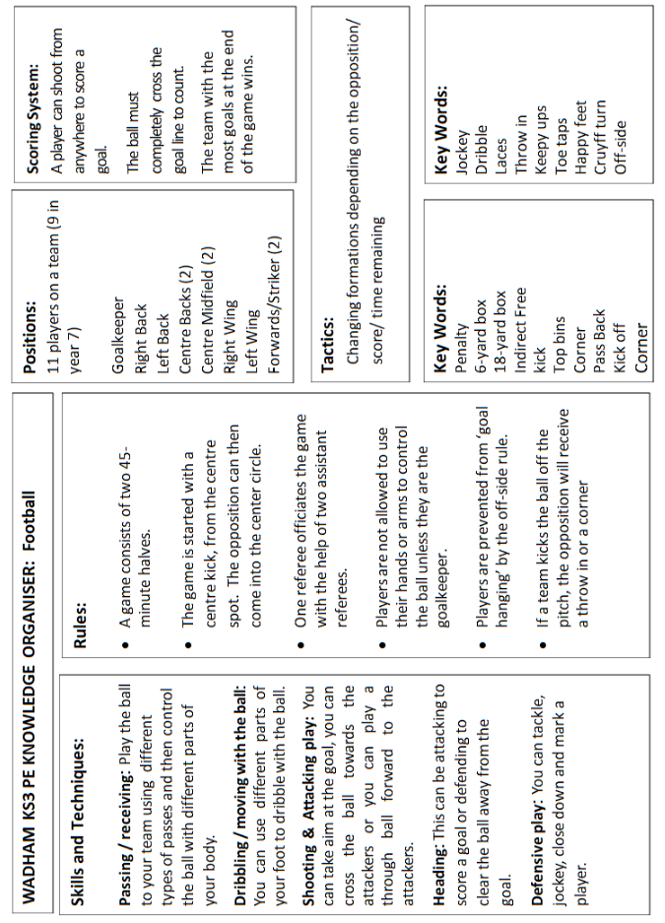
Phyical Education

Slide 34
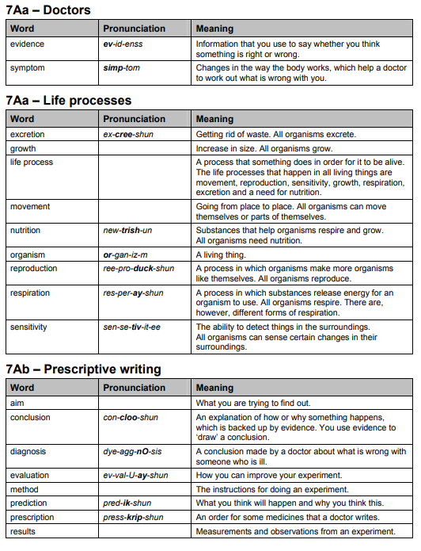
Science

Slide 35
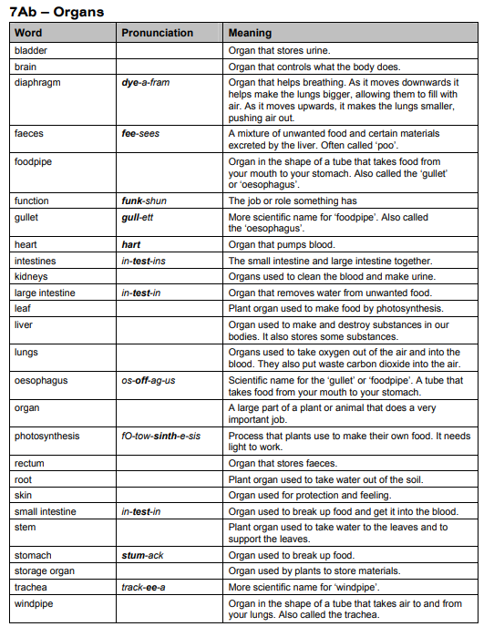
Science

Slide 36
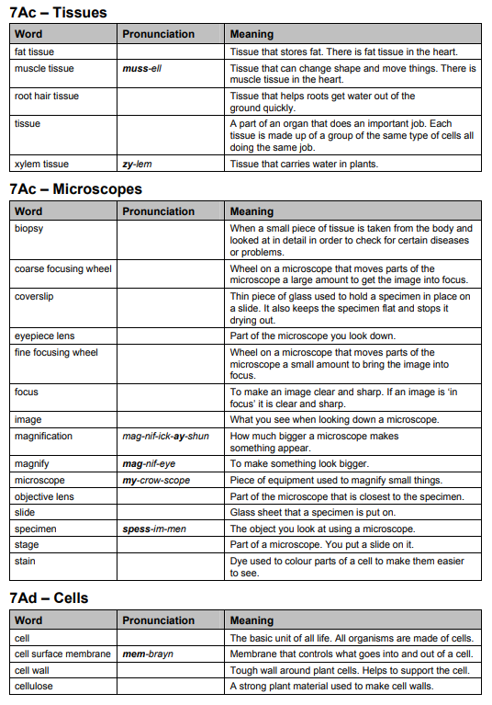
Science

Slide 37
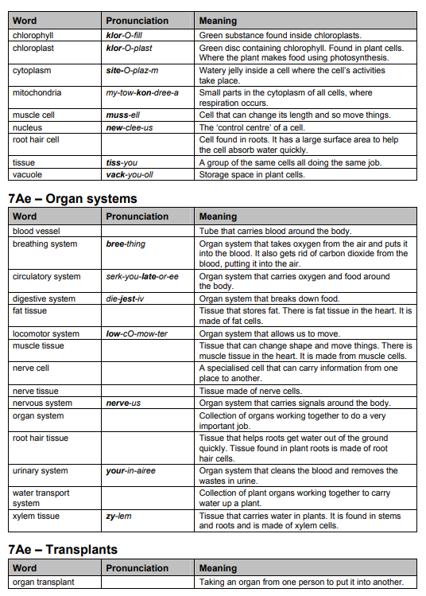
Science

Slide 38
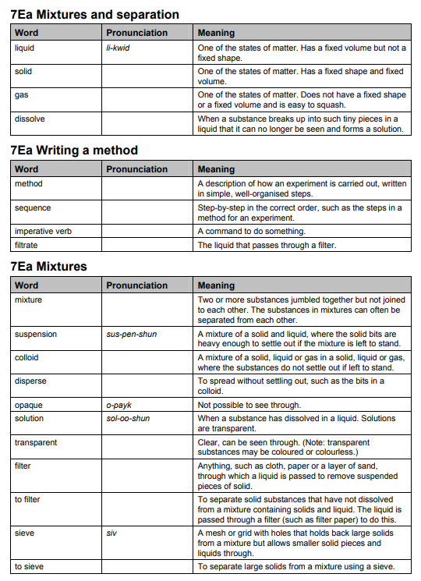
Science

Slide 39
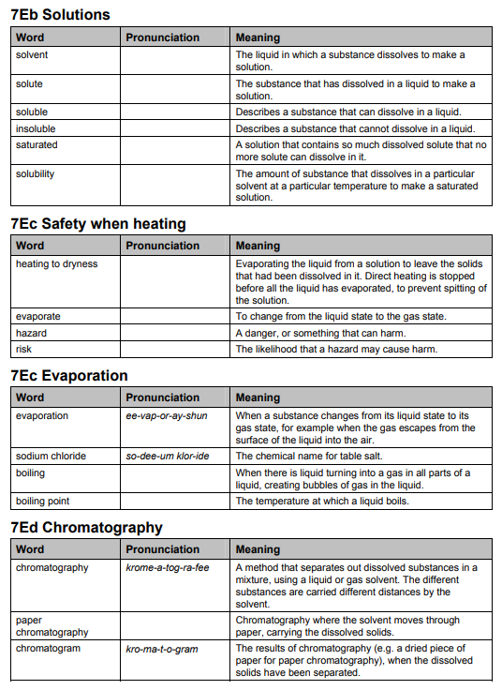
Science

Slide 40
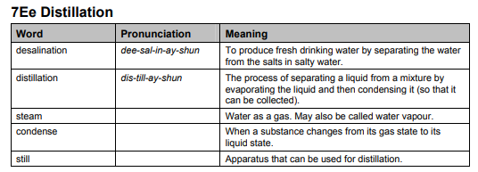
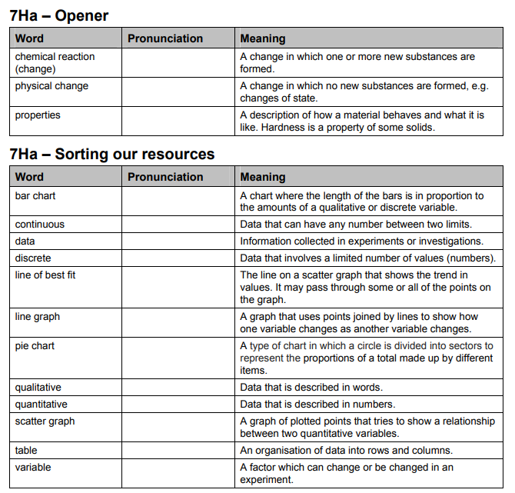
Science

Slide 41
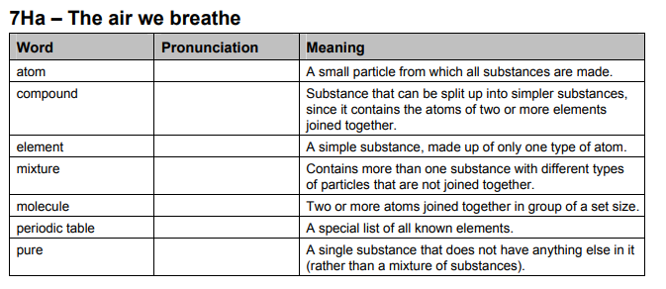
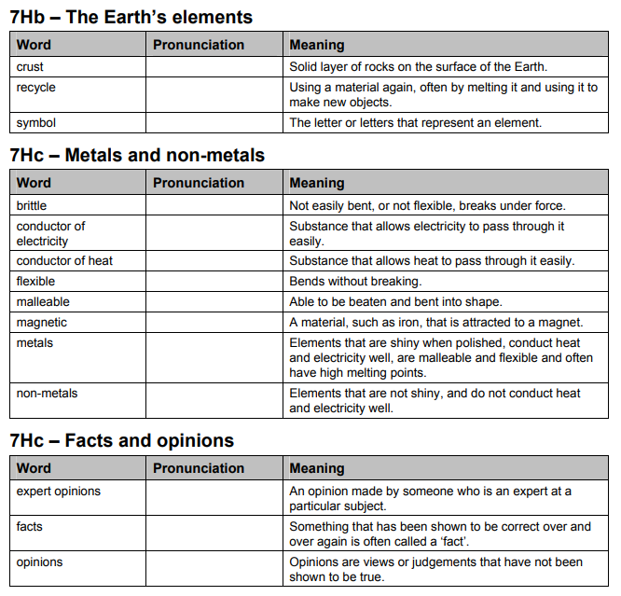
Science

Slide 42
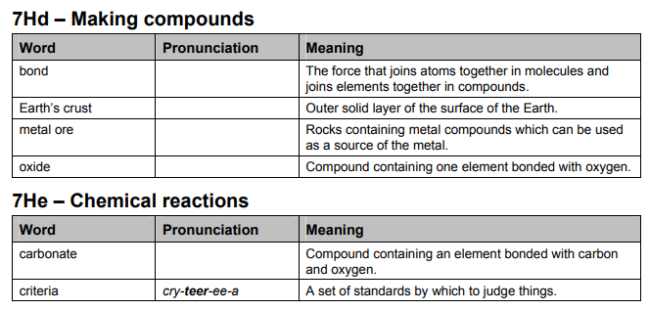
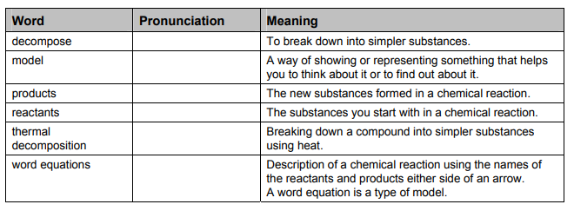
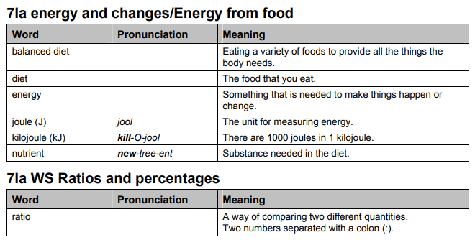
Science

Slide 43
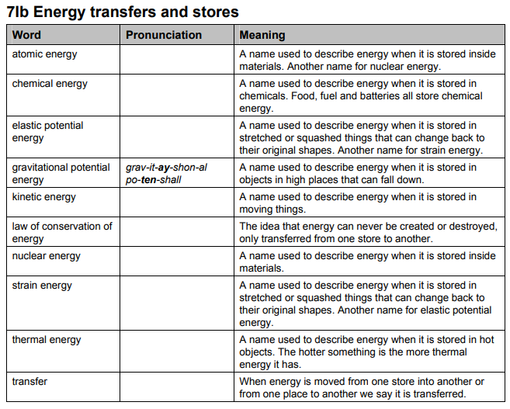
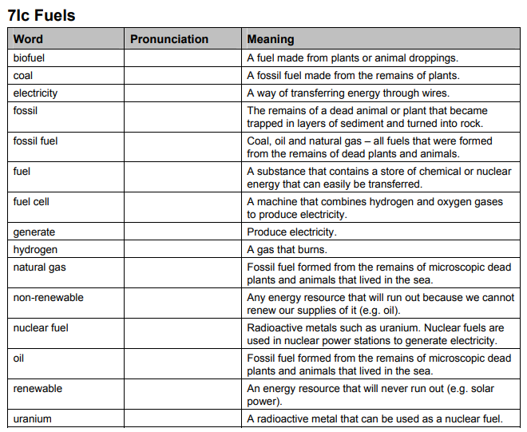
Science

Slide 44


Science

